Slide 1


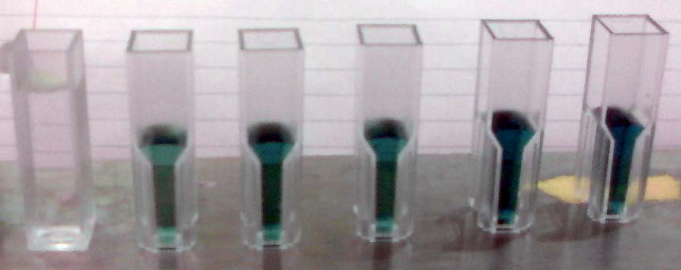
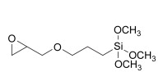
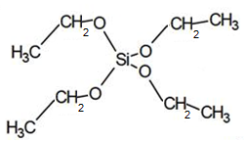
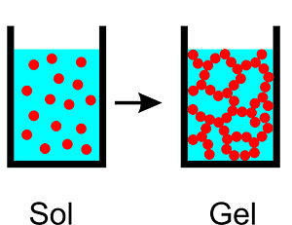
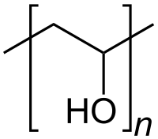

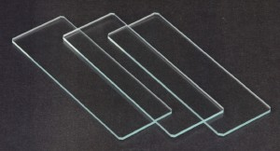
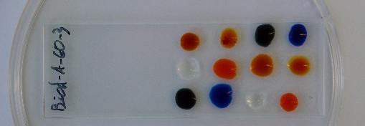
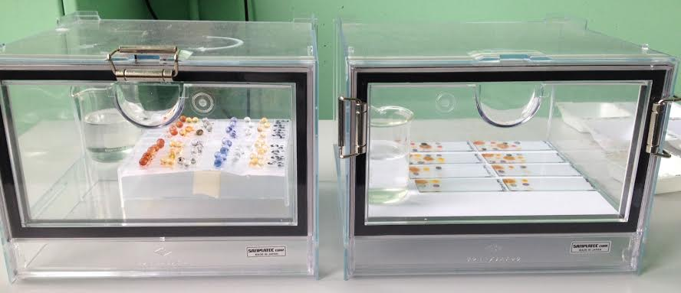
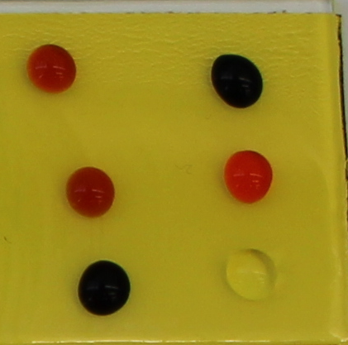
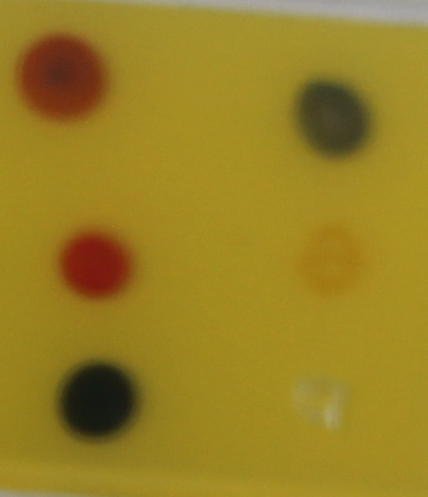
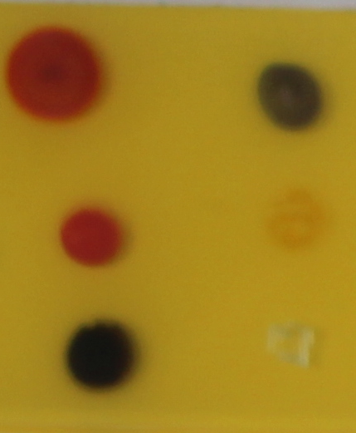
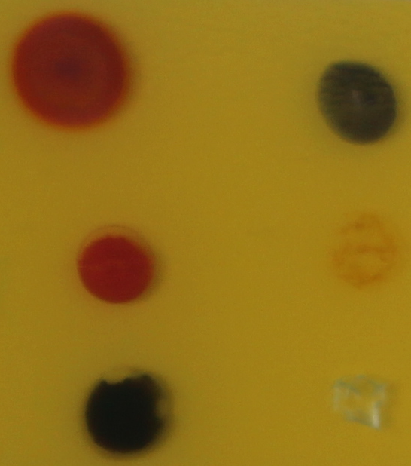
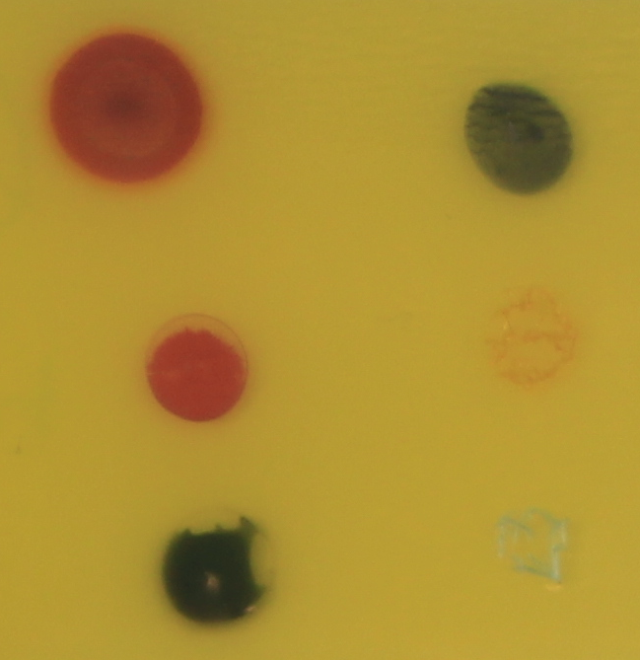
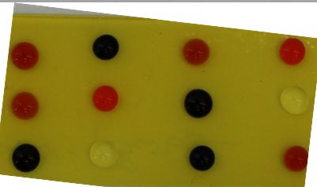
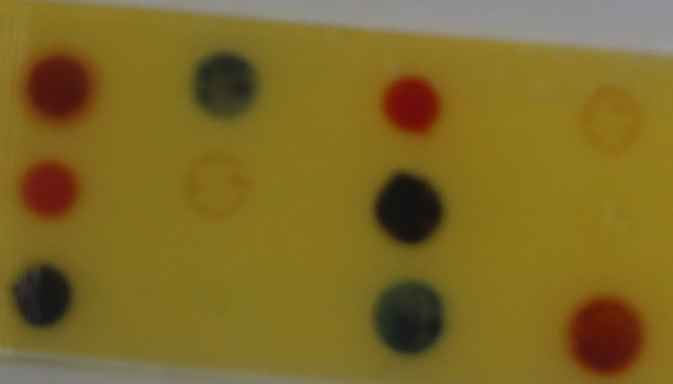
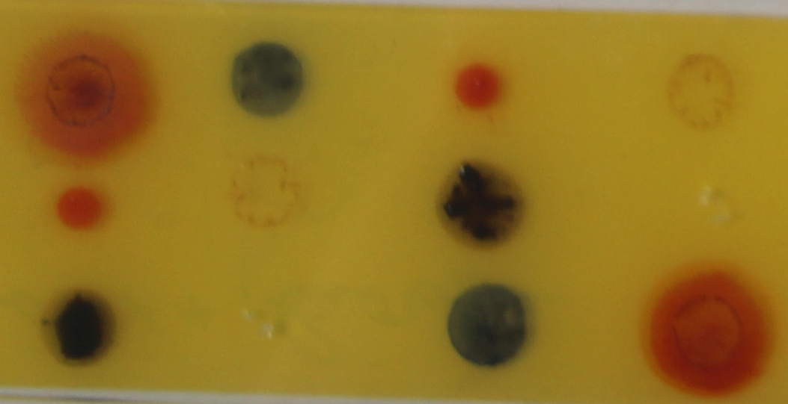
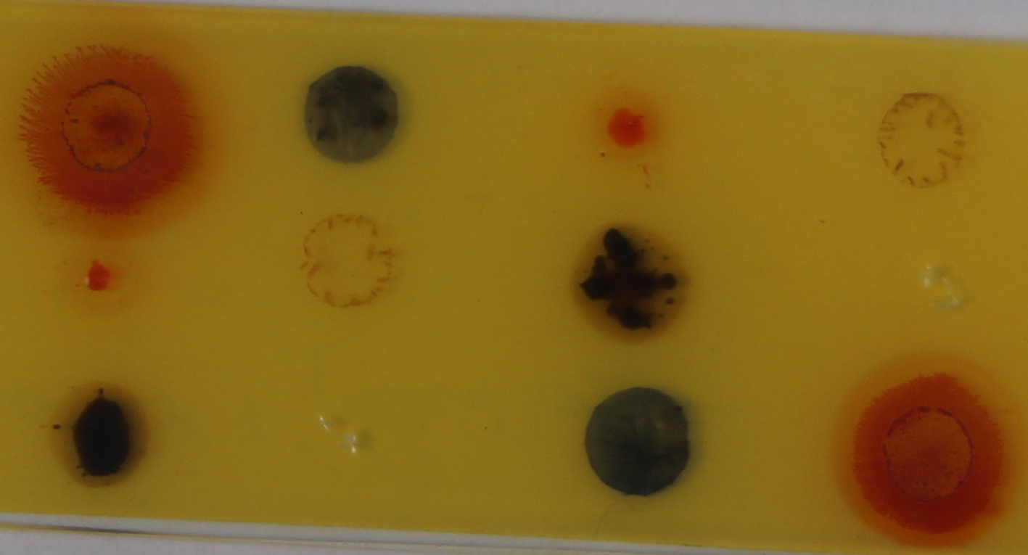
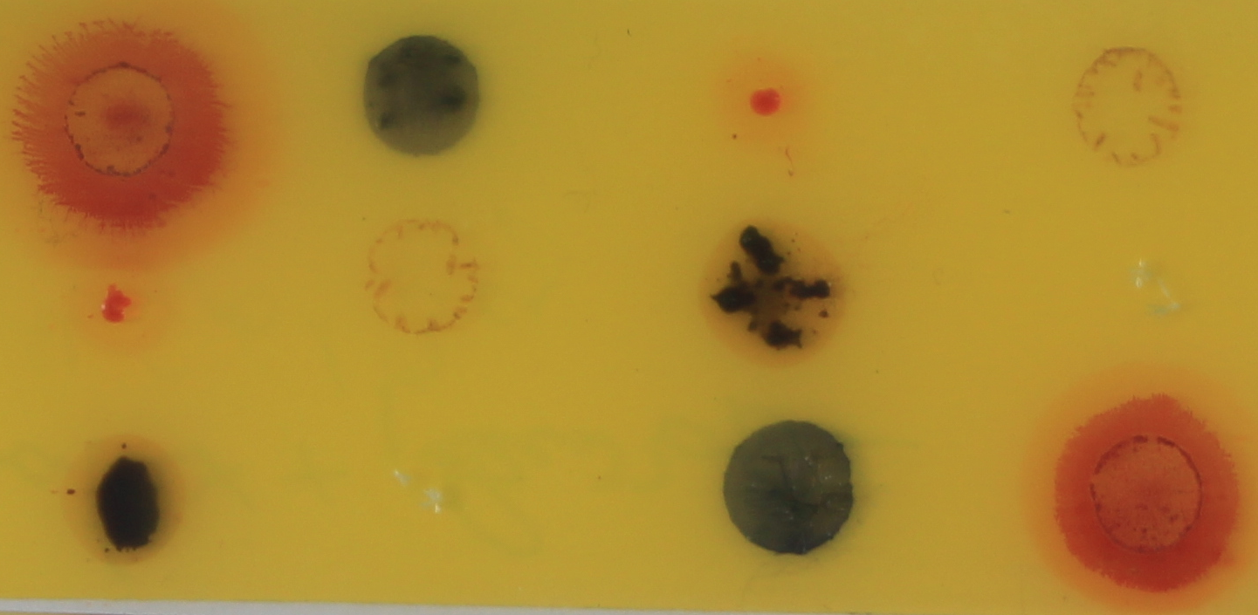
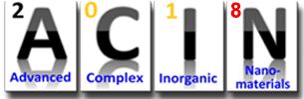
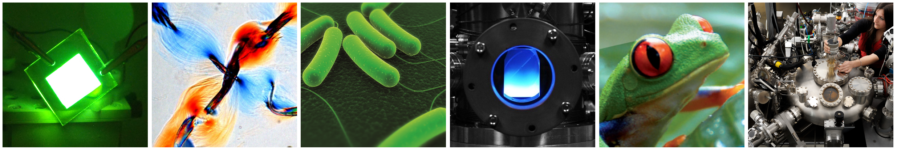

Evaluation of distinct coating formulations for Pleurotus osteatus cells encapsulation for laccase synthesis
Castro C.C.¹, Senechal T.², Lahem D.², Hantson A.-L.¹
1 Laboratory of Applied Chemistry and Biochemistry, Faculty of Engineering of UMONS, University of Mons, Mons, Belgium
2 Materia Nova Research and Development Centre, University of Mons, Mons, Belgium
In the context of Feder BIODEC project, UMons and Materia Nova are developing coating for indoor depollution based on the encapsulation of microorganism into coatings. In the first step of the project the use of a microorganism expressing a laccase activity was used to control the conservation of the enzyme activity after encapsulation and application of the coating on samples. Laccase is an enzyme that catalyzes the one-electron oxidation of a wide range of phenolic and aromatic amines. This enzyme is present in plants, insects and microorganisms such as bacteria and mainly fungi. Laccase from white rot fungus Pleurotus ostreatus has been extensively studied for its potential for xenobiotic.
Hydrophilic sol-gel formulations for the physical entrapment of heat-sensitive and fragile biomolecules, has been widely explored in the recent years. Besides being easily prepared low-temperature systems, the incorporation of PVOH or PEG in the formulation allows to retain a large content of water, improving cells viability and maintaining enzymes activities. Silica based sol-gels presents also high mechanical properties and durability and can be applied industrially on different type of substrate by dip coating or spray.
In the present work, different coating formulations were evaluated for P. ostreatus cells immobilization and laccase synthesis. Three coating precursors, TEOS, GPTMS and PVOH and a latex were used in for the formulations.
An optimized experimental designed allowed to study the influence of different coating parameters on the laccase activity. Direct detection of the activity on the substrates was also possible, screening different colorants evolution through the reaction time. Methylene blue, methyl orange and phenol red showed a higher reactivity to the laccase entrapped coatings.
BIODEC project financed
Through the feder-FMF program
Background
Optimized experimental design
SUBSTRAT
Modifications of coating parameter and study of the laccase activity with ABTS redox mediator
Oxidized ABTS is responsible of blue color followed at 420 nm → kinetic of laccase activity
Improvement of indoor air quality by VOC degradation
Use of enzymes and microorganism for bio-active coatings with formaldehyde deshydrogenase activity
Incorporation of microorganism in sol-gel coatings
Optimized Experimental Design (OED)
4 factors - 3 levels for each factor - 1 central point - 2 Replicates
Work with pleurotus ostreatus for a laccase activity before FDH microorganism is ready
Precursor ratio TEOS/GPTMS 1/0,1 – 1/0,3 – 1/0,5
Addition of PEG 600 0 – 2,5 % - 5 % molar/TEOS
Microorganism ratio 20 % - 30 % - 40 % mass/sol-gel
Speed of deposition 200 – 400 – 600 mm/min
Coating preparation
Results and discussion
Microorganism preparation
Extended estimation
Error
 | Estimation | Standard | T ratio | Prob. > |t|
Constant | 0,2389 | 0,0517 | 4,62 | 0,0007
Precursor | 0,0475 | 0,0574 | 0,83 | 0,4261
PEG | 0,1247 | 0,0574 | 2,17 | 0,0527
Microorganism | 0,1567 | 0,0574 | 2,73 | 0,0196
Withdrawal speed | 5,65E-5 | 0,0574 | 0,00 | 0,9992
Grinding and freeze drying allow to obtain water dispersible particles.
Microorganism is dead but enzymes are still actives.
Freeze drying
Pleurotus ostreatus
Homogenization
grinding
Bio-active coating preparation
Important influence of
Microorganism ratio
PEG amount
Combination of both parameters
TEOS GPTMS PVOH
Phosphate buffer
pH 2,5 → ~5
GPTMS
TEOS
Alternative enzyme activity testing
PVOH
Objective : Detection of enzyme activity directly on the coated substrate
Hydrolysis and condensation
Ethanol removal
Addition of freeze-dried
microorganism
Sol-gel precursors
Enzymes are sensitive to :
Temperature
pH
Solvents
UV and ultrasounds
Coated beads and blades deposition of colorants Hermetic cage: RH≈ 80%
Dip coating
Latex coating
Day 0
Day 1
Day 9
Day 10
Day 15
1
4
1 – Methyl red
2 – Phenol red
3 – Methyl thymol blue
4 - Methylene blue
5 – Methyl orange
6 - ABTS
2
5
Room temperature reticulation
Latex coating
+
P. ostreatus
3
6
Phenol red and methyl orange changed in the presence of laccase
M. L. Ferrer, L. Yuste, F. Rojo and F. del Monte, Chem. Mater., 2003, 15, 3614–3618.
Conclusions
key parameters in the use of bioactive coatings for indoor air depollution is to be able to conserve enzyme accessibility and activity through time. In this study we used sol-gel and latex coating for the incorporation of Pleurotus ostreatus, a microorganism expressing a laccase activity. 2 different detection where used to assess the enzyme activity, an indirect through the degradation of ABTS by the enzyme and a direct one depositing colorants directly on the substrate.
An Optimized Experimental Design allowed us to highlight coating parameters increasing laccase activity, namely the microorganism ratio and PEG incorporation.
We were also able to follow the laccase activity depositing Methylene blue, methyl orange and phenol red showed a higher reactivity to the laccase entrapped coatings directly on the bioactive coatings, allowing a quicker, easier and cheaper way of assessing the enzyme activity of laccase, directly on coated substrates.
Fourth International Conference on Advanced Complex Inorganic Nanomaterials
Workshop VOC
Notes:
1

