Slide 1

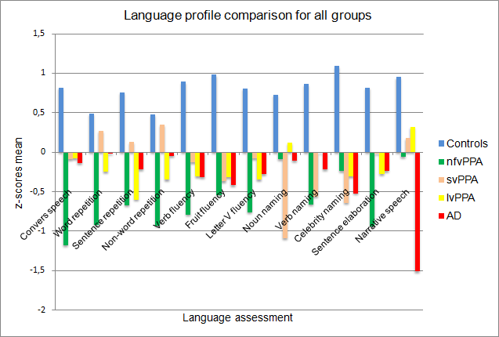
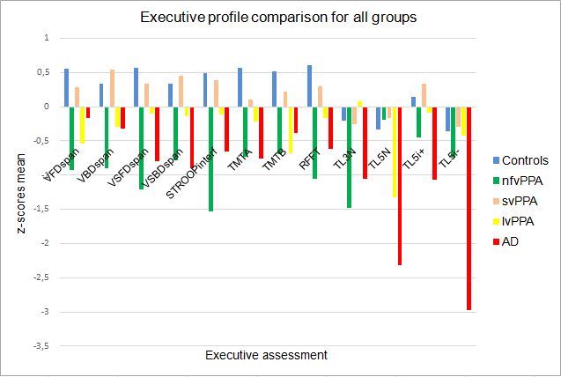
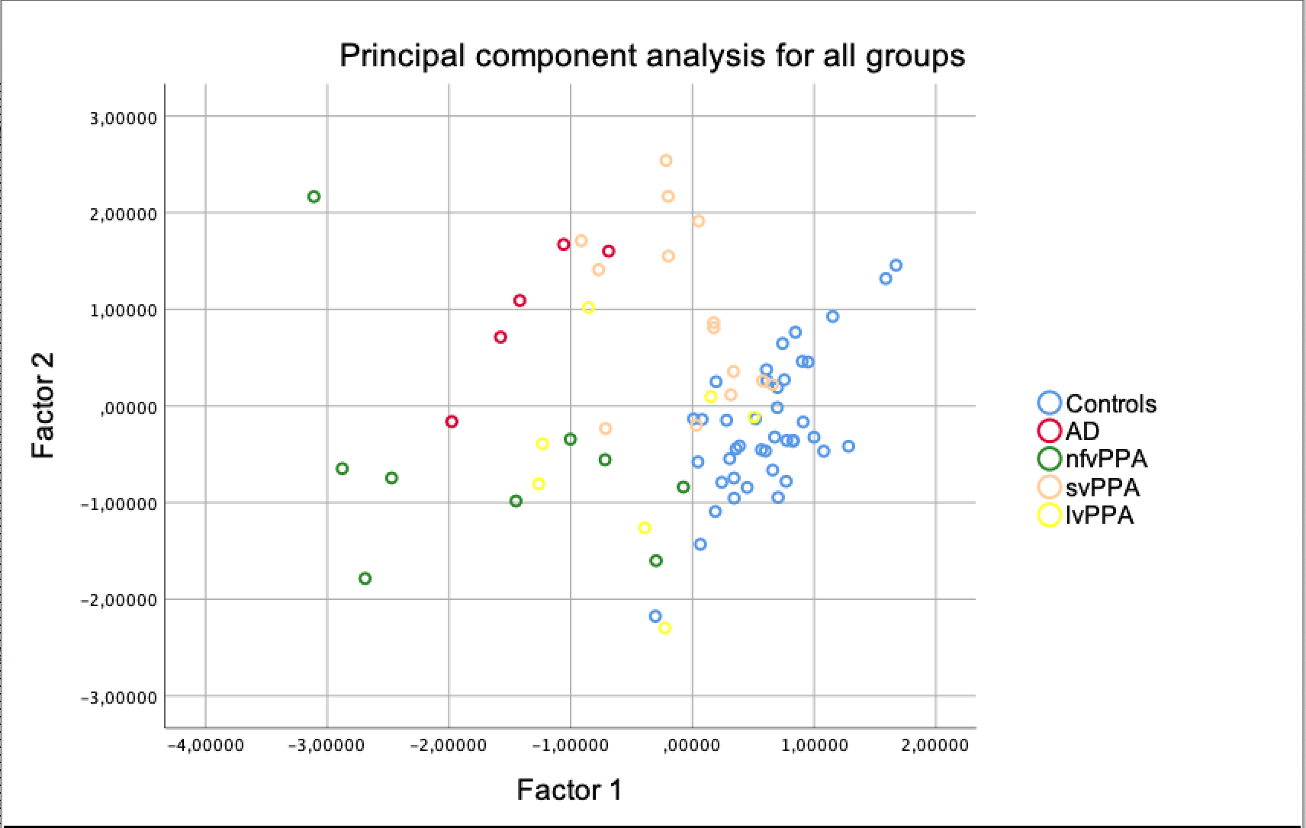
Laurent Lefebvre¹, Sandrine Basaglia-Pappas^{1,2}, Kendra Kandana Arachchige¹, Bernard Laurent², Mandy Rossignol¹, Isabelle Simoes Loureiro¹
¹University of Mons, Cognitive Psychology and Neuropsychology department, Health Institute, Belgium
²CHU Nord, CMRR, Neuropsychology department, Saint-Etienne, France
Language and executive functions
in primary progressive aphasia
Laurent.Lefebvre@umons.ac.be
Objectives
The goal of our research was to describe the language and executive profiles of the three variants of primary progressive aphasia (PPA) and to clarify the complex relationship between these cognitive processes. We also compared the PPA profiles to an Alzheimer’s disease (AD) patients group as well as to a healthy matched group.
Method
Population : 70 PPA (22 non-fluent/agrammatic (nfvPPA), 26 semantic (svPPA), 22 logopenic (lvPPA)), 32 AD and 41 matched healthy controls.
Material :
Participants underwent an oral language (OL)
and executive functions (EF) assessment.
Results
Scores on most of the measures differed significantly in PPA and AD groups relative to healthy controls (p>.05). A principal component analysis (PCA) regrouped all language and executive tests onto one factor for controls, but not for PPA and AD groups. Regression analysis highlighted relationships between language and EF in all groups.
Conversational speech
Repetition
Short term and working memory
Verbal fluency
Confrontation naming
Sentence elaboration
Design fluency task (RFFT)
Narrative speech
Trail Maiking Test (TMTA, TMTB)
STROOP test
Tower of London task (TL)
Spatial forward digit span (SFDspan)/Spatial backward digit span (SBDspan)
Verbal forward digit span (VFDspan)/Verbal backward digit span (VBDspan)
Executive functions
Oral langage (GREMOTs)
Relative to healthy controls :
nfvPPA, lvPPA and AD groups : scores on all the measures are significantly decreased (p<.001).
svPPA : scores differed significantly (p<.001), except for words repetition (U=455.500 ; z=-1.284 ; p=.199) and non-words repetition (U=477.500 ; z=-.859 ; p=.390).
Relative to healthy controls :
nfvPPA : scores are significantly decreased (p<.001), except TL5N (U=56.000 ; z=-1.772 ; p=.076).
svAPP : only TMTA (U=253.500 ; z=-3.052 ; p.002) is significantly decreased.
lvPPA : scores are significantly decreased (p<.05), except spatial forward digit span spatial (U=219.500 ; z=-1.410 ; p=.159), spatial backward digit span (U=218.000 ; z=-1.417 ; p=.157), STROOP interference (U=156.500 ; z=-1.903 ; p=.057), TL3N (U=137.000 ; z=-.310 ; p=.757) and TL5i+ (U=123.000 ; z=-.746 ; p=.456).
AD : scores on all the measures are significantly decreased (p<.001).
The PCA yielded a 2-factor solution, which accounted for 51,933% of the variance in performance (F1=42,266% ; F2=9,667%).
Factor 1 : conversational and narrative speech, sentence elaboration, flexibility, inhibition, planification
Factor 2 : confrontation naming, verbal and spatial span
=> Most of the 24 original variables loaded highly on Factor 1.
Main results for simple linear regression analysis in connexion with our hypotheses :
nfvPPA |  | svPPA |  | lvPPA
Predictive variable (executive testing) | Dependant variable (language testing) | Predictive variable (executive testing) | Dependant variable (language testing) | Predictive variable (executive testing) | Dependant variable (language testing)
- Verbal short-term memory - Verbal working memory - Visuo-spatial working memory - Processing speed - Cognitive flexibility - Cognitive inhibition - Planning | - Sentence repetition, grammatical fluency, celebrity naming - Conversational speech, semantic and alphabetic fluency - Semantic fluency, noun naming - Alphabetic fluency, sentence elaboration - Alphabetic fluency, sentence elaboration - Grammatical fluency - Conversational and narrative speech, semantic fluency, noun and verb naming, sentence elaboration | - Verbal short-term memory - Verbal working memory - Visuo-spatial working memory - Processing speed - Cognitive inhibition - Planning | - Sentence elaboration - Word repetition, grammatical and alphabetic fluency, verb naming, sentence elaboration - Word repetition, noun and celebrity naming, semantic fluency - Word, non-word and sentence repetition, grammatical, semantic and alphabetic fluency, noun and celebrity naming, narrative speech - Sentence repetition - Conversational speech | - Verbal short-term memory - Verbal working memory - Cognitive flexibility - Design fluency | - Narrative speech, grammatical fluency, sentence repetition - Sentence repetition, narrative speech - Conversational speech, sentence repetition - Conversational speech, sentence repetition
Discussion
Dysexecutive difficulties are observed at the onset of the disease in the three variants of PPA. This breakdown appears to be more important than what it was expected according to current diagnostic criteria of Gorno-Tempini et al. (2011)^{[1]}. SvPPA is the less dysexecutive variant. The interrelationship between OL and EF is less important in patients than in controls.
Conclusions
(i) Although language deficits remain the core symptoms, executive dysfunction is also observed at the early stages of PPAs, even though it has been described to remain relatively unaffected and is currently excluded from diagnostic criteria ; (ii) the relationship between language and EF seems to weaken with the disease. We then propose that high-level cognitive functions such as EF should contribute to classification of PPAs.
References
^{[1]} Gorno-Tempini, M.L., Hillis, A.E., Weintraub, S., Kertesz, A., Mendez, M., Cappa, S.F., Ogar, J.M., Rohrer, J.D., Black, S., Boeve, B.F., Manes, F., Dronkers, N.F., Vandenberghe, R., Rascovski, K., Patterson, K., Miller, B.L., Knopman, D.S., Hodges, J.R., Mesulam, M.M., Grossman, M. (2011). Classification of primary progressive aphasia and its variants. Neurology, 76(11), 1006-1014.

