Slide 1
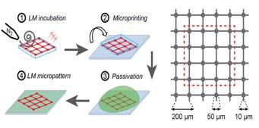
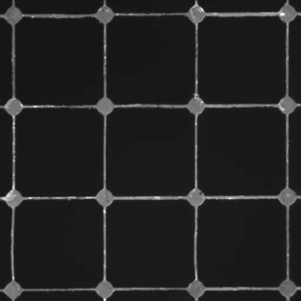
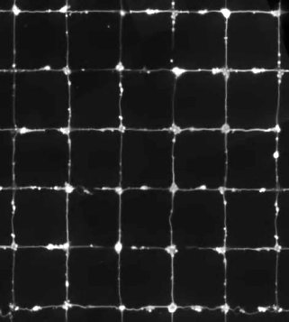
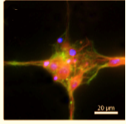
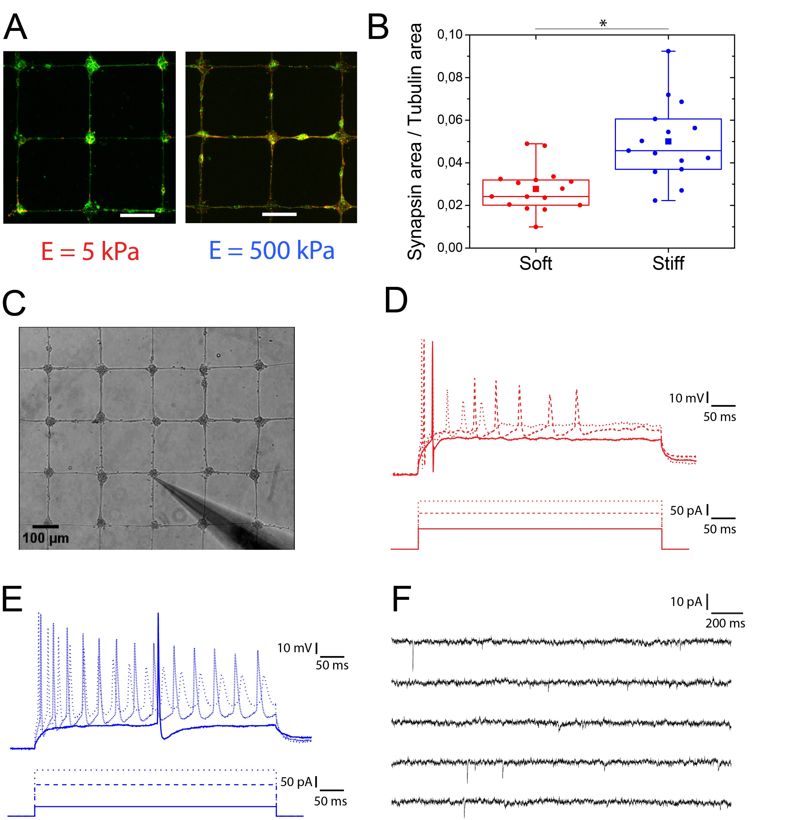
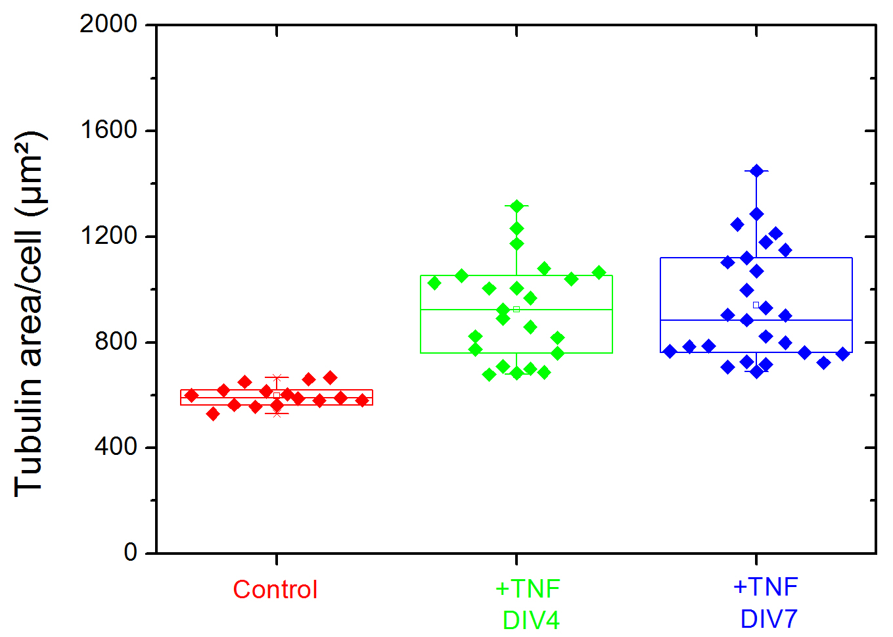
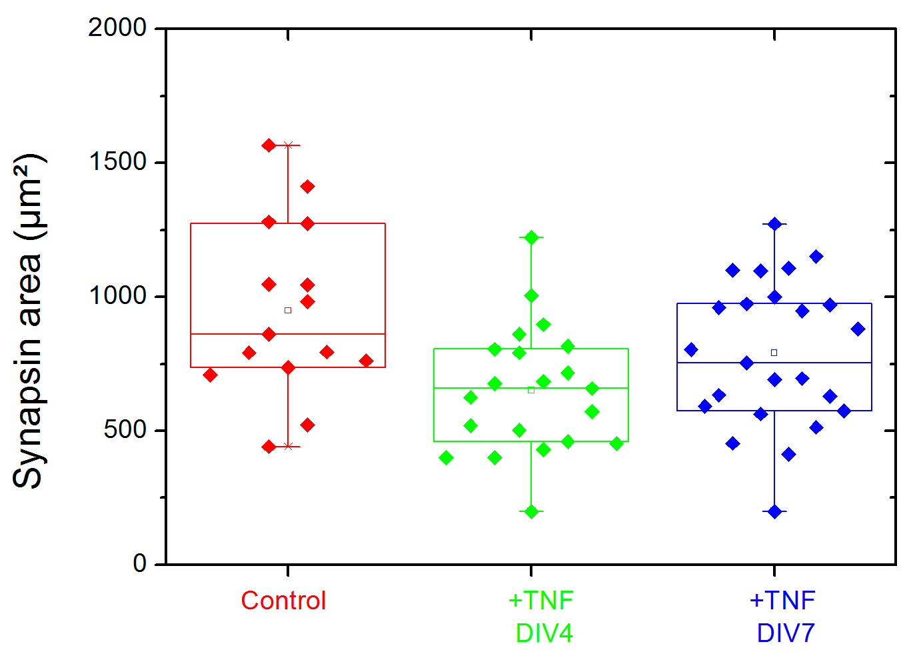
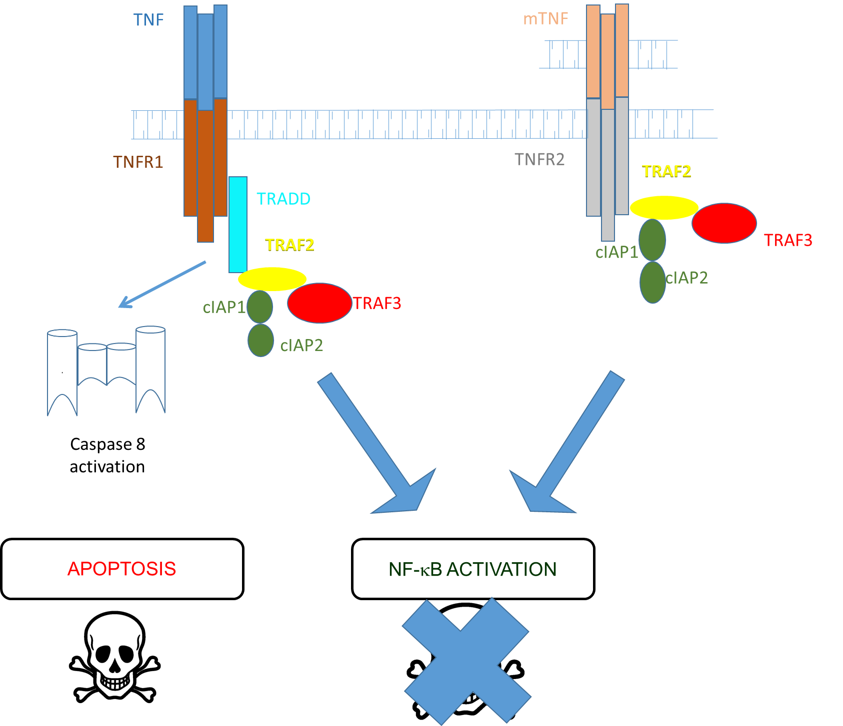
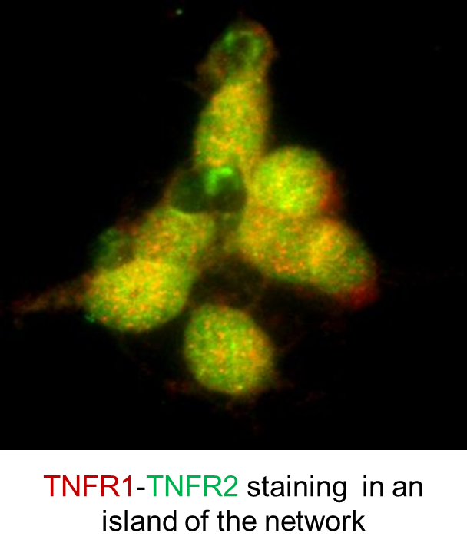
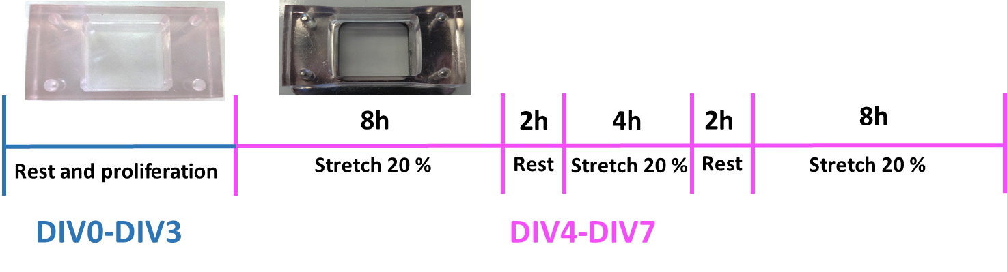
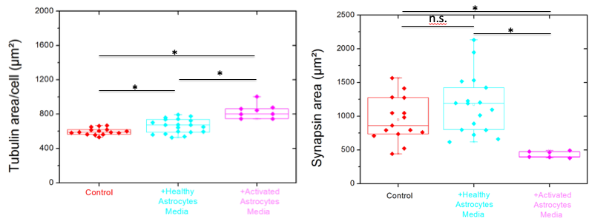
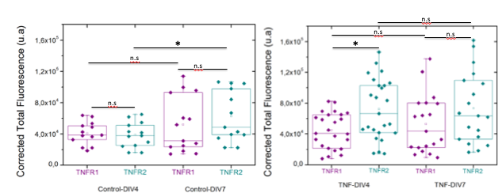
Microprinted neuronal networks as an efficient platform for studying the role of cytokines on neuronal plasticity ​
Joséphine Lantoine¹, Anthony Procès^{1,2}, Laurence Ris² and Sylvain Gabriele¹
​
​ ​
¹Mechanobiology & Soft Matter group,
Laboratoire Interfaces et Fluides Complexes.
²Département des Neurosciences.
Understanding neuroinflammatory processes sustaining a traumatic brain injury (TBI) requires pertinent in vitro platforms. To address this challenge, we designed in vitro networks of cortical neurons with a controlled architecture on soft hydroxyl-PAAm hydrogels. We then used these neuronal networks of controlled architectures to test the impact of tumor necrosis factor alpha (TNF-alpha), a pro-inflammatory cytokine, on the neuronal plasticity of neuronal networks. Indeed the compression and stretching of brain tissues that occur during a traumatic injury leads to the activation of glial cells that release inflammatory molecules such as the cytokines and interleukins. At the early stages, inflammatory molecules are globally neurotoxic, whereas they have been reported to enhance the neuronal regeneration at long terms. As a consequence, the key to developing future anti-inflammatory based neuroprotective treatments for TBI is to minimize the detrimental and neurotoxic effects of neuroinflammation while promoting the beneficial and neurotrophic effects.​ ​
Platform of study : neuronal networks of controlled architectures
We developed a microcontact printing technique to create two-dimensional laminin micropatterns on culture substrates with tunable rigidities.
100 µm
100 µm
25 µm
Laminin micropatterns
Neuronal culture
J. Lantoine et al,Biomaterials (2016)
T. Grevesse et al, Médecine/Sciences (2016)
T. Grevesse et al, Neuroscience Communications (2015)
Influence of substrate rigidity on neuronal networks
Effect of TNF-alpha on neuronal networks
Using soft (E=5 kPa) and stiff (E=500 kPa) matrices, we investigated the influence of the surface rigidity on the network formation firstly on the synaptic activity of the networks.
We added 10 ng/ml of TNF-alpha to cortical neuronal networks at early (DIV4 to DIV13) and late (DIV7 to DIV13) growth stages.
DIV 0
DIV 4
DIV 7
DIV 12
TNF-alpha (10ng/ml)
TNF-alpha
*
*
n.s
*
n.s
n.s
Effect of stretched astrocytes supernatant on neuronal networks
Capture d’écran 2019-03-07 à 13.41.39Capture 2019-03-07 à 13.41.39
Astrocytes cultivated on a stretchable membrane were stretched during 3 days and then the medium was added to neuronal network at DIV7.
Quantification of TNF-alpha receptors
CONCLUSIONS
OUTLOOKS
Development of a robust method to form neuronal networks
Deciphering the impact of TNF alpha on neuronal plasticity
Investigation of the role of TNF alpha receptors (R1 and R2) in the processus of neuroinflammation
Characterization of the cytokines in the astrocytic medium
Modulating the amount of TNF alpha
Investigation of the elctrophysiological modifications in neuroinflammatory conditions via MEA
Personne de contact
Dr. Sylvain Gabriele
Sylvain.gabriele@umons.ac.be
0032 65 37 38 24

