Slide 1





Relaxometric study of manganese complexes based on a pyclen structure as MRI contrast agents
Marie Devreux^{1,2}, Céline Henoumont¹, Fabienne Dioury³, Sébastien Boutry ⁴, Olivier Vacher³, Luce Vander Elst¹, Marc Port³, Robert N. Muller^{1,4}, Olivier Sandre² and Sophie Laurent^{1,4}.
¹University of Mons, General, Organic and Biomedical Chemistry, NMR and Molecular Imaging Laboratory, 7000 Mons, Belgium
²University of Bordeaux, CNRS, Bordeaux INP, ENSCBP, Laboratory of Organic Polymer Chemistry (LCPO), 33607 Pessac, France
³Conservatoire national des arts et métiers (CNAM), GBCM Laboratory, EA 7528, 2 rue Conté, 75003 Paris, HESAM Université, France
⁴Center for microscopy and molecular imaging (CMMI), ﻿8 rue Adrienne Bolland, 6041 Charleroi, Belgium
COST – 16th March 2021
Projet COMMUCAN

Slide 2
Introduction Results Conclusion & perspectives
Introduction
Gadolinium complexes
Gd-DTPA
Gd-DOTA
Nephrogenic systemic fibrosis (NSF)¹
Retention in the brain²
¹Beam, A. S, et al, Radiol. Technol. 88, 583–589 (2017)
²Gianolio, E., et la, Eur. J. Inorg. Chem. 2019, 137–151 (2019)

Slide 3
Introduction Results Conclusion & perspectives
Introduction
Gadolinium complexes
Gd-DTPA
Gd-DOTA
Nephrogenic systemic fibrosis (NSF)¹
Retention in the brain²
Alternative ?
Manganese complexes
¹Beam, A. S, et al, Radiol. Technol. 88, 583–589 (2017)
²Gianolio, E., et la, Eur. J. Inorg. Chem. 2019, 137–151 (2019)

Slide 4
Introduction Results Conclusion & perspectives
Introduction
Purpose of the work
Can be tuned to have one water molecule in the innersphere
7 coordination bond
Increase the kinetic inertness
Increase the thermodynamic stability
Can play on the rotationals correlations time to increase the relaxivity
Pyclen structure

Slide 5
Introduction Results Conclusion & perspectives
Synthesis of the pyclen derivative
Steps :
  Functionalization of the upper and lower part
  Macrocyclization
  Selective deprotection
  Complexation

Slide 6
Introduction Results Conclusion & perspectives
Synthesis of the pyclen derivative
Functionalization of the upper and lower part

Slide 7
Introduction Results Conclusion & perspectives
Synthesis of the pyclen derivative
Macrocyclisation step

Slide 8
Introduction Results Conclusion & perspectives
Synthesis of the pyclen derivative
Selective deprotection steps
R¹ = H (commercial product)
R² = -OCH₂CO₂Et
R³ = -OCH₂CO₂⁻
R⁴ = -OCH₂CONHCH₂CCH
R⁵ = -OCH₂CONHCH₂CH₂NH₃⁺

Slide 9
Introduction Results Conclusion & perspectives
Synthesis of the pyclen derivative

Slide 10
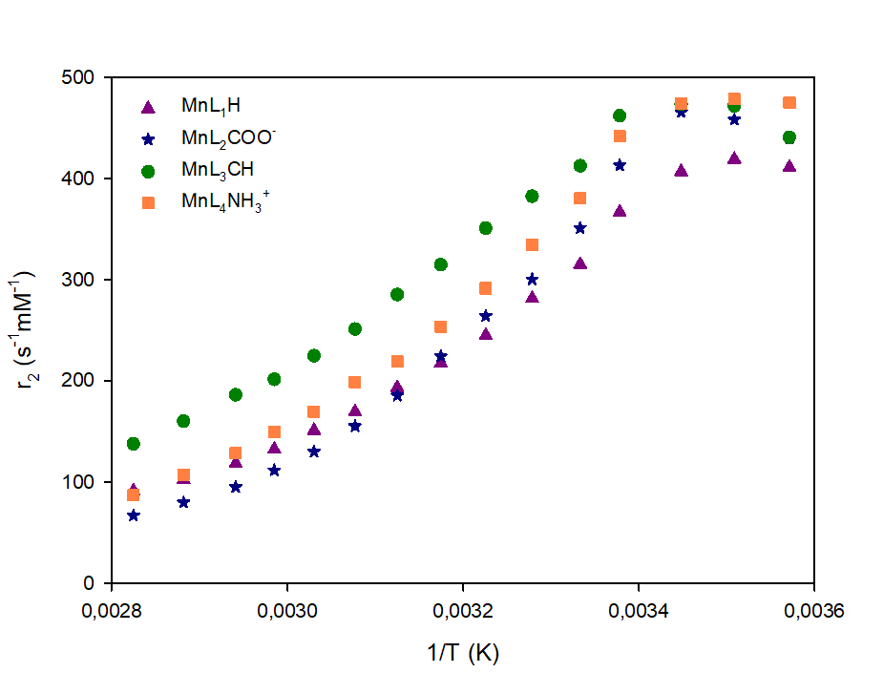
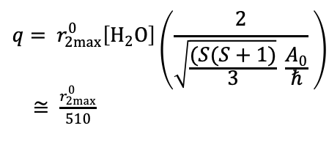
Introduction Results Conclusion & perspectives
Relaxometric characterization
Determination of q
First technique by E. Gale et al.¹ : the ¹⁷O water transverse relaxivity versus inverse of temperature, at 11.75 T
$$q= r_{2max}^{0}\left[H_{2}O\right]\left(\frac{2}{\sqrt{\frac{(S(S+1)}{3}} \frac{A_{0}}{ℏ}} \right)$$
$≅ \frac{r_{2max}^{0}}{510}$
 | r⁰_{2max} (s⁻¹·mM⁻¹) (67.8 MHz) | q (Eq. 1)
MnL₁H | 419.2 | 0.82 ± 0.2
MnL₂COO⁻ | 458.4 | 0.90 ± 0.2
MnL₃CH | 473.4 | 0.93 ± 0.2
MnL₄NH₃⁺ | 478.6 | 0.94 ± 0.2
¹ Gale, E. M., et al, J. Am. Chem. Soc. 2013, 135, 18600−18608.

Slide 11
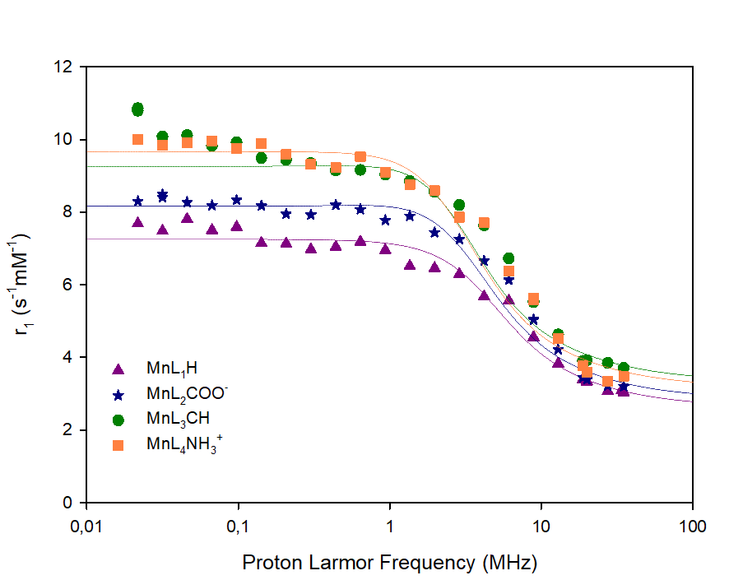

Introduction Results Conclusion & perspectives
Relaxometric characterization
Determination of q
Second technique by J. Peters and C. Geraldes¹ : NMRD profiles at 25°C
$$q=\frac{r_{1p}}{9.16 \left\{1−e^{\left(−2.97 FW {10}^{−3}\right)}\right\}}$$
 |  |  | r_{1p} (s⁻¹·mM⁻¹) (25°C and 0.02 MHz) | q (Eq. 2)
MnL₁H |  |  | 7.7 | 1.25 ± 0.4
MnL₂COO⁻ |  |  | 8.3 | 1.30 ± 0.4
MnL₃CH |  |  | 9.4 | 1.35 ± 0.4
MnL₄NH₃⁺ |  |  | 10.0 | 1.42 ± 0.4
¹ Peters, J. A.; Geraldes, C. F. G. C., Inorganics, 2018, 6, 116.

Slide 12
Introduction Results Conclusion & perspectives
Relaxometric characterization
Determination of q
Comparison of the two techniques : 1 water molecule in the innersphere
 | r⁰_{2max} (s⁻¹·mM⁻¹) (67.8 MHz) | q (Eq. 1) | r_{1p} (s⁻¹·mM⁻¹) (25°C and 0.02 MHz) | q (Eq. 2)
MnL₁H | 419.2 | 0.82 ± 0.2 | 7.7 | 1.25 ± 0.4
MnL₂COO⁻ | 458.4 | 0.90 ± 0.2 | 8.3 | 1.30 ± 0.4
MnL₃CH | 473.4 | 0.93 ± 0.2 | 9.4 | 1.35 ± 0.4
MnL₄NH₃⁺ | 478.6 | 0.94 ± 0.2 | 10.0 | 1.42 ± 0.4

Slide 13
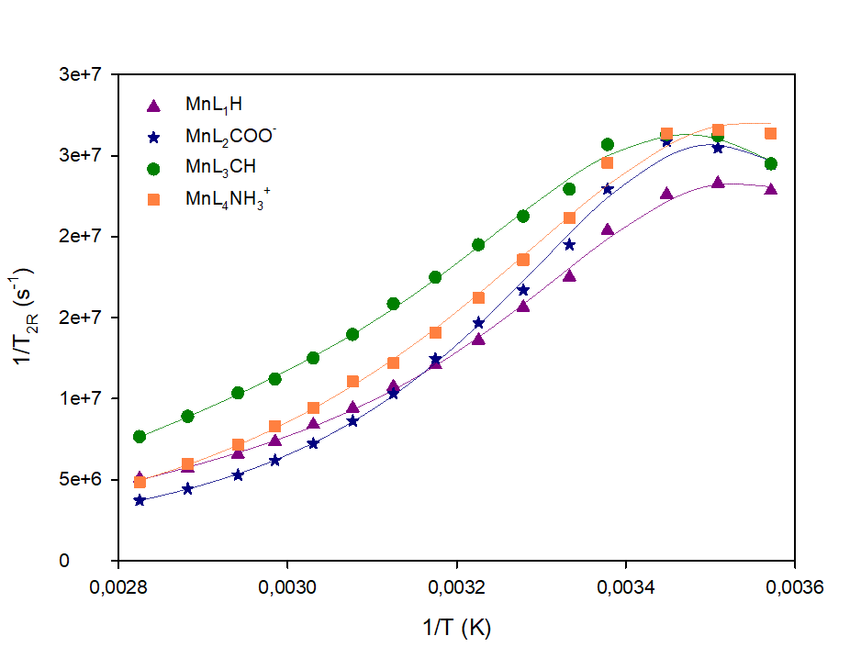
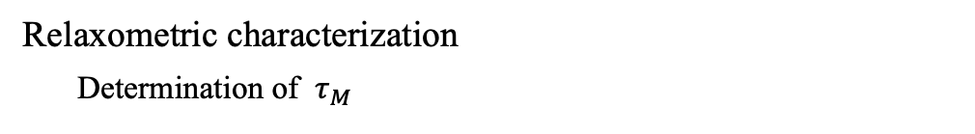
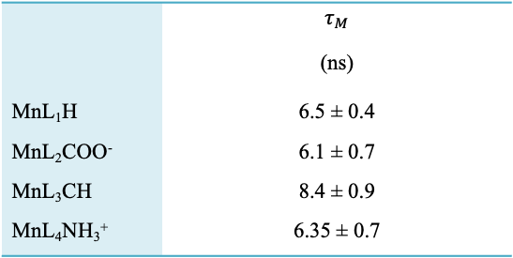
Introduction Results Conclusion & perspectives
Relaxometric characterization
Determination of $τ_{M}$
Measurement of the ¹⁷O water transverse relaxation rate as a function of the inverse of temperature, at 11.75 T¹
 | $$τ_{M}$$ (ns)
MnL₁H | 6.5 ± 0.4
MnL₂COO⁻ | 6.1 ± 0.7
MnL₃CH | 8.4 ± 0.9
MnL₄NH₃⁺ | 6.35 ± 0.7
Fast exchange between the water molecule in the innersphere and the water molecules of the bulk
¹ Swift, T. J.; Connick, R. E., J. Chem. Phys., 1962, 37, 307.

Slide 14
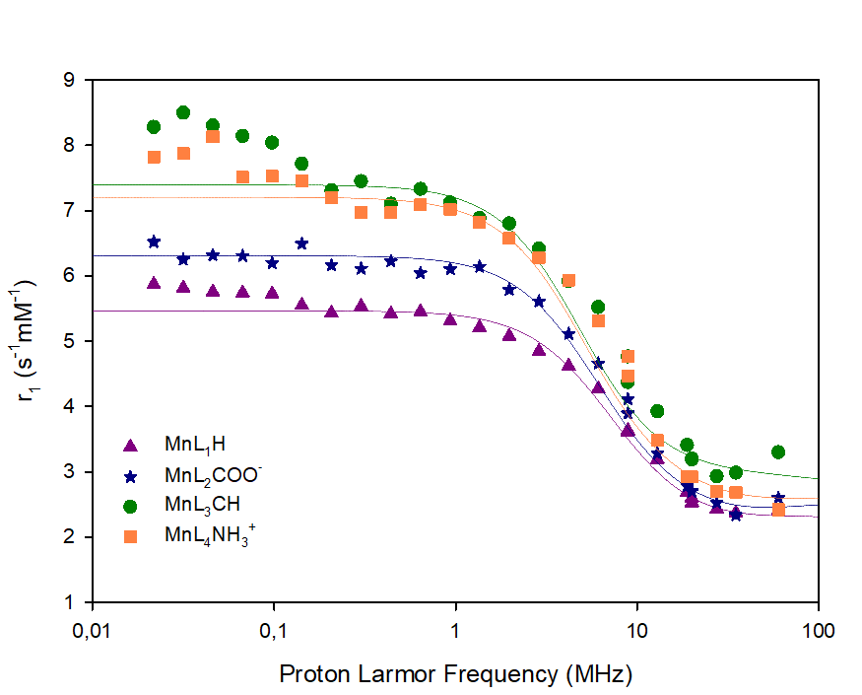
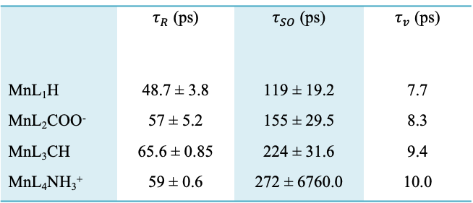
Introduction Results Conclusion & perspectives
Relaxometric characterization
NMRD profiles at 37°C
 | $τ_{R}$ (ps) | $τ_{SO}$ (ps) | $τ_{v}$ (ps)
MnL₁H | 48.7 ± 3.8 | 119 ± 19.2 | 7.7
MnL₂COO⁻ | 57 ± 5.2 | 155 ± 29.5 | 8.3
MnL₃CH | 65.6 ± 0.85 | 224 ± 31.6 | 9.4
MnL₄NH₃⁺ | 59 ± 0.6 | 272 ± 6760.0 | 10.0
the theoretical fitting of ¹H NMRD profiles at 37°C with Bloembergen and Solomon’s theory using the MINUIT minimization software.^{1,2,3}
Increase with the presence of the arm on the pyridine
¹Solomon, I., Phys. Rev., 1955, 99, 559−565.
²Bloembergen, N., J. Chem. Phys., 1957, 27, 572−573.
³Bloembergen, N.; Morgan, L. O., J. Chem. Phys., 1961, 34, 842.

Slide 15
Introduction Results Conclusion & perspectives
Relaxometric characterization
NMRD profiles at 37°C
 | $τ_{R}$ (ps) | $τ_{SO}$ (ps) | $τ_{v}$ (ps)
MnL₁H | 48.7 ± 3.8 | 119 ± 19.2 | 7.7
MnL₂COO⁻ | 57 ± 5.2 | 155 ± 29.5 | 8.3
MnL₃CH | 65.6 ± 0.85 | 224 ± 31.6 | 9.4
MnL₄NH₃⁺ | 59 ± 0.6 | 272 ± 6760.0 | 10.0
the theoretical fitting of ¹H NMRD profiles at 37°C with Bloembergen and Salomon’s theory using the MINUIT minimization software.^{1,2,3}
Slightly lower values for MnL₁H and MnL₂COO⁻
¹Solomon, I., Phys. Rev., 1955, 99, 559−565.
²Bloembergen, N., J. Chem. Phys., 1957, 27, 572−573.
³Bloembergen, N.; Morgan, L. O., J. Chem. Phys., 1961, 34, 842.

Slide 16
Introduction Results Conclusion & perspectives
Relaxometric characterization
NMRD profiles at 37°C
 | $τ_{R}$ (ps) | $τ_{SO}$ (ps) | $τ_{v}$ (ps)
MnL₁H | 48.7 ± 3.8 | 119 ± 19.2 | 7.7
MnL₂COO⁻ | 57 ± 5.2 | 155 ± 29.5 | 8.3
MnL₃CH | 65.6 ± 0.85 | 224 ± 31.6 | 9.4
MnL₄NH₃⁺ | 59 ± 0.6 | 272 ± 6760.0 | 10.0
the theoretical fitting of ¹H NMRD profiles at 37°C with Bloembergen and Solomon’s theory using the MINUIT minimization software.^{1,2,3}
 | r₁ at 20MHz (s⁻¹·mmol⁻¹·L)* | r₁ at 60MHz (s⁻¹·mmol⁻¹·L)*
MnL₁H | 2.6 | 2.4
MnL₂COO⁻ | 2.7 | 2.6
MnL₃CH | 3.2 | 3.3
MnL₄NH₃⁺ | 2.9 | 2.4
¹Solomon, I., Phys. Rev., 1955, 99, 559−565.
²Bloembergen, N., J. Chem. Phys., 1957, 27, 572−573.
³Bloembergen, N.; Morgan, L. O., J. Chem. Phys., 1961, 34, 842.
37°C in water*

Slide 17
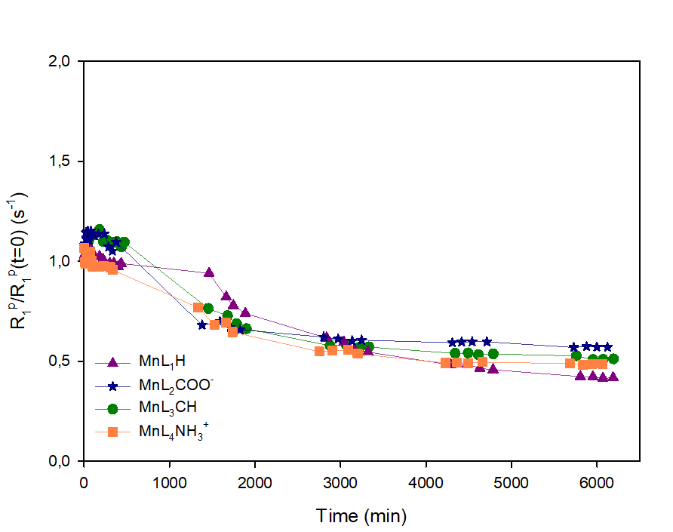
Introduction Results Conclusion & perspectives
Transmetallation evaluation
Evolution of the normalized paramagnetic longitudinal relaxation rate in order to evaluate the transmetallation kinetic between manganese and zinc ions
t_{1/2} half-life of approximately 1350 min
Experiment performed during 5 days in phosphate buffer at 20 MHz and 37°C. The concentration of Mn-complexes and of competing Zn(II) salt is 2.5 mM, which is much higher than its normal physiological level (∼10 µM). ^{1,2}
¹ Laurent, S. et al, Contrast Media Mol., Imaging 2010, 5, 305−308.
² Laurent, S. et al, Invest. Radiol., 2001, 36, 115−122.

Slide 18
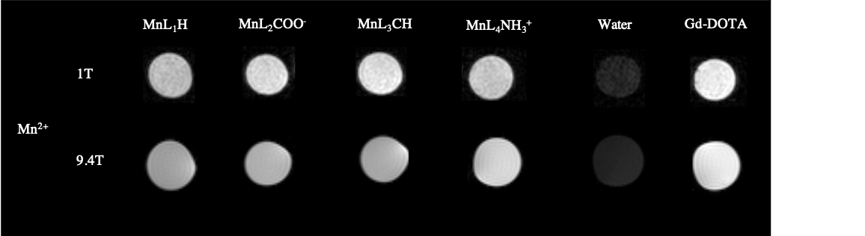
Introduction Results Conclusion & perspectives
Phamtom images
Mn²⁺-complexes at a concentration of 0.5 mM compared with a commercial Gd-complex, Gd-DOTA, at the same concentration, and with pure water
r₁ (s⁻¹·mM⁻¹) 9.4T, 37°C | 2.8 ± 0.1 | 2.7 ± 0.1 | 3.1 ± 0.1 | 2.95 ± 0.1 |  | 3.2 ± 0.1

Slide 19
Introduction Results Conclusion & perspectives
Conclusions
Manganese complexes based on pyclen derivatives
Functionalization of the arm on the pyridin
Close to the Gd-DOTA efficacy
Perspectives
Increase of the relaxivity
Thermodynamic stability

Slide 20






Thank you for your attention
doi/10.1021/acs.inorgchem.0c03120
Prof. Laurent Sophie
Dr Henoumont Céline
Dr Stanicki Dimitri
Prof Vander Elst Luce
Prof Muller Robert N.
Dr Boutry Sébastien
RMN group
Dr Dioury Fabienne
Prof. Port Marc
Vachez Olivier
Dr Sandre Olivier
Dr Couillaud Franck
Team 3
Projet COMMUCAN

