Slide 1


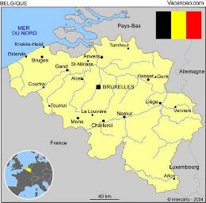


Electroless nickel-boron coatings,
can it replace hard chrome?
Véronique Vitry¹
Luiza BONIN²
Muslum YUNACTI¹
Alexandre MEGRET¹
Fabienne DELAUNOIS¹
¹UMONS – POLYTECH
²GENT University
Notes:
Enter speaker notes here.

Slide 2
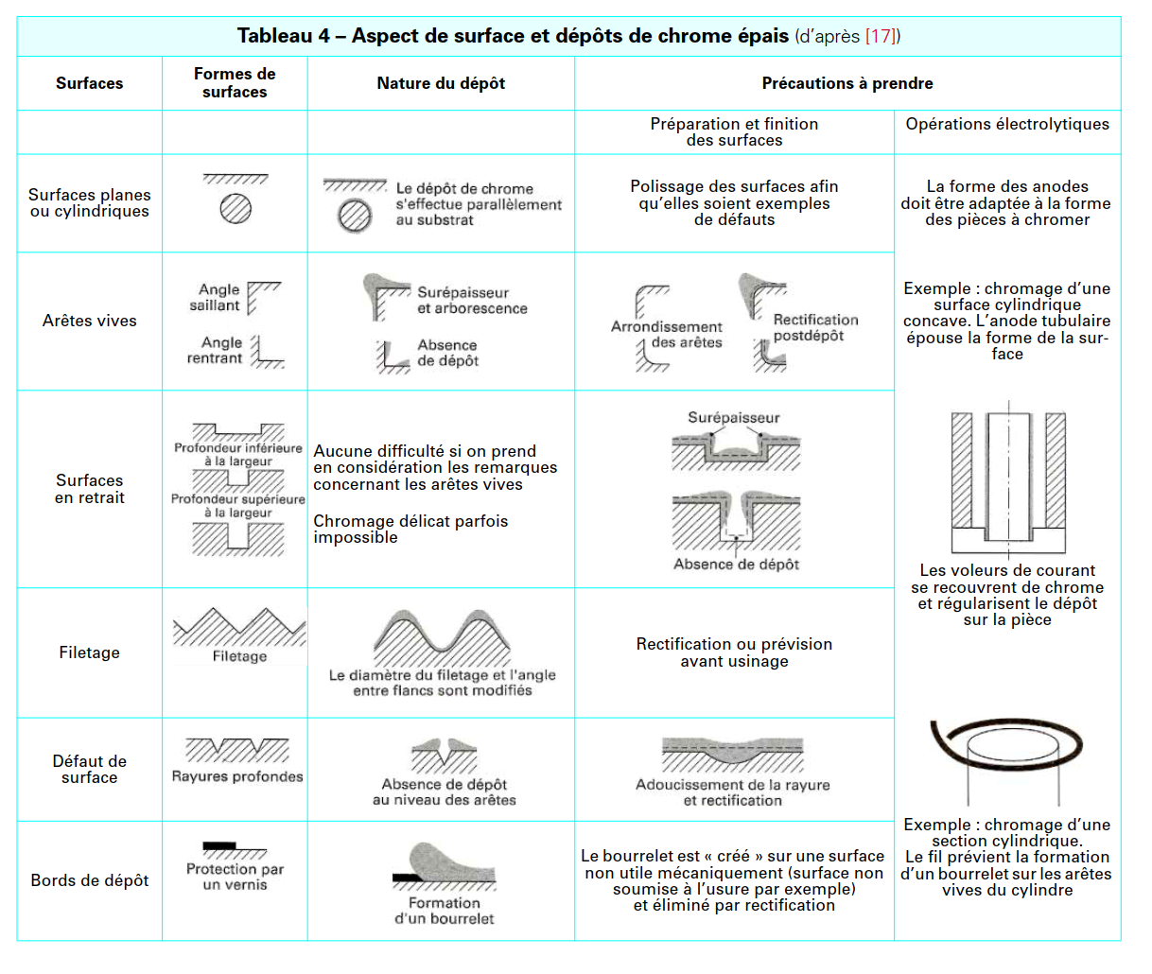
Why should we replace hard chrome?
Hard chrome has interesting properties and has been used for wear and corrosion protection of materials for decades.
However, it suffers from several drawbacks
Low cathode efficiency
Bad throwing power
Toxicity: standard hard chrome is made from hex-chrome
baths, which is carcinogenic. Cr(VI) cannot decompose in nature, it thus can accumulate in dangerous quantities via the food chain if it ends up in drinking water or wastewater.
Regulations: due to Cr(VI) toxicity, several laws in different parts of the law that have or will soon be taking effect, severely restrict or prohibit the use of Cr(VI)

Slide 3
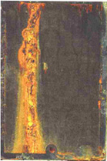
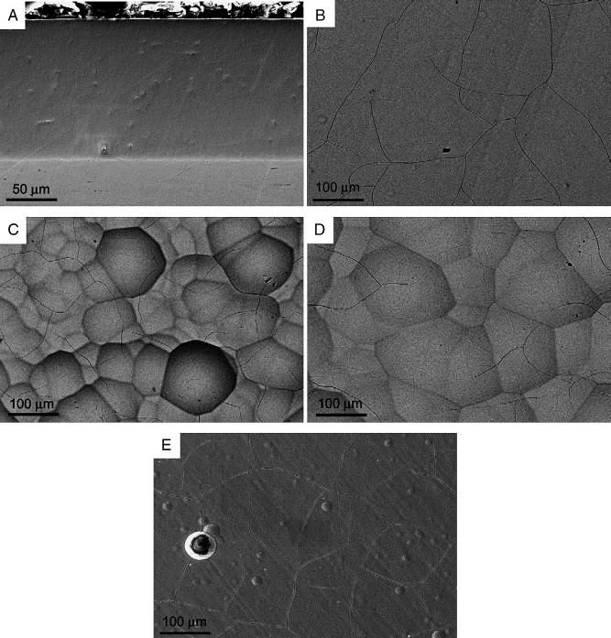
What should we aim at?
The properties of hard chrome are as follow:
Thickness : 20-700 µm
Hardness : 750-1000hv (can be higher for some specific processes)
Microcracked surface with moderate nodular texture
Roughness: = 0,3-0,5 µm on substrate with similar roughness
Corrosion resistance (NSS): No rust up to 48h, rust attack after more than 100h
Hardness decreases with heat treatment
Hard chrome 288h ASTM B117-07a (NSS)

Slide 4
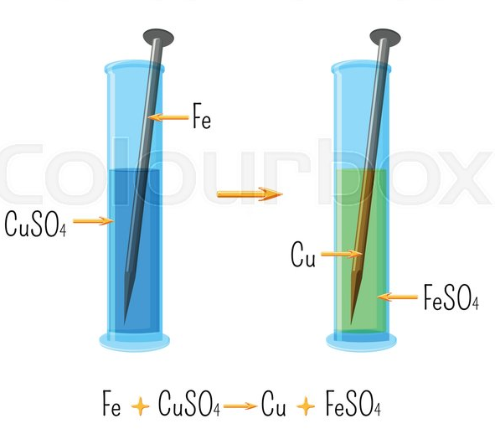
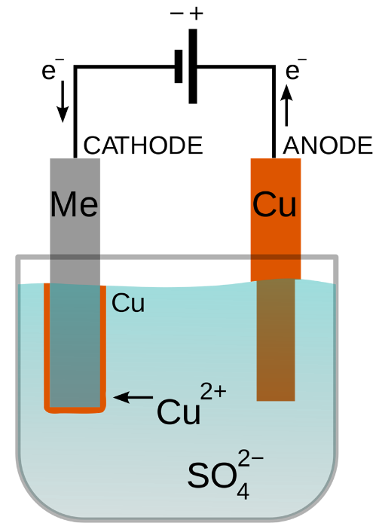
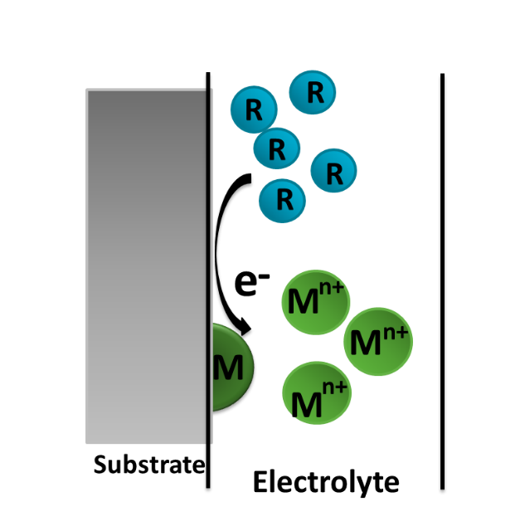
What is electroless nickel?
Electrochemical plating process: reduction of metallic salts in aqueous solution
Displacement
e- given by external source
Conductive substrate
Electroless plating
e- given by chemical reducing agent
All types of substrates
Unsuitable for complex shapes
Non-catalytic (bath chemistry is not a constraint)
e- given by substrate oxydation
Stops when a continuous layer is formed
Extremely thin deposits
electroplating
Any part geometry
Thickness variations
Constant thickness
Catalytic (strict control of bath chemistry)
Oxydation of chemical agent
Red → Ox + ne⁻
Deposition of metal (reduction)
Me₁ n⁺ + ne⁻ → Me₁

Slide 5
The various electroless nickel deposits
Amine-boranes (DMAB/TMAB)
Sodium borohydride (NaBH₄)
Hydrazine (NH₂NH₂)
4 reducing agents for several coatings
Sodium hypophosphite (NaH₂PO₂)
Pure nickel
Ternary alloys
Ni-P-B
Ni-X-P or Ni-X-B where X = codeposited metal
Composites
Incorporation of inert particles
NiB with NaBH₄ or DMAB
NiP with NaH₂PO₂
Binary alloys
Red. NH₂NH₂
Properties of nearly all electroless nickel coatigns can be improved by heat treatment

Slide 6
Electroless nickel-boron bath
Source of metal
Nickel salts (chloride)
Reducing agent
Electron donnor: DMAB or NaBH4
Stabilizer
Complexing agent
pH adjuster
Increases solubility of metallic ions and stability by complexing the cations
Regulates pH and deposition conditions
(IV) unsaturated organic acids, such as maleic acid; thiourea
The most effective stabilizers:
(I) compounds of Group VI elements, such as S, Se, Te
(II) compounds containing oxygen, such as AsO₂⁻ , IO₃⁻, MoO₄²⁻
(III) heavy metal cations, such as, Pb²⁺ , Cd²⁺ , Sb³⁺
Prevent decomposition of plating bath over extended periods and avoid spontaneous reduction outside of the objevt to be plated.
Most popular for Ni-B : Tl, Pb
~1 wt.% Pb in coating
Demands from End of Life Vehicle (ELV) and Restriction of Hazardous Substance (RoHS):
Lead <1.000 ppm
Cadmium <100 ppm
Need to remove or replace Pb and Tl

Slide 7
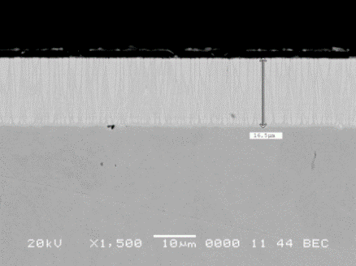
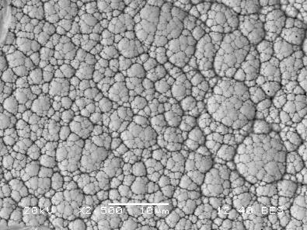
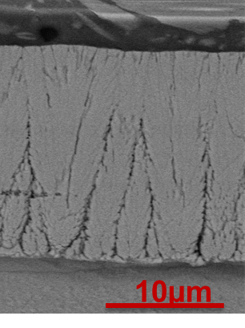
Standard electroless nickel-boron
Stabilizer
Pb or Tl salt in bath
Coating composition
5-6 wt.% B
Co-deposited stabilizer
Morphology and structure
Cauliflower-like surface / Columnar coating
Amorphous coating
Codeposited (up to 1wt.% for Pb, up to 5 wt.% for Tl)
Reducing agent
NaBH₄ (some DMAB based baths are available but they are slower)
Homogeneous thickness / perfect dimensional compliance
No microcracks
10 µm
10 µm

Slide 8
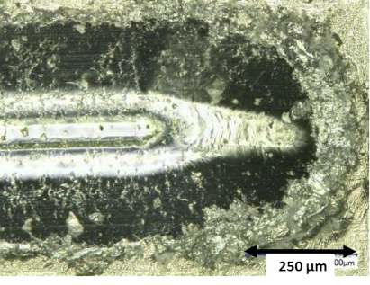
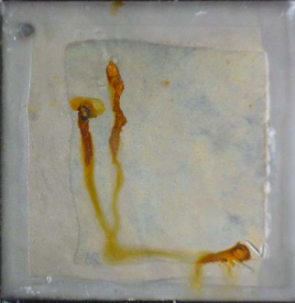
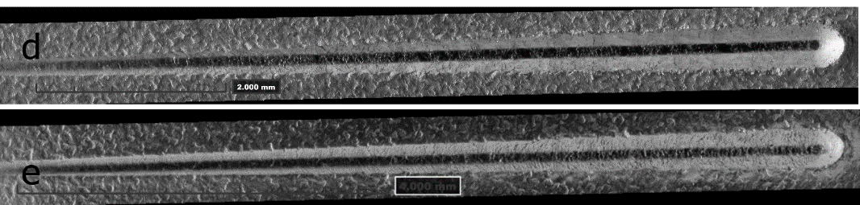
Standard electroless nickel-boron
Roughness
~0,2 µm for a substrate of similar roughness
Wear resistance
Corrosion resistance
Passable
Hardness
800 to 900 hv₁₀₀
Scratch resistance
TWI: 11 for C-17 wheels (very harsh)
Excellent : first damage only after 30N
No scaling or spallation
Corrosion potential around -0,3V Vs Ag/AgCl (KCl sat’d)
168h ASTM B117-07a (NSS)
NiB-Tl
NiB-Pb

Slide 9
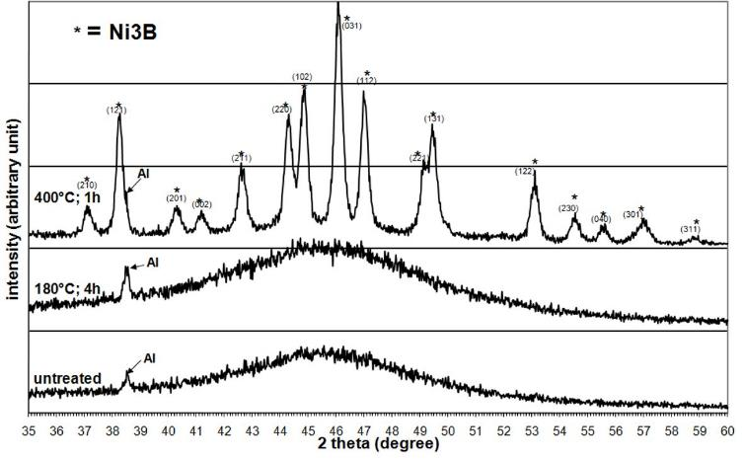
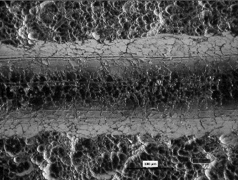
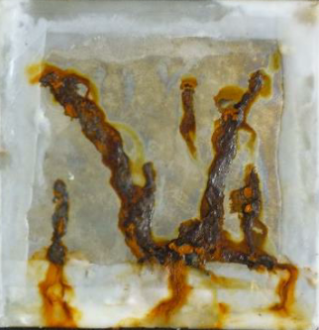
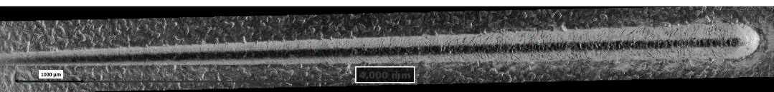
Standard electroless nickel-boron
With heat treatment (modified properties only)
Wear resistance
Corrosion resistance
Improved corrosion resistance but lowered salt spray resistance
Hardness
1150 hv100
Scratch resistance
TWI: 6 for C-17 wheels (very harsh)
Still no scaling or spallation
Crystallization of Ni and Ni₃B (hard) phases
Structure
First damage at slightly lower load
NiB-Pb
168h ASTM B117-07a (NSS)
NiB-Pb

Slide 10
Standard electroless nickel-boron
Issues with standard electroless nickel-boron: stabilizer that contains lead (or worse, thallium).
 Must be replaced by more environmentally friendly element to ensure process sustainability
Complete absence of stabilizing agent
Substitution of lead by a non-toxic stabilizer
Stabilization by adjustment of plating parameters
Investigation of several metallic cations
Constituents | Bath
Nickel chloride, g/l | 24
Sodium hydroxide, g/l | 39
Sodium borohydride, g/l | 0.602
Ethylene diamine, g/l | 59
Lead tungstate | 0.021
Temperature | 95±1

Slide 11
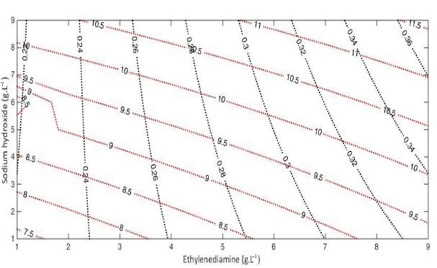
Purely binary electroless nickel-boron (NiB)
Removal of heavy metal stabilizer
Modification of plating conditions
pH
Complexing agent
Use of experimental design to determine working conditions
Factorial design with central point.
Component | Compound | Quantity
Metallic ions | NiCl₂·6H₂O | 24 g/L
Reducing agent | NaBH₄ | 0,602 g/L
Complexing agent | NH₂CH₂ CH₂NH₂ (ED) | 160 g/L
Stabilizer
pH adjuster | NaOH | 120g/L
Factors | Low level (−1) | Central level (0) | High level (+1)
Sodium hydroxide (g.L⁻¹) | 120 | 140 | 160
Ethylenediamine (g.L⁻¹) | 120 | 140 | 160
1 hour
Argon/hydrogen atmosphere
400°C
Heat treatments
Investigated responses:
Thickness = productivity
Roughness = image of bath stability

Slide 12
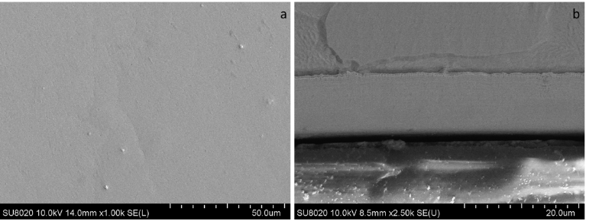
Purely binary electroless nickel-boron (NiB)
Coating composition
8 wt.% B
No co-deposited stabilizer
Morphology
Smoother
Amorphous coating
Structure
Not etched by nital
No visible columnar morphology
Can be explained by modifications of the growth mode due to the absence of heavy metal stabilizers.
Their presence in the coating limits lateral growth of NiB.
50µm
20µm

Slide 13
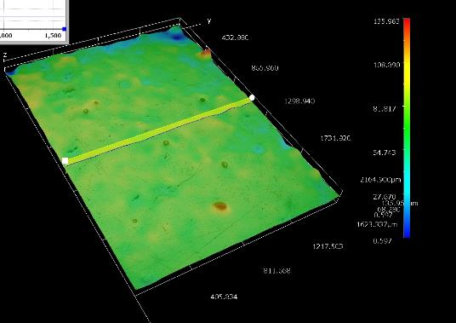
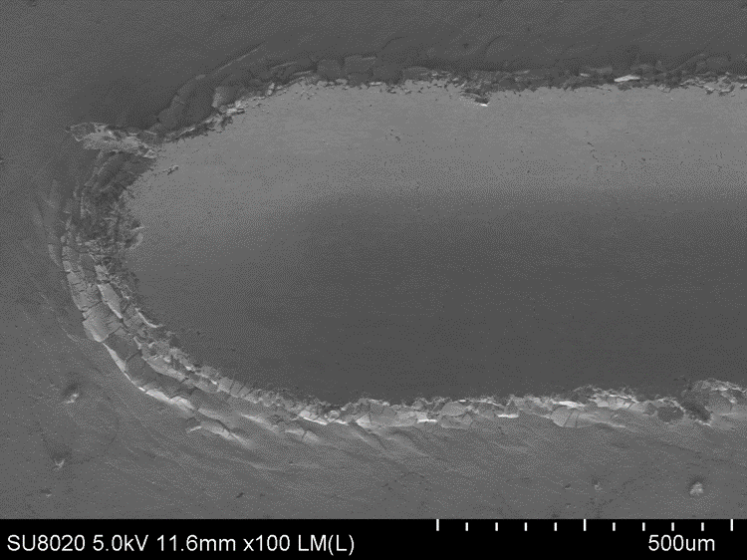
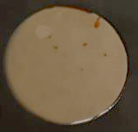
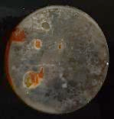
Purely binary electroless nickel-boron (NiB)
Roughness
~0,2 µm for a substrate of similar roughness
Corrosion resistance
Improved resistance to NSS
Hardness
= 800 hv₁₀₀
Slightly lower than NiB
First damage after 20N
No scaling or spallation
Scratch resistance
Wear resistance
168h
240h
NiB

Slide 14
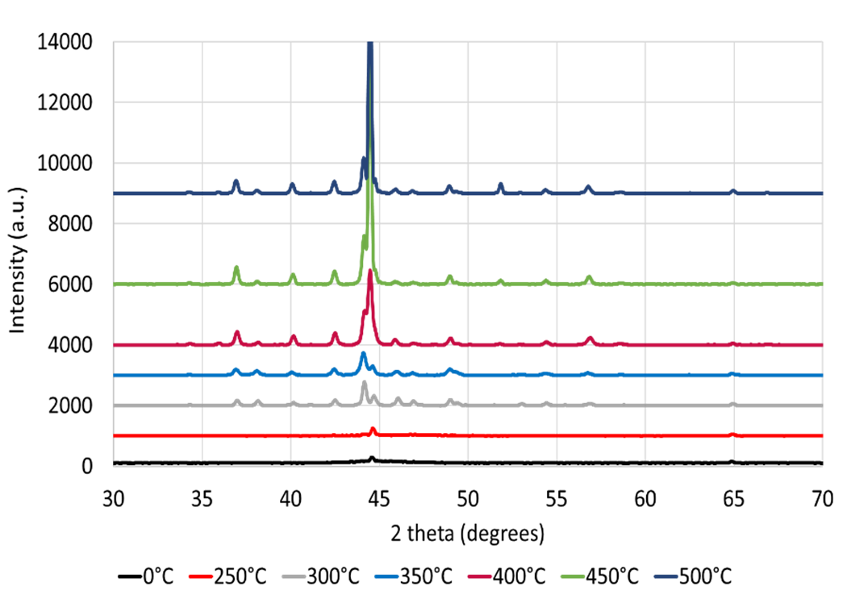
Purely binary electroless nickel-boron (NiB)
With heat treatment (modified properties only)
Hardness
1200 hv100
Crystallization of Ni and Ni₃B (hard) phases
Structure

Slide 15
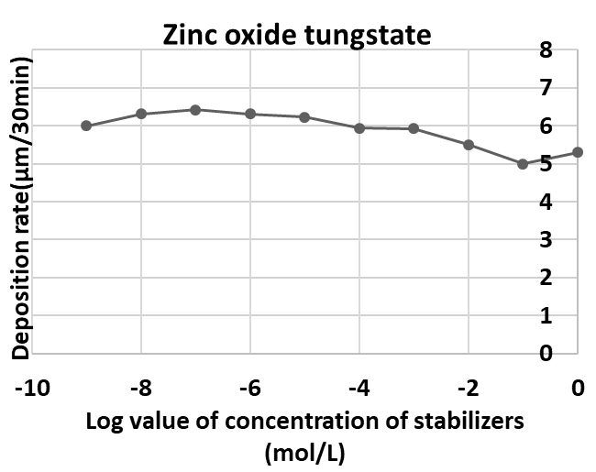
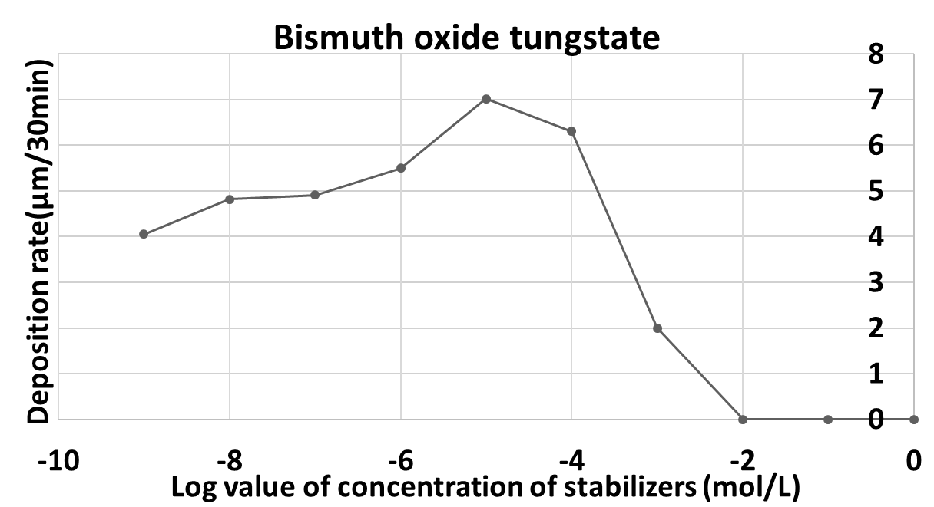
Alternate stabilizer
Investigation of stabilizing activity by measurement of deposition rate for various concentrations of the potential stabilizer
No stabilizing power
Potential stabilizer
Among candidates, best response for Bi, Sn

Slide 16
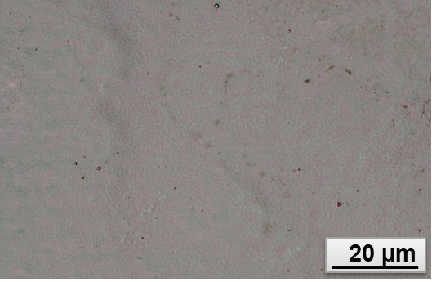
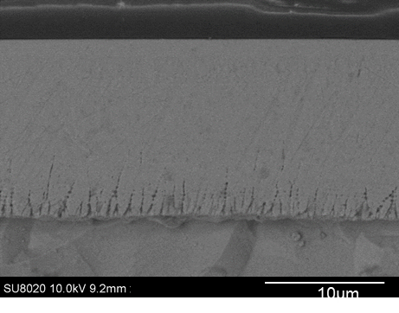
Nickel-boron with Bi as stabilizer
Coating composition
5-6 wt.% B
Co-deposited stabilizer
Morphology
‘muted’ cauliflower-like texture
Amorphous coating
Structure
Columnar morphology only apparent near the interface
Hardness
Slightly under 800 hv 100

Slide 17
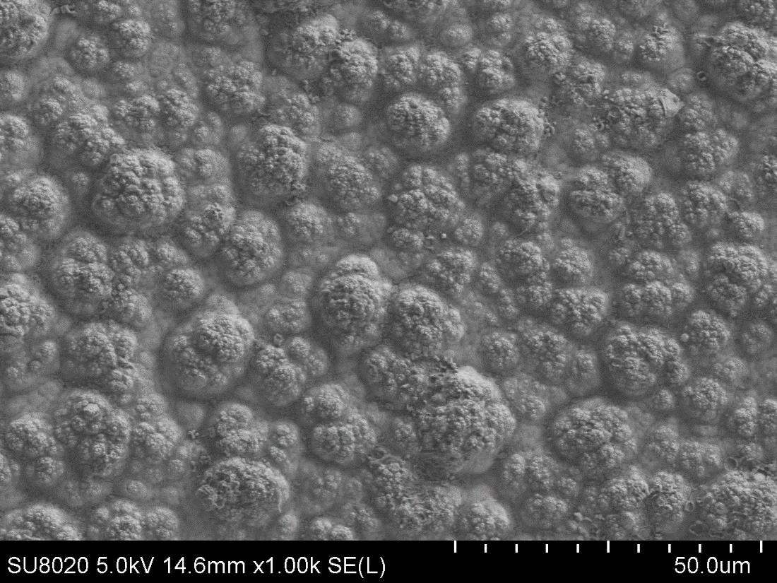
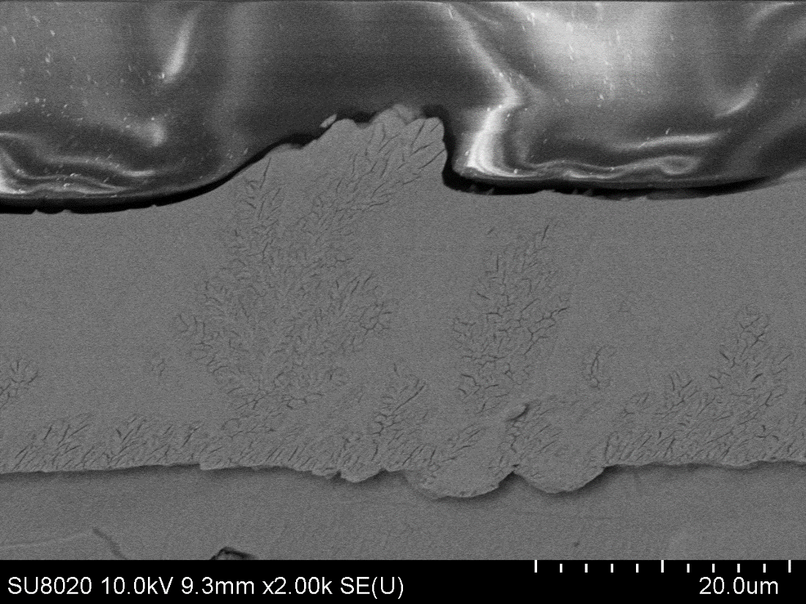
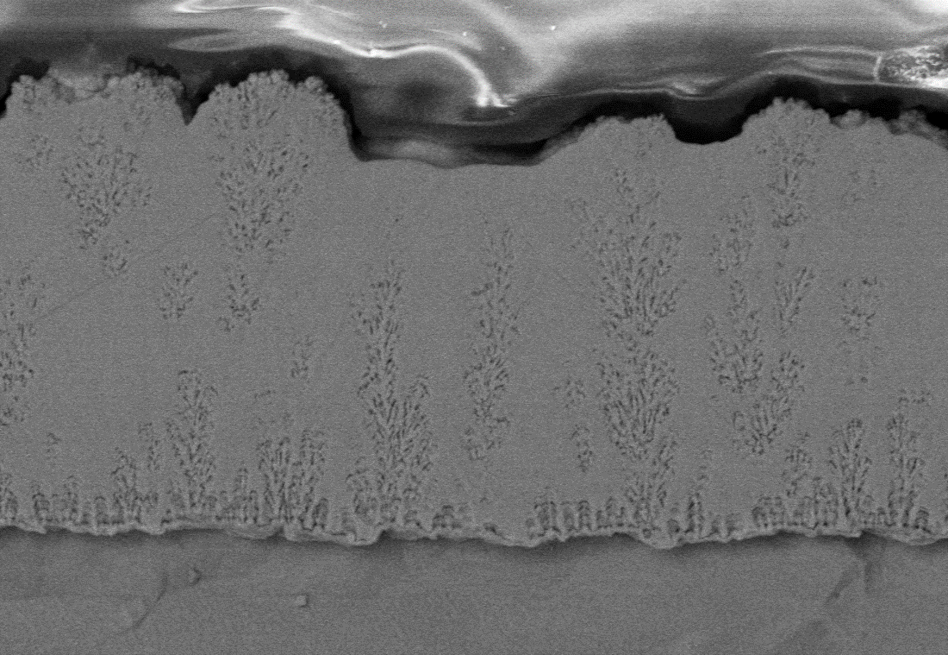
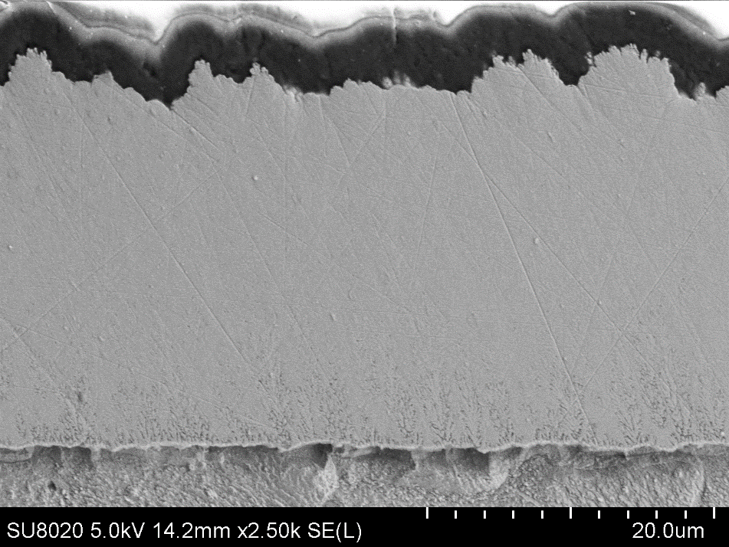

Nickel-boron with Sn as a stabilizer
Coating composition
5-6 wt.% B
Co-deposited stabilizer, up to 2 wt.% Sn
Morphology
Very fine cauliflower-like texture
Amorphous coating
Structure
Columnar coating that disappears for High Sn.
Low Sn
Mid Sn
High Sn
15.0 μm µm
15.0μm µm
15.0 μm µm

Slide 18
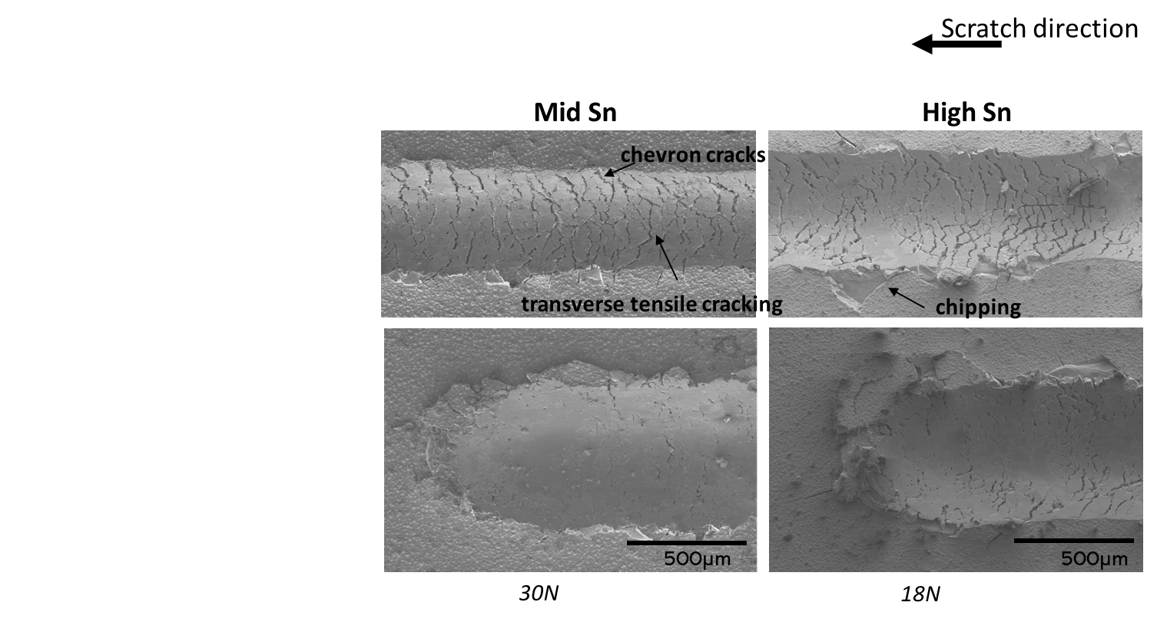
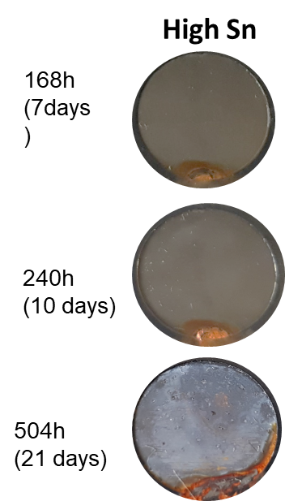
Nickel-boron with Sn as a stabilizer
Roughness
~0,6 µm for a substrate of Ra = 0, 2 µm
Wear resistance
Corrosion resistance
Much better than other electroless NiB
Hardness
800 to 850 hv₁₀₀
Scratch resistance
Slightly better than NiB(Pb)
First damage after 20 to 30 N
ASTM B117-07a (NSS)
168 h 240 h 500 h

Slide 19
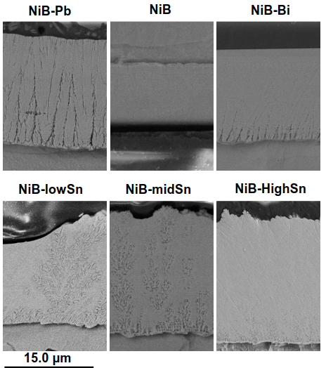
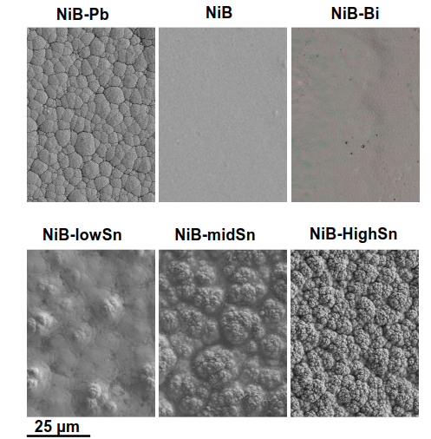
Summary of properties of various NiB coatings
Morphology
Bi or no stabilizer
no or nearly no
features
Pb, Sn, Tl
cauliflower like
texture, finer when
stabilizer content
increases
Confirmed by cross
section observaiton

Slide 20
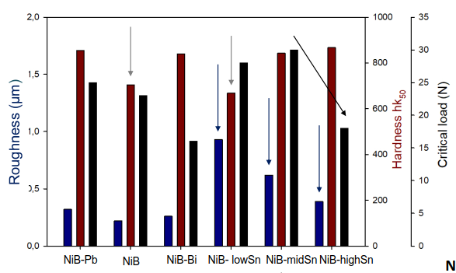
Summary of properties of various NiB coatings
Rougher coatings when Sn is used.
Presence of co-deposited stabilizer leads to hardness increase

Slide 21
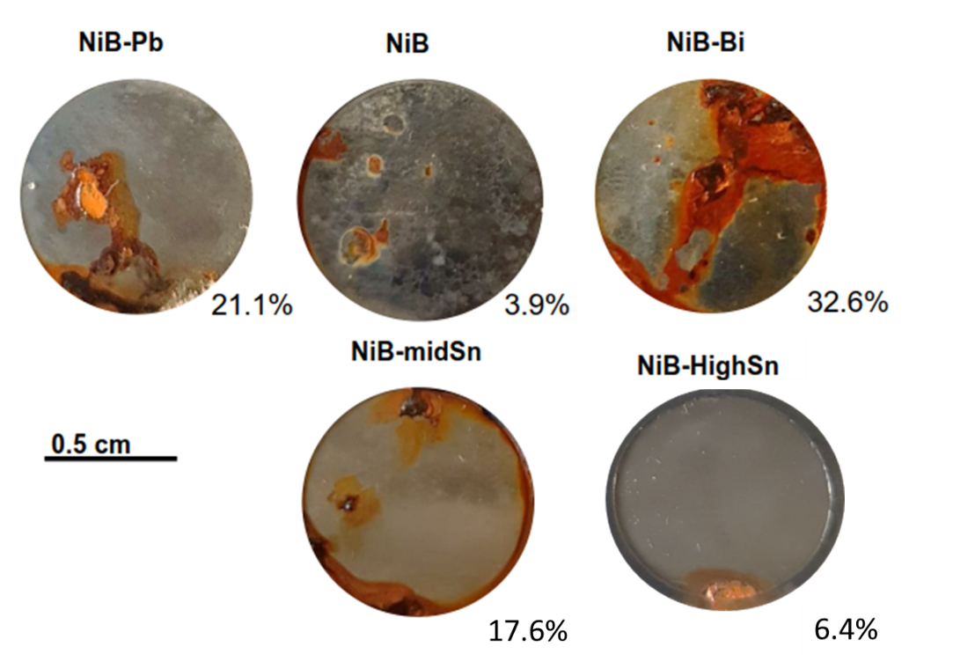
Summary of properties of various NiB coatings

Slide 22
Summary of properties of various NiB coatings
 | NiB-Pb | NiB | NiB-Bi | NiB-Sn | Hard chrome
 | 6 wt.% B 0.1 Wt.% Pb | 8 wt.% B |  | 5 wt.% B ~1 wt. Sn
Cross section hardness hk50 | 847 | 800 | 839 | 842 | 750-1000
Roughness Ra (μm) | 0.32 | 0.22 | 0.26 | 0.62 | 0.3-0.5
Critical load for first damage Lc (N) | 25 | 23 | 16 | 30 | ?
Plating rate (μm/h) | 16.2 | 10 | 15 | 18.3
Corroded surface % | 21.1 | 3.9 | 32.6 | 17.6 | ?

Slide 23

Conclusions
Development of new, Pb and Tl-free NiB coatings was carried out
Most coatings reach the requisite hardness and corrosion resistance in the as-plated state
Various coatings present different properties
If higher hardness is required heat treatment can improve hardness of coating
If higher corrosion resistance is required, high tin or purely binary coating can be used
Electroless nickel-boron is an interesting alternative to hard chrome plating
Thank you for your attention
Notes:
Enter speaker notes here.

