Slide 1

Reciprocal influence between APP expression and glucose metabolism in the hippocampus
Poster board # 104
30th March 2017
Mélanie GLOIRE
PhD student
melanie.gloire@umons.ac.be
Head of department: Prof. Laurence RIS
Department of Neuroscience, University of Mons, Belgium

Slide 2

Faculty Disclosure
March 30 - April 2, 2014 Sheraton Sonoma County Petaluma, California
 | No, nothing to disclose
 | Yes, please specify:
Company Name | Honoraria/ Expenses | Consulting/ Advisory Board | Funded Research | Royalties/ Patent | Stock Options | Ownership/ Equity Position | Employee | Other (please specify)
Example: company XYZ | x |  | x |  | x
Off-Label Product Use
Will you be presenting or referencing off-label or investigational use of a therapeutic product?
 | No
 | Yes, please specify:

Slide 3
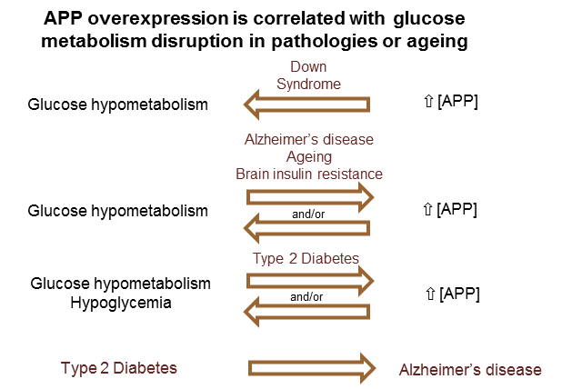
Working hypothesis and mouse model

Slide 4
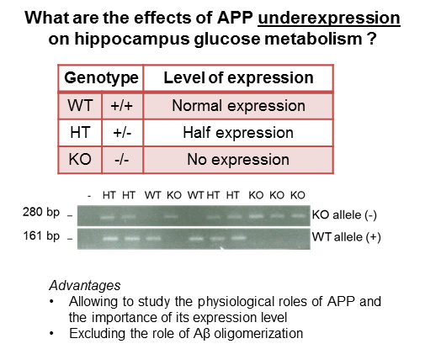
Working hypothesis and mouse model

Slide 5
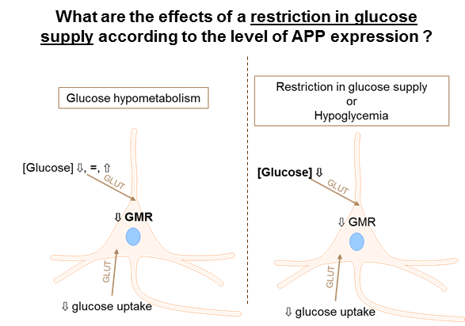
Working hypothesis and mouse model

Slide 6
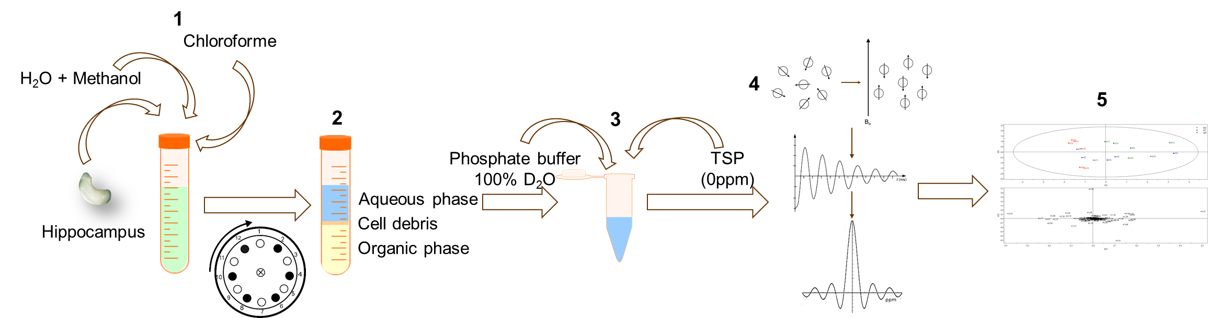
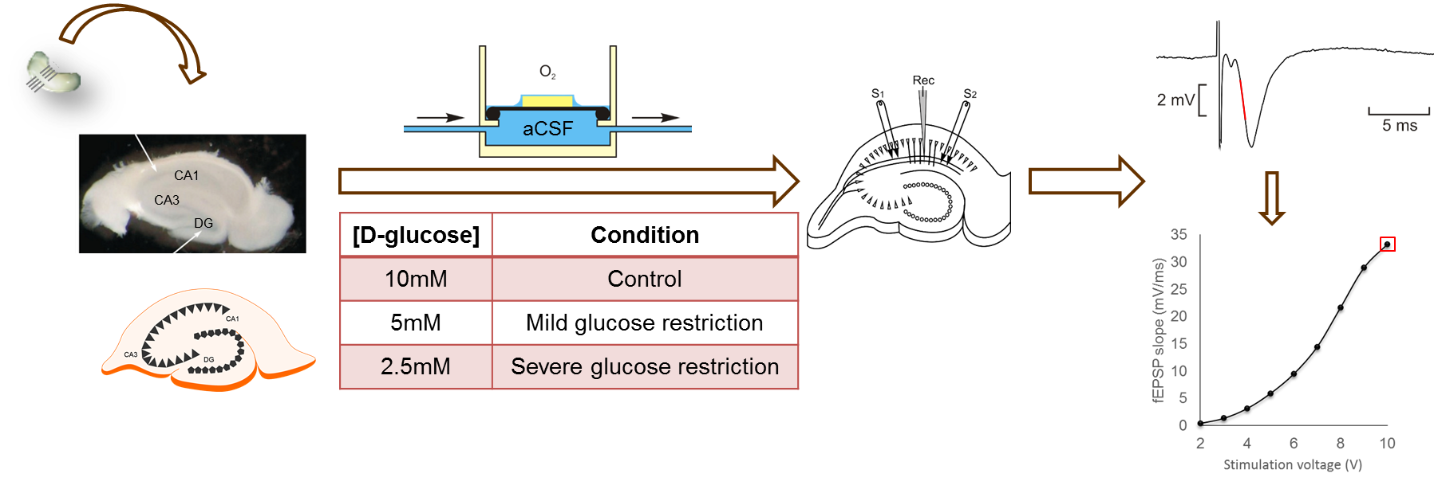
Methods
^{1H}NMR: in vivo hypoglycemia
Electrophysiological recordings: ex vivo restriction in glucose supply

Slide 7
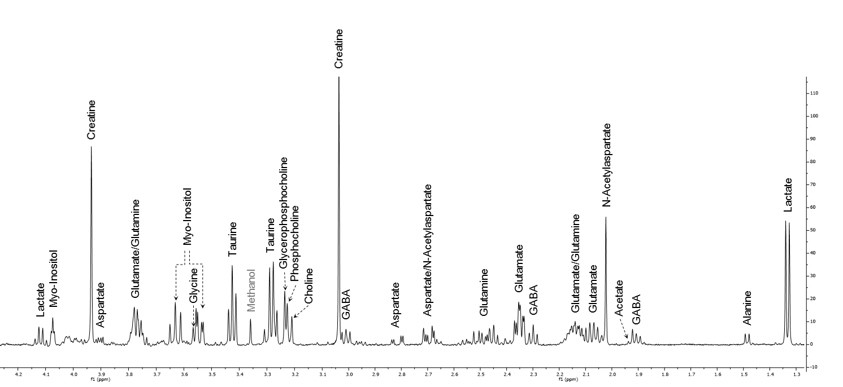
^{1H}NMR Control condition
Identification of aqueous metabolites detectable on a ^{1H}NMR spectrum obtained from the extraction of APP KO mouse hippocampi
Area under the curve (0.04ppm) → PCA

Slide 8
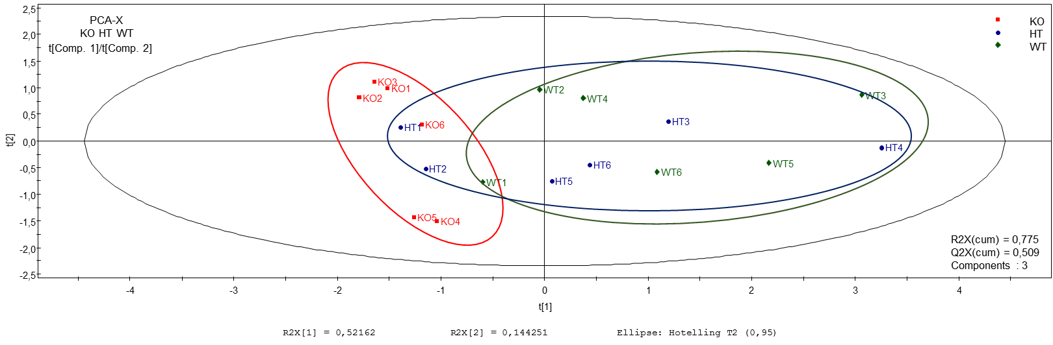
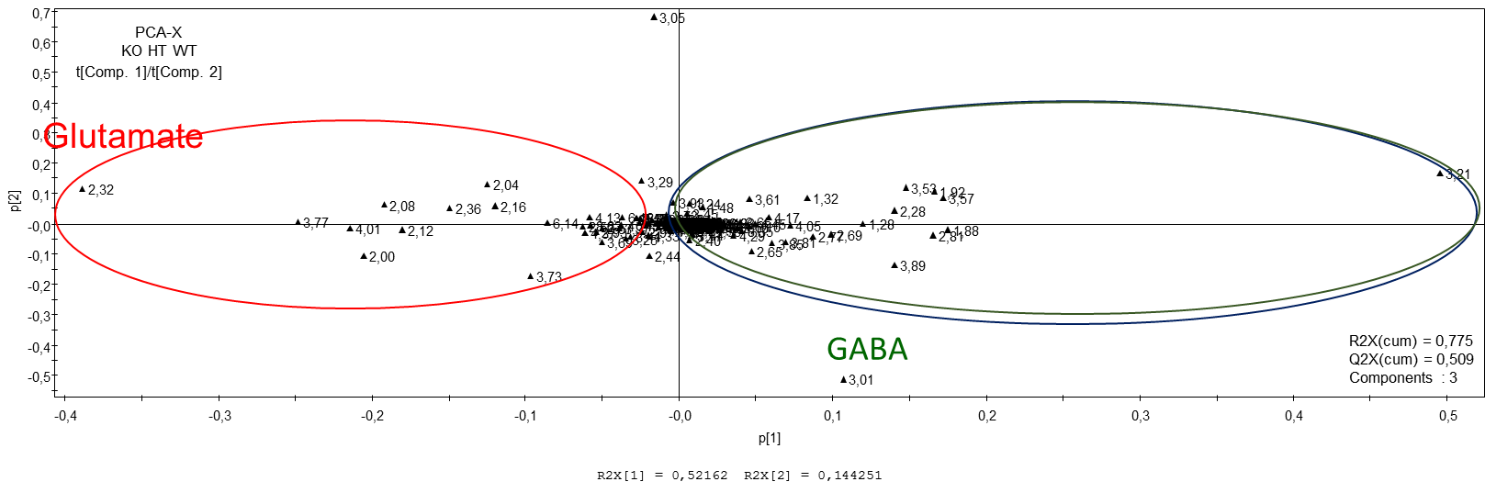
^{1H}NMR Control condition
Principal component analysis (PC1 – PC2)
HT WT
Score plot
KO
Loading plot
KO
HT WT
Genotypes segregate →The level of APP expression modifies the metabolic function in the hippocampus

Slide 9
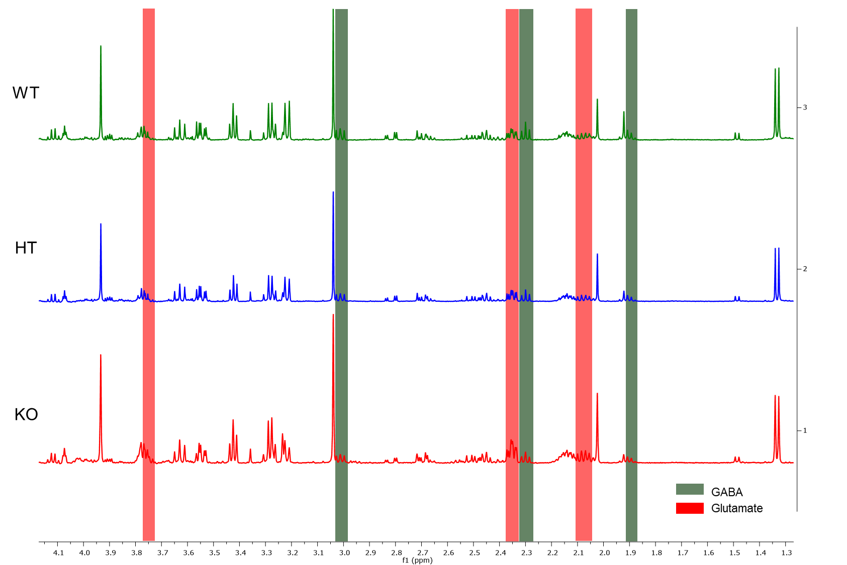
^{1H}NMR Control condition
↓ GABA
↑ glutamate
HT present an intermediate phenotype

Slide 10
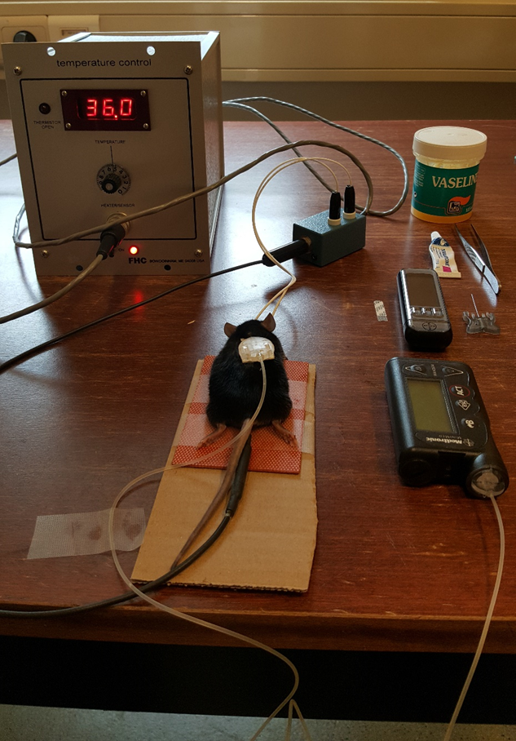
^{1H}NMR Hypoglycemia
~3mM (~54mg/dl)
2 hours
Glycemia monitoring every 15’

Slide 11
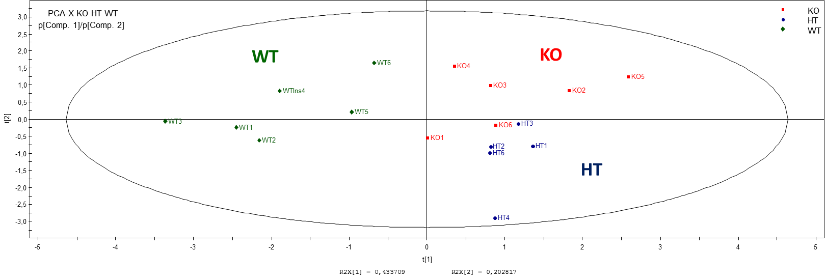
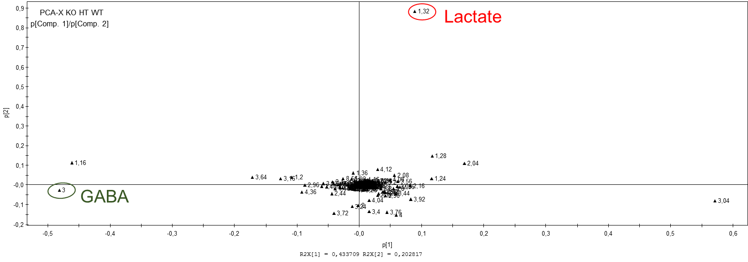
^{1H}NMR Hypoglycemia

Slide 12
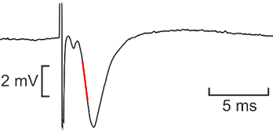
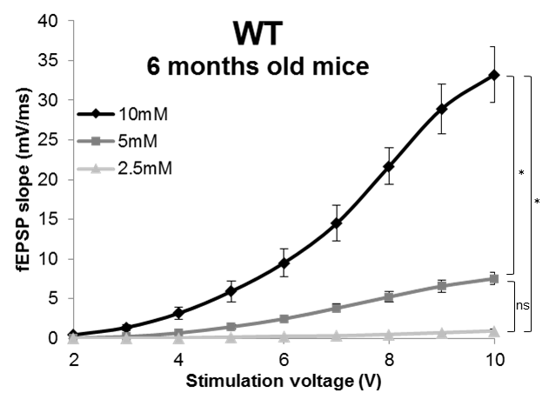
Electrophysiological recordings
Glucose restriction reduces synaptic transmission in a concentration dependant way
fEPSP (field excitatory posstynaptic potential) slope
fEPSP ~ synaptic activity

Slide 13
Electrophysiological recordings
Glucose restriction reduces synaptic transmission in a concentration dependant way
fEPSP (field excitatory posstynaptic potential) slope
fEPSP ~ synaptic activity
In basal condition, fEPSP slopes are similar in the three genotypes

Slide 14
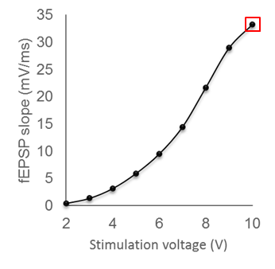
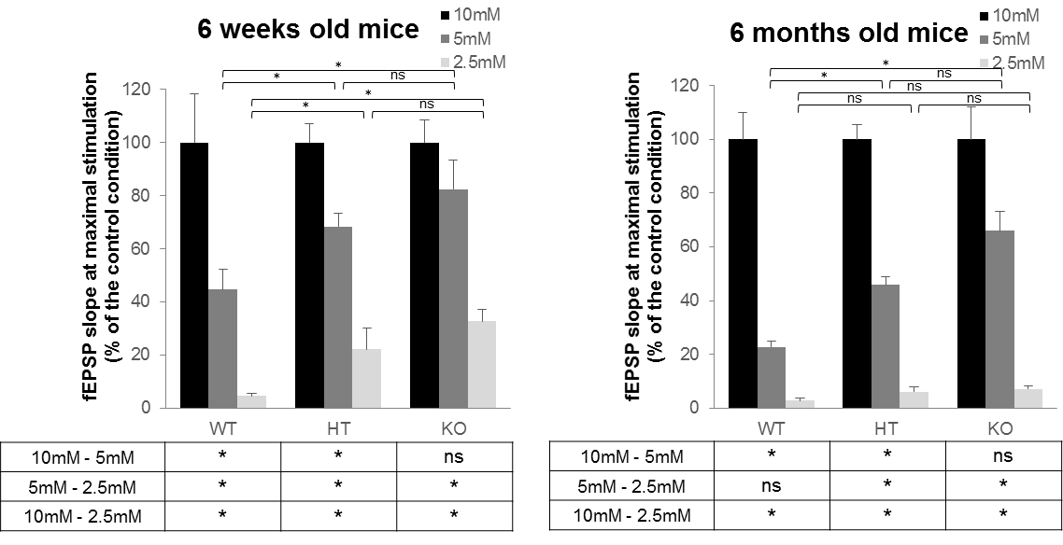
Electrophysiological recordings
The level of APP expression modulates the sensitivity to restriction in glucose supply
fEPSP
at maximal
stimulation
10mM =
100%

Slide 15
Electrophysiological recordings
The level of APP expression modulates the sensitivity to restriction in glucose supply
fEPSP
at maximal
stimulation
10mM =
100%

Slide 16
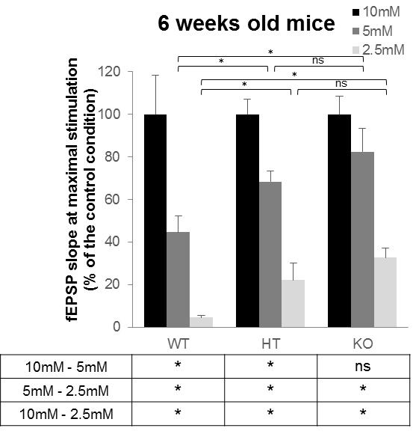
Hypothesis linking electrophysiological recordings and^{1H}NMR
↓ GABA
↑ Lactate
Increased excitability of the neuronal network
“Lactate allows the brain to function normally under acute hypoglycemic conditions”

Slide 17
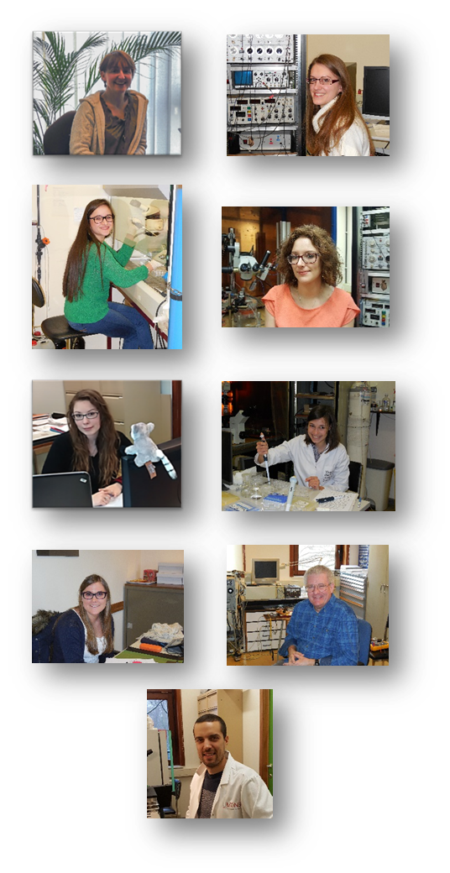







Acknowledgements
Neuroscience team
Prof. Laurence Ris
Dr. Agnès Villers
Dr. Paula Paci
Mélanie Gloire (PhD student)
Adeline Rinchon (PhD student)
Mathilde Wauters (PhD student)
Célestine Brunois (PhD student)
Bernard Foucart (technicial staff)
Claudio Palmieri (technical staff)
melanie.gloire@umons.ac.be

Slide 18
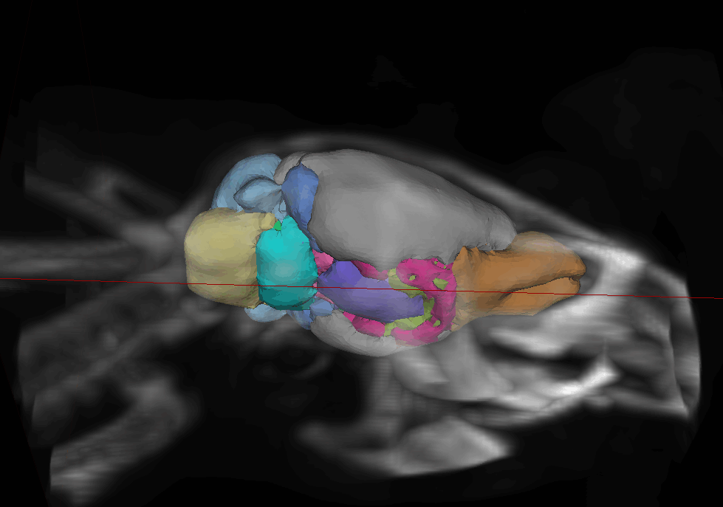
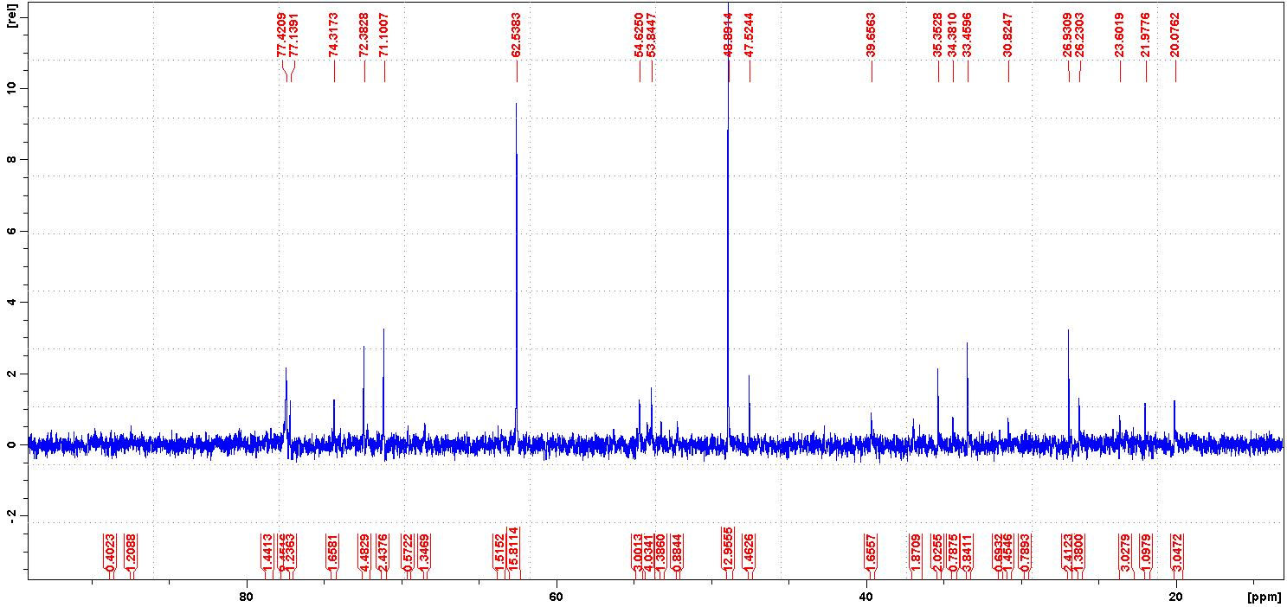
Preliminary results from next experiments..
^{18F}FDG PET-Scan
^{13C}NMR: [1-13C]glucose and [2-13C]acetate

