Slide 2
Translating Quantity Modification: A Case Study of English all and French tout
Marion Jesse
jesse.marion@umons.ac.be
Notes:
Greeting & intro (oral comment)

Slide 3
Outline
Literature
Methodology
Results
EN>FR
FR>EN
Deviant Cases
Conclusion
References

Slide 4
Literature
Literature | Methodology | Results | Conclusion | References
• • • • • • • • • • • • • • •
Quantifier
“Quantifiers are expressions that denote a quantity, such as many, all, three, a large amount of, etc.”
(Radden & Dirven 2007: 116)
Two subtypes of quantifiers:
Absolute (e.g. few people)
Relative (e.g. all dogs)
Quantity modification
Modification of a quantifier (e.g. very few people, almost all dogs)
Conceptual analogy with degree modification
(Njende et al. 2017)
quite many people vs quite a hot oven

Slide 5
Relative Quantifiers
Literature | Methodology | Results | Conclusion | References
• • • • • • • • • • • • • • •
Definition
Indicate the (non-)coincidence of the predicated mass p with a reference mass r_{t} by comparing their respective sizes (Njende et al. 2017; Langacker 1991, 2016)
All dogs love their owners.
Proportional Quantifiers | Representative Instance Quantifiers
Mass nouns & plurals | Singular count nouns
all, most, some, no | every, each, any
(Langacker 2008, 2016, 2017)

Slide 6
Relative Quantifiers
Literature | Methodology | Results | Conclusion | References
• • • • • • • • • • • • • • •
Proportional modifiers (Njende et al. 2017)
“[…] focus on the comparison of the predicated mass with the extension of the reference mass [and] comment on the coincidence (1) […], partial coincidence (2) […] or empty overlap (non-coincidence) (3) with the contextually indicated extension.” (Njende et al. 2017: 36)
It means that they will give you kits on how to run car washes, etc. to raise the money for your trip. Absolutely all the expenses will be on you--and where you stay, who you get to see, are all decided for you. (YCCQA_uk)
Most high-end variants of cars and almost all luxury brands have these installed out of the factory, but they usually don't have the purple-ish tinge […]. (YCCQA_uk)
Not all places in the U.S. observe daylight time. (YCCQA_uk)

Slide 7
Proportional Modifiers
Literature | Methodology | Results | Conclusion | References
• • • • • • • • • • • • • • •
Approximating | Totality | Negational
The boundaries of the predicated mass p and the reference mass r_{t} nearly coincide. | The boundaries of the predicated mass p and the reference mass r_{t} coincide completely. | The boundaries of the predicated mass p and the reference mass r_{t} do not coincide, without commenting on the actual size of p vis-à-vis r_{t}.
Partial coincidence: p ~ r_{t} | Full coincidence: p = r_{t} | No coincidence: p ≠ r_{t}
almost, nearly, pretty much, etc. | absolutely, completely, totally, etc. | not
(Langacker 2008, 2016, 2017; Njende et al. 2017; Marion 2021)

Slide 8
Proportional Modifiers
Literature | Methodology | Results | Conclusion | References
• • • • • • • • • • • • • • •
Approximating quantity modification |  | EX
Au-delà de cela, il faut rappeler que Chypre remplit déjà actuellement presque toutes les conditions pour adhérer à l'Union européenne. | Beyond that, it has to be said that Cyprus currently meets almost all the terms of membership needed to join the European Union. | 1
Totality quantity modification |  | EX
Il faut aujourd'hui qu'elle fasse de l'emploi et de la prospérité des peuples son premier objectif, auquel tous, absolument tous les autres, devront se plier, (…). | It must now make employment and the prosperity of its people its primary objective, to which all, absolutely all, other objectives must give way, (…). | 2
Negational quantity modification |  | EX
Des entreprises qui ne sont d'ailleurs pas toutes, loin de là, comme voudrait le faire croire ce rapport, des PME, mais, pour certaines, des filiales de grands groupes. | These are businesses which, moreover, are not all, far from it, small and medium-sized enterprises, as the report would have us believe, but some are subsidiaries of large groups. | 3

Slide 9
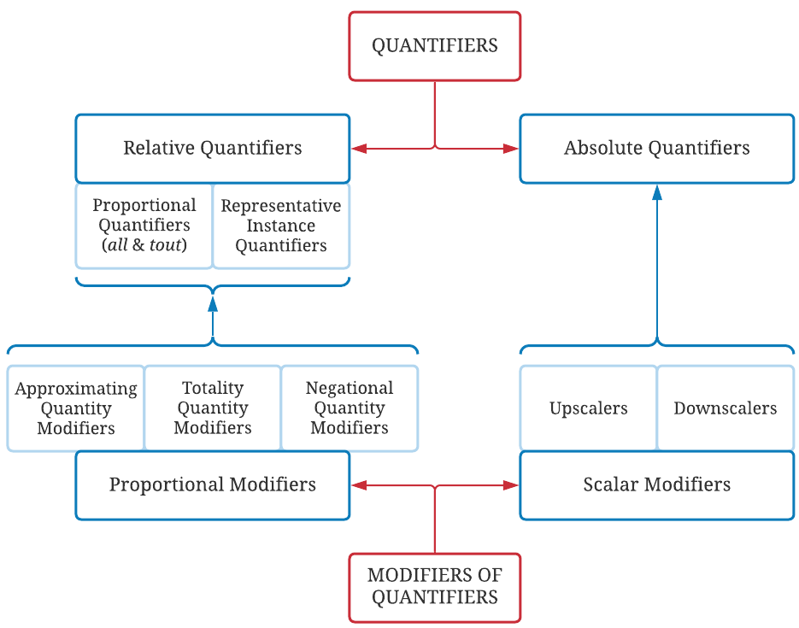
Quantifier-Modifier Interactions
Literature | Methodology | Results | Conclusion | References
• • • • • • • • • • • • • • •

Slide 10
Methodology
Literature | Methodology | Results | Conclusion | References
• • • • • • • • • • • • • • •
Corpus | Europarl Direct (accurate language tagging) (Koehn 2005, Cartoni & Meyer 2012)
 | ± 50 million words per language
 | April 1996 – December 2010
Preparation | TXT files into Excels
 | Upload onto SketchEngine: N-grams → list of potential modifiers
 | Extraction with AntConc (Anthony 2010)
 | EN>FR: 317 instances (!sampling) FR>EN: 255 instances
 | Analysis in Excel
Notes:
Quantitative & Qualitative, but qualitative: NM max 150, although more
Extraction with AntConc (SE & context limit)

Slide 11
Results
Literature | Methodology | Results | Conclusion | References
• • • • • • • • • • • • • • •
Language | Approximating | Totality | Negational
English | ✓ |  | ✓
French | ✓ | ✓ | ✓
Language direction | Modifier not translated | Quantifier not translated | Quantifier replaced | Neither Q nor M translated
EN>FR | 14 (4.7%) | 10 (3.3%) | 48 (16.1%) | 4 (1.3%)
FR>EN | 14 (5.5%) | 25 (9.8%) | 72 (28%) | 3 (1.2%)
Examples | 4 | 5 | 6 | 7
Overall: QM translated by direct equivalent,
although great variety of translations
e.g. absolument tout into absolutely nothing, or almost all into la quasi-totalité
Notes:
If ‘not translated’: typically QM>DM
If ‘replaced’: other quantifier, e.g. every into English
Will go over examples from handout with audience

Slide 12
English into French
Literature | Methodology | Results | Conclusion | References
• • • • • • • • • • • • • • •
EN | Number | %corpus | Main translations | Number | %corpus | EX
(just) about all | 2 | 0.6 | à peu près tou* | 1 | 0.3 | 8
 |  |  | presque tou* | 1 | 0.3 | 9
almost all | 77 | 24.3 | presque tou* | 42 | 14.1 | 10
essentially all | 5 | 1.6 | essentiellement tou* | 4 | 1.3 | 11
(very) nearly all | 25 | 7.9 | presque tou* | 12 | 4 | 12
not all | 169 (150) | 53.3 | (ne...) pas (…) tou* | 55 | 18.4 | 13
 |  |  | tou* (…) ne (…) pas | 73 | 24.5 | 14
practically all | 15 | 4.7 | pratiquement tou* | 6 | 2 | 15
virtually all | 24 | 7.6 | pratiquement tou* | 11 | 3.7 | 16
TOT | 317 | 100
Notes:
Formally corresponding (Catford’s terminology)

Slide 13
French into English
Literature | Methodology | Results | Conclusion | References
• • • • • • • • • • • • • • •
FR | Number | %corpus | Main translations | Number | %corpus | EX
à peu près tou* | 14 | 5.5 | (just) about/virtually/almost all | 5 | 2 | 17
 |  |  | almost/practically every(thing/one) | 6 | 2.3 | 18
absolument tou* | 22 | 8.6 | absolutely (…) everything | 8 | 3.1 | 19
 |  |  | N.A. | 6 | 2.3 | 20
(ne) pas tou* | 150 | 58.8 | not (…) all | 92 | 36.1 | 21
 |  |  | (can)not (…) every(thing/one) | 26 | 10.2 | 22
pratiquement tou* | 21 | 8.2 | virtually/practically/nearly all | 13 | 5.1 | 23
presque tou* | 39 | 15.3 | almost/virtually/nearly all | 29 | 11.4 | 24
quasi(ment) tou* | 9 | 3.5 | almost/practically all | 8 | 3.1 | 25
TOT | 255 | 100

Slide 14
Deviant Cases
Literature | Methodology | Results | Conclusion | References
• • • • • • • • • • • • • • •
QM > DM shifts
EN>FR: 26/298 (8.7%), of which 19 with almost all
“I say to almost all colleagues that have spoken in this debate that they are walking away from the problem.”
« Je veux dire à la quasi-totalité de nos collègues qui se sont exprimés dans ce débat qu'ils s'écartent du problème. »
FR>EN: 12/255 (4.7%), of which 10 with (ne) pas tou*
« Monsieur le Président, chers collègues, je voudrais remarquer à quel point aujourd'hui, finalement, nous ne sommes pas tous d'accord ici, dans cette enceinte, ce qui est un point tout à fait positif. »
“Mr President, ladies and gentlemen, I should like to comment on the extent to which we in this House are still, even today, not entirely in agreement, which is quite a positive point.”
Notes:
‘Deviant’ as from ‘deviating from a norm’, viz. a 1-1 translation of the quantifier under modification

Slide 15
Deviant Cases
Literature | Methodology | Results | Conclusion | References
• • • • • • • • • • • • • • •
Quantifier shifts
EN>FR: 48/298 (16.1%)
“Grubbing-up was mentioned by almost all of you.”
« L'arrachage a été mentionné par presque chacun d'entre vous. »
FR>EN: 72/255 (28%)
« Elle mécontente à peu près tout le monde, à commencer par ceux que l'on appelle les petits pays. »
“It upsets almost everyone, beginning with those known as the smaller countries.”

Slide 16
Conclusion
Literature | Methodology | Results | Conclusion | References
• • • • • • • • • • • • • • •
QM most often translated, direct counterpart in target language
Nearly twice as many QM>DM shifts in EN>FR translations than in FR>EN (<10% vs <5% respectively)
Quantifier shifts more frequent in FR>EN translations than EN>FR (28% vs 16% respectively)

Slide 17
References
Literature | Methodology | Results | Conclusion | References
• • • • • • • • • • • • • • •
Anthony, L. (2010). AntConc (Version 3.5.9) [Computer Software]. Tokyo, Japan: Waseda University. www.antlab.sci.waseda.ac.jp.
Cartoni, B., & Meyer, T. (2012). Extracting Directional and Comparable Corpora from a Multilingual Corpus for Translation Studies. Proceedings 8th International Conference on Language Resources and Evaluation (LREC), Istanbul, Turkey. Available online at http://www.lrec-conf.org/proceedings/lrec2012/pdf/188_Paper.pdf.
Catford, J. C. (1965). A Linguistic Theory of Translation. Oxford University Press.
Davidse, K., Ghesquière, L., & Njende, N. M. (2018). Pursuing the analogy between quality and quantity modification [PowerPoint presentation]. PowerPoint presented at the BAAHE conference, 30th November 2018, Université de Mons.
De Smet, H. (2009). Yahoo-based Contrastive Corpus of Questions and Answers (YCCQA). varieng.helsinki.fi/CoRD/corpora/YCCQA.
Koehn, P. (2005). Europarl: A parallel corpus for statistical machine translation. In MT Summit, 5, 79-86. https://aclanthology.org/2005.mtsummit-papers.11.pdf
Langacker, R. W. (1991). Foundations of Cognitive Grammar (Vol. 2, Descriptive Application). Stanford University Press.
Langacker, R. W. (2008). Cognitive Grammar – A Basic Introduction. Oxford University Press.

Slide 18
References
Literature | Methodology | Results | Conclusion | References
• • • • • • • • • • • • • • •
Langacker, R. W. (2016). Nominal grounding and English quantifiers. Cognitive Linguistic Studies, 3(1), 1-31. https://doi.org/10.1075/cogls.3.1.01lan
Langacker, R. W. (2017). Grounding, semantic functions, and absolute quantifiers. English Text Constructions, 10(2), 233-248. https://doi.org/10.1075/etc.10.2.03lan
Marion, J. (2021). Almost all and presque tout: A corpus-based study of quantity modification with English all and French tout [Paper presentation]. Using Corpora in Contrastive and Translation Studies (6th edition), Bertinoro, Italy. https://events.unibo.it/uccts2021.
Munday, J. (2016). Introducing Translation Studies (4th ed.). Routledge.
Njende, N. M., Davidse, K., & Ghesquière, L. (2017). Precious few and practically all: A cognitive grammar approach to the modification of quantifiers. Leuven Working Papers in Linguistics, 34, 96-121.
Njende, N. M., Ghesquière, L., & Davidse, K. (2015). Re-assessing the absolute quantification restriction in existential constructions. Paper presented at the 48th Annual Meeting of the Societas Linguistica Europaea (SLE 48), 2nd-5th September 2015, Leiden, the Netherlands.
Radden, G., & Dirven, R. (2007). Cognitive English Grammar (Vol. 2, Cognitive Linguistics in Practice). Benjamins.

Slide 19
Thank you for your attention! Questions? Remarks? Suggestions?

