Slide 2
Three’s a Charm – On Negational Modification as a Third Type of Quantity Modification of English all and French tout
Marion Jesse
jesse.marion@umons.ac.be
UMONS, Belgium
FTI-EII – English unit: Literature, Language, Translation and Interpretation (ELLIT)
Notes:
Greeting & intro

Slide 3
Outline
Literature
Methodology
Negational Quantity Modification (NQM)
Scope of Negation
Test
Semantic Specification
Conclusion
References

Slide 4
Literature
Literature | Methodology | Negational Quantity Modification | Conclusion | References
►►►► ► ►►►►►►►►►►►►► ►► ►►
Quantifiers
“Quantifiers are expressions that denote a quantity, such as many, all, three, a large amount of, etc.” (Radden & Dirven 2007: 116)
Two subtypes of quantifiers:
Absolute (e.g. few people, peu de gens)
Relative (e.g. all dogs, tous les chiens)
Quantity modification
Modification of a quantifier (e.g. very few people, almost all dogs) (Njende et al. 2017: 34)
(Langacker 2008, 2016, 2017)

Slide 5
Relative Quantifiers
Literature | Methodology | Negational Quantity Modification | Conclusion | References
►►►► ► ►►►►►►►►►►►►► ►► ►►
Indicate the (non-)coincidence of the predicated mass p with a reference mass r_{t} (by default, the maximal extension me) by comparing their respective sizes (Langacker 1991, 2016)
All dogs love their owners.
Proportional Quantifiers | Representative Instance Quantifiers
Mass nouns & plurals | Singular count nouns
all, most, some, no | every, each, any
(Langacker 2008, 2016, 2017)
(Langacker 2016: 7)

Slide 6
Proportional Modifiers
Literature | Methodology | Negational Quantity Modification | Conclusion | References
►►►► ► ►►►►►►►►►►►►► ►► ►►
“[…] focus on the comparison of the predicated mass with the extension of the reference mass [and] comment on the coincidence (1) […], partial coincidence (2) […] or empty overlap (non-coincidence) (3) with the contextually indicated extension.” (Njende et al. 2017: 36)
(1) Totality | (2) Approximating | (3) Empty overlap
Full coincidence: p = r_{t} | Partial coincidence: p ~ r_{t} | Universal exclusion: p (r_{t})
Absolutely all the expenses will be on you. (YCCQA_uk) | (…) almost all luxury brands have these installed (...) (YCCQA_uk) | (…) a (…) Boeing 747 only it had absolutely no markings! (YCCQA_uk)
=
P
=
P
P
P
R_{T}
R_{T}
R_{T}
(Illustrations based on Langacker 2016: 7; Langacker 2008, 2017; Njende et al. 2017)
Notes:
we argue all/tout can pair with not/pas respectively to form a fourth subtype of proportional quantity modification

Slide 7
Quantifier-Modifier Interactions
Literature | Methodology | Negational Quantity Modification | Conclusion | References
►►►► ► ►►►►►►►►►►►►► ►► ►►

Slide 8
Methodology
Literature | Methodology | Negational Quantity Modification | Conclusion | References
►►►► ► ►►►►►►►►►►►►► ►► ►►
Corpus
Yahoo-based Contrastive Corpus of Questions and Answers (YCCQA) (De Smet 2009)
29 million words
English, French, German, and Spanish - comparable
2006-2009
Extraction with AntConc (Anthony 2010)
Datasets
2 datasets (not all, pas tout) – 150 instances each
Analysed in Excel
Notes:
Parameters: count/uncount, co-occurrence criteria, pronominal use vs prenominal use, position in sentence
Mess around with the data: 14m (EN), 9m (FR)
Nearly 230k Q&As for EN, nearly 160k for FR

Slide 9
Proportional Modifiers
Literature | Methodology | Negational Quantity Modification | Conclusion | References
►►►► ► ►►►►►►►►►►►►► ►► ►►
Approximating | Totality | Empty overlap
Partial coincidence: p ~ r_{t} | Full coincidence: p = r_{t} | Universal exclusion: p (r_{t})
(…) almost all luxury brands have these installed (...) (YCCQA_uk) | Absolutely all the expenses will be on you. (YCCQA_uk) | (…) a (…)Boeing 747 only it had absolutely no markings! (YCCQA_uk)
DISCLAIMER
BUT…
P
P
=
P
R_{T}
R_{T}
R_{T}
(Illustrations based on Langacker 2016:7; Langacker 2008, 2017; Njende et al. 2017)
Notes:
DISCLAIMER: Examples can be offensive, insulting, racist, homophobic & Co. >Forum
Holds true for the rest of the presentation

Slide 10
Negational Quantity Modification
Literature | Methodology | Negational Quantity Modification | Conclusion | References
►►►► ► ►►►►►►►►►►►►► ►► ►►
English (YCCQA_uk)
Not all atheists believe in evolution.
Not all policies cover those things.
Acids burn stuff. Any acid will burn skin but not all will do it quickly of [sic] noticeably.
French (YCCQA_fr)
Les chats n’ont pas tous peur de l’eau !
Et toi tu as dit une majorité pas TOUS les Français, eh bien réfléchis que nous on dit aussi une majorité pas TOUS les Sénégalais.
(…) le prix etait [sic] de 100 livres (environ 150€ la semaine) mais on paye pas tout sur le site (trop cool pour ceux qui ne veulent pas payer sur le net) (…)

Slide 11
Negational Quantity Modification
Literature | Methodology | Negational Quantity Modification | Conclusion | References
►►►► ► ►►►►►►►►►►►►► ►► ►►
Approximating | Totality | Empty overlap | ???
Partial coincidence: p ~ r_{t} | Full coincidence: p = r_{t} | Universal exclusion: p (r_{t}) | ???
(…) almost all luxury brands have these installed (...) (YCCQA_uk) | Absolutely all the expenses will be on you. (YCCQA_uk) | (…) a (…)Boeing 747 only it had absolutely no markings! (YCCQA_uk) | ???
 |  |  | ???
P
P
=
P
R_{T}
R_{T}
R_{T}
(Illustrations based on Langacker 2016: 7; Langacker 2008, 2017; Njende et al. 2017)

Slide 12
Negational Quantity Modification
Literature | Methodology | Negational Quantity Modification | Conclusion | References
►►►► ► ►►►►►►►►►►►►► ►► ►►
Approximating | Totality | Empty overlap | Negational
The boundaries of the predicated mass p and the reference mass r_{t} nearly coincide. | The boundaries of the predicated mass p and the reference mass r_{t} coincide completely. | The predicated mass is being excluded from the domain of instantiation. | The boundaries of the predicated mass p and the reference mass r_{t} do not coincide, without commenting on the actual size of p vis-à-vis r_{t}.
Partial coincidence: p ~ r_{t} | Full coincidence: p = r_{t} | Universal exclusion: p (r_{t}) | No coincidence: p ≠ r_{t}
(…) almost all luxury brands have these installed (...) (YCCQA_uk) | Absolutely all the expenses will be on you. (YCCQA_uk) | (…) a (…) Boeing 747 only it had absolutely no markings! (YCCQA_uk) | Not all atheists believe in evolution. (YCCQA_uk)
However, typically implies p ~ majority
/!\ exceptions
(Illustrations based on Langacker 2016: 7; Langacker 2008, 2017)
P
P
=
P
P
≠
R_{T}
R_{T}
R_{T}
R_{T}
(Illustrations based on Langacker 2016: 7; Langacker 2008, 2017; Njende et al. 2017)

Slide 13
Negational Quantity Modification
Literature | Methodology | Negational Quantity Modification | Conclusion | References
►►►► ► ►►►►►►►►►►►►► ►► ►►
not all?
(Langacker 2016: 7)
Typically: not all ~ most → majority reading
BUT (few) cases where minority reading possible, e.g. simple because woman [sic] have feelings and men don’t that’s why and not all men are like that just slugs like you
P
ME = R_{T}
(Based on Langacker 2016: 7)

Slide 14
Negational Quantity Modification
Literature | Methodology | Negational Quantity Modification | Conclusion | References
►►►► ► ►►►►►►►►►►►►► ►► ►►
Scope of negation?
Si seulement il n'y avait pas tous ces intégristes de tout bord !!!! (YCCQA_fr)
Et heureusement, ce ne sont pas tous les musulmans qui affirment ça (que tout le monde serait musulman). (YCCQA_fr)
Although I'm sure it's not all men, I think the answers on here speak for themselves! (YCCQA_uk)
It'll help to look good,of course..but that's not all that matters. (YCCQA_uk)
Test required
Notes:
fundamentalists

Slide 15
Test – Phase 1
Literature | Methodology | Negational Quantity Modification | Conclusion | References
►►►► ► ►►►►►►►►►►►►► ►► ►►
Under construction
Klima (1964): if either a positive question tag, a neither tag, or a not even tag can be added → sentential negation
John didn’t find a job, did he?/*didn’t he?
John didn’t find a job, and neither did Mary/*and so did Mary.
John didn’t find a job, not even a part time one/*even a part time one.
(Bross 2020: 5, quoting Penka 2015)
Ducrot (1973): similar test for French, relying on the equivalent of a neither tag (FR ni même and ni non plus)
Jacques n’est pas venu, ni même/ni non plus Paul.
Il n’est pas venu beaucoup d’amis, ni même beaucoup de curieux/ni non plus beaucoup d’ennemis.
(Touratier 2008, quoting Ducrot 1973)
Notes:
Oral comment: ni non plus can be paraphsed as et X non plus, X being the subject → et Paul non plus

Slide 16
Test – Phase 2
Literature | Methodology | Negational Quantity Modification | Conclusion | References
►►►► ► ►►►►►►►►►►►►► ►► ►►
Cleft sentence to determine which constituent: move not in the sentence & compare to the original meaning (same applies for French pas)
Original Sentence | Phase 2
Acids burn stuff. Any acid will burn skin but not all will do it quickly [sic] of noticeably. | Acids burn stuff. Any acid will burn skin but it is all that will not do it quickly [sic] of noticeably.
 | Acids burn stuff. Any acid will burn skin but it is all that will do it not quickly [sic] of noticeably.
 | Acids burn stuff. Any acid will burn skin but it is all that will do it quickly [sic] of not noticeably.
Not does not have scope over the other clause constituents

Slide 17
Test – Problems
Literature | Methodology | Negational Quantity Modification | Conclusion | References
►►►► ► ►►►►►►►►►►►►► ►► ►►
Input welcome! ☺
English data: 16/150 occurrences = sentential negation → replaced
French data: 136/150 occurrences = sentential >< intuition
Les chats n’ont pas tous peur de l’eau ! (e.g. test: … ni non plus les chiens)
Test (not?) applicable if
position in sentence = N.A., e.g. Pas tous mon grand, pas tous, si j'en crois ce que je lis sur ce site...
relative clause, e.g. (…) la plupart de ces dérapages malheureux et condamnables viennent de gens qui ne vivent pas tous dans nos démocraties et n'en n'ont manifestement ni la culture ni le sens du débat.
(partly) cleft sentence, e.g. Parce qu'ils bossent, ce ne sont pas tous des petits bourgeois ou des fils de riches (…)
appositive clause with gerund, e.g. Ne mettant pas tous les Yankees dans le même panier, je n'ai pas la réponse.
Notes:
English data: test confirms intuition
French data: test nearly always contradicts intuition

Slide 18
Semantic Specification?
Literature | Methodology | Negational Quantity Modification | Conclusion | References
►►►► ► ►►►►►►►►►►►►► ►► ►►
English (YCCQA_uk)
Not all atheists believe in evolution. Many do, but not all.
Not all policies cover those things, but most do and some have even more perils that are covered.
Acids burn stuff. Any acid will burn skin but not all will do it quickly of noticeably.
French (YCCQA_fr)
Les chats n’ont pas tous peur de l’eau ! Certains adorent même se baigner.
Et toi tu as dit une majorité pas TOUS les Français, eh bien réfléchis que nous on dit aussi une majorité pas TOUS les Sénégalais.
(…) le prix etait de 100livres (environ 150€ la semaine) mais on paye pas tout sur le site (trop cool pour ceux qui ne veulent pas payer sur le net) en fait on ne paye que les arrhes (10% de la somme) (…)

Slide 19
Semantic Specification Phenomenon (SSP)
Literature | Methodology | Negational Quantity Modification | Conclusion | References
►►►► ► ►►►►►►►►►►►►► ►► ►►
Addition of one or more elements to the sentence to clarify the intended meaning,
either by means of contrast (>contrast-based SSP),
or by providing an explanation or (list of) example(s) (>similarity-based SSP).
Not all atheists believe in evolution. Many do, but not all.
Not all the time. I would say it's Gold about 95% of the time. 5% of the time you just need to hear a comforting voice.

Slide 20
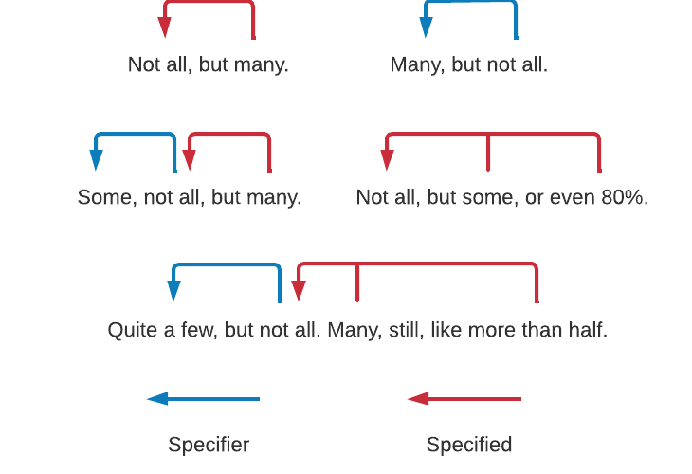
Not All and Semantic Specification
Literature | Methodology | Negational Quantity Modification | Conclusion | References
►►►► ► ►►►►►►►►►►►►► ►► ►►

Slide 21
Semantic Specification Phenomenon (SSP)
Literature | Methodology | Negational Quantity Modification | Conclusion | References
►►►► ► ►►►►►►►►►►►►► ►► ►►
Role | Specifier | Specified | Double | Triple | tot | TOT
Pro_EN | 4 | 5 | 5 | 0 | 14 | 65/150
Pre_EN | 9 | 29 | 12 | 1 | 51
Pro_FR | 1 | 13 | 2 | 0 | 16 | 25/150
Pre_FR | 2 | 4 | 2 | 1 | 9
Type | Contrast | Similarity | Double (repetitive) | Double (hybrid) | Triple (Hybrid)
Pro_EN | 8 | 1 | 4 | 1 | 0
Pre_EN | 24 | 14 | 1 | 11 | 1
Pro_FR | 9 | 5 | 1 | 1 | 0
Pre_FR | 2 | 4 | 0 | 2 | 1
Notes:
Possible explanation for number of SSPs FR//EN: Nb of position = N.A. ++ in FR (‘pas tous’ standing alone)

Slide 22
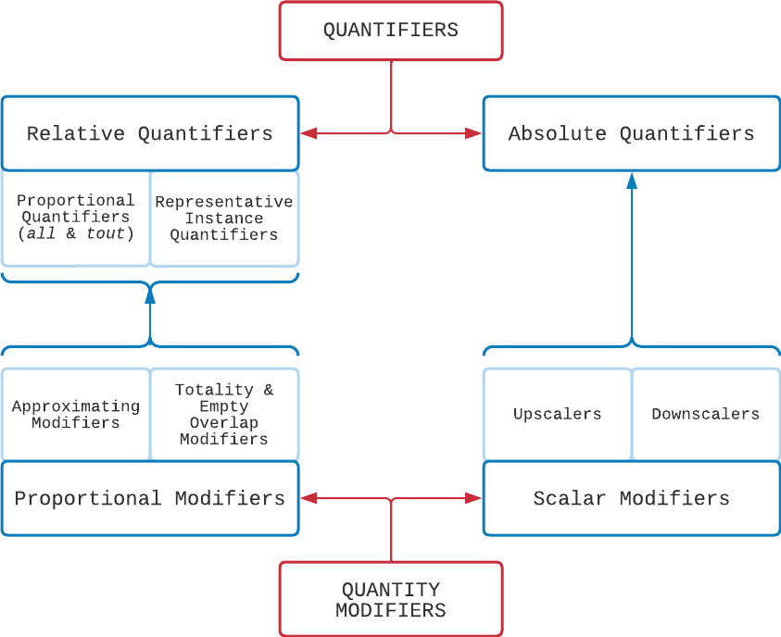
Conclusion
Literature | Methodology | Negational Quantity Modification | Conclusion | References
►►►► ► ►►►►►►►►►►►►► ►► ►►

Slide 23
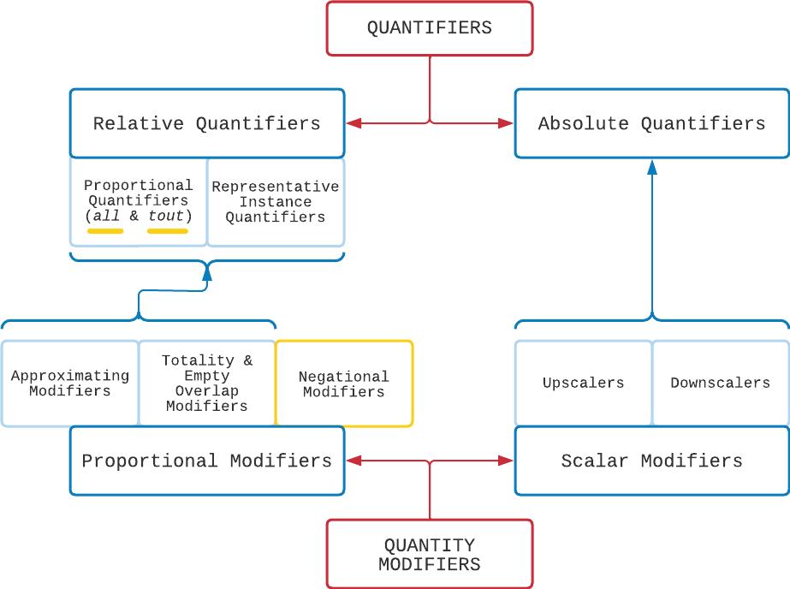
Conclusion
Literature | Methodology | Negational Quantity Modification | Conclusion | References
►►►► ► ►►►►►►►►►►►►► ►► ►►
Semantic specification
contrast
similarity
BUT
Test → scope of negation ☹

Slide 24
References
Literature | Methodology | Negational Quantity Modification | Conclusion | References
►►►► ► ►►►►►►►►►►►►► ►► ►►
Anthony, L. (2010). AntConc (Version 3.5.9) [Computer Software]. Tokyo, Japan: Waseda University. www.antlab.sci.waseda.ac.jp.
Bross, F. (2020). The why-how alternation and a new test for sentential negation - on negated how-questions. Glossa: A Journal of General Linguistics, 5(1): 1-8. https://doi.org/10.5334/gjgl.1175.
De Smet, H. (2009). Yahoo-based Contrastive Corpus of Questions and Answers (YCCQA). varieng.helsinki.fi/CoRD/corpora/YCCQA.
Ducrot, O. (1973). La preuve et le dire : langage et logique. Mame.
Klima, E. S. (1964). Negation in English. In J. Fodor & J. Katz (Eds.), The Structure of Language, 246-323. Prentice-Hall.
Langacker, R. W. (1991). Foundations of Cognitive Grammar (Vol. 2, Descriptive Application). Stanford, CA: Stanford University Press.
Langacker, R. W. (2008). Cognitive Grammar – A Basic Introduction. Oxford: Oxford University Press.
Langacker, R. W. (2016). Nominal Grounding of English Quantifiers. Cognitive Linguistics Studies, 3(1), 1–31.

Slide 25
References
Literature | Methodology | Negational Quantity Modification | Conclusion | References
►►►► ► ►►►►►►►►►►►►► ►► ►►
Langacker, R. W. (2017). Grounding, semantic functions, and absolute quantifiers. English Text Constructions, 10(2), 233–248.
Marion, J. (2021). Almost all and presque tout: A corpus-based study of quantity modification with English all and French tout [Paper presentation]. Using Corpora in Contrastive and Translation Studies (6th edition), Bertinoro, Italy. https://events.unibo.it/uccts2021.
Njende, N. M., Davidse, K., & Ghesquière, L. (2017). Precious few and practically all: A cognitive grammar approach to the modification of quantifiers. Leuven Working Papers in Linguistics, 34, 96-121.
Penka, D. (2015). Negation and polarity. In N. Riemer (Eds.), Routledge Handbook of Semantics, 303-319. Routledge.
Quirk et al. (1985). A Comprehensive Grammar of the English Language. Pearson Longman.
Radden, G., & Dirven, R. (2007). Cognitive English Grammar (Vol. 2, Cognitive Linguistics in Practice). Amsterdam: Benjamins.
Touratier, C. (2008). La portée de la négation ? De Lingua Latina. Revue de Linguistique Latine du Centre Alfred Ernout, 1, 1-33. https://hal.archives-ouvertes.fr/hal-03528306

Slide 26
Thank you for your attention! Questions? Comments? Suggestions?

Slide 27
Negational Quantity Modification
Literature | Methodology | Results | Conclusion | References
Parameters |  | English | French
Occurrences |  | 150
Quantifier in pronominal use | (Count) | 18 | 60
 | (Uncount) | 1 | 5
 | N.A. | 1 | 36
Quantifier in prenominal use | Count | 106 | 48
 | Uncount | 4 | 1
 | (Count) | 18 | 0
 | (Uncount) | 2 | 0
 | N.A. | 0 | 0

Slide 28
Negational Quantity Modification
Literature | Methodology | Results | Conclusion | References
Parameters |  | English | French
Position in the sentence (pronominal use) | Subject | 7 | 35
 | Direct object | 3 | 48
 | Initial in prepositional clause | 1 | 1
 | Temporal complement | 2 | 0
 | N.A. | 7 | 17
Position in the sentence (prenominal use) | Subject | 108 | 5
 | Direct object | 3 | 26
 | Initial in prepositional clause | 0 | 0
 | Temporal complement | 11 | 15
 | N.A. | 8 | 3
TOT |  | 150
Notes:
Boxes highlight significant behavioural differences.
Labels adapted from Quirk et al. 1987.
S = subject
Od = direct object
I = initial position of adverbial, pr = prepositional verb (here adapted into initial position of prepositional clause)
C = complement, temp (my own) for temporal

