Slide 1
Translating Contrastive Markers in Journalistic Texts: The Case of the Translation of Dutch maar Into French by Translation Students and Professional Translators
Stilmant Nathanaël (Nathanael.STILMANT@umons.ac.be)
XIV Congreso Internacional de Lingüística de Corpus – CICL 2023
Notes:
Buenos días a todos, Hello everyone, I am very happy to be here with you today to talk about an experiment I conducted as part of my doctoral thesis, which concerns the study of the translation of the Dutch marker "maar" (the equivalent of "but" in English) into French by translation students and professional translators.

Slide 2
Outline
Context and goal of the study
Literature
Methodology
3.1. Semantic classification of mais and maar
3.2. Didactic experiment
4. Results
4.1. Students
4.2. Professionals
4.3. Similarities and differences
5. Conclusions
6. References
Notes:
The structure of today's presentation is as follows: I) I will begin by situating the study I am about to present to you, and by telling you about the context in which it takes place, which will enable me to describe its goals. II) I will then go on with the literature, focusing mainly on the notion of contrast. III) After that, I will describe the methodology of this study, which I will divide into two parts, one devoted to the semantic classification of "mais" and "maar", and the other, which will describe the details of the experiment that was conducted. IV) I will then conclude by discussing, of course, the results I have observed in the translations of students and professionals, and we will see to what extent they are similar or differ.

Slide 3
1. Context and goal of the study
Part of a larger project on the translation of contrastive markers from French into Dutch and vice versa
Exploratory purpose
Understand better the markers in their respective languages
Highlight their differences and similarities
Analyse their translations
Students’ strategies vs translator’ strategies
Notes:
First of all, I think it is relevant to talk briefly about the context of this study. It is part of a larger PhD project dedicated to the study of the translation of the most common contrastive markers into French and Dutch. Here you have the basic steps of this project: I started by conducting monolingual studies in French and Dutch journalistic corpora on the markers I wanted to study (today we are mainly interested in 'mais' and 'maar'). The second step was to study these markers in a parallel corpus which allowed me to analyse the way they are translated. And with today's experiment, we are at the last stage of the process, which has an exploratory purpose.

Slide 4
1. Context and goal of the study
Complementary study to parallel corpus studies
Maar
Maar
Maar
Maar
Maar
Parallel corpus studies
Exploratory
study
Notes:
This study is therefore quite complementary to parallel corpus studies, because parallel corpora show markers that are translated only once by a single translator, whereas the study we are going to discuss today analyses markers that have been translated several times by different translators.

Slide 5
1. Context and goal of the study
Investigation of the translational strategies of the Dutch contrastive marker maar into French produced by translation students as well as professional translators, with a double goal:
To identify the main trends in the translational strategies of students (and professional translators)
To compare the results of students and professionals, in order to see to what extent they differ or are similar
Notes:
With this study, I wanted to investigate the translation strategies of translation students when faced with these markers, and then to see to what extent they are similar or different from those of professional translators.
2,50 min

Slide 6
2. Literature
Before discussing the literature on maar (and mais in French), it is worth looking at the notion of contrast
Extremely diverse approaches (Dupont, 2019)
Traditional views of the notion of contrast vary from one language to another
Not much has been studied on the notion of contrast from a translational point of view in FR and DU
Notes:
Before studying “mais" and "maar" per se, it is worth taking a look at the notion to which they are inextricably linked, namely the notion of contrast. It is a matter of debate in the literature, and Dupont notes that its approaches can be extremely diverse. It is therefore necessary first of all to adopt a definition of the notion of contrast, as it will condition the semantic definition of "mais" and "maar" that we will use in this study. Traditions in the conception of the notion of contrast vary according to the languages one studies, and this notion has not been much studied from a parallel point a view for the French-Dutch language pair.

Slide 7
2. Literature
Traditional views of the notion of contrast of the languages studied:
See Dupont (2019: 60) for an overview of traditional conceptions of contrast in French, English, and multimodal studies, and Perrez (2006) for a description of the notion of contrast in Dutch.
 | Concession | Opposition | Correction
French | * |  | *
Dutch | * | * | *
English | * | *
Multilingual studies | * | * | *
Notes:
In her doctoral work, Dupont portrays the traditional views of the notion of contrast in several languages. We notice that, in French, the traditional view of the notion of contrast is based on concession and correction, whereas in Dutch, as Perrez states, a three-dimensional vision of the notion of contrast is traditionally adopted, which is also typical of multilingual studies. Since this study is also a multilingual study, I have adopted a three-dimensional view of the notion of contrast in this study.

Slide 8
2. Literature
Contrast
Concession
Correction
Opposition
Notes:
We then come to this diagram which summarises the three fundamental contrastive sub-notions, namely concession, opposition and correction. I will go into more detail about these notions in the next section of this presentation and give several examples.
7 Minutes +/-

Slide 9
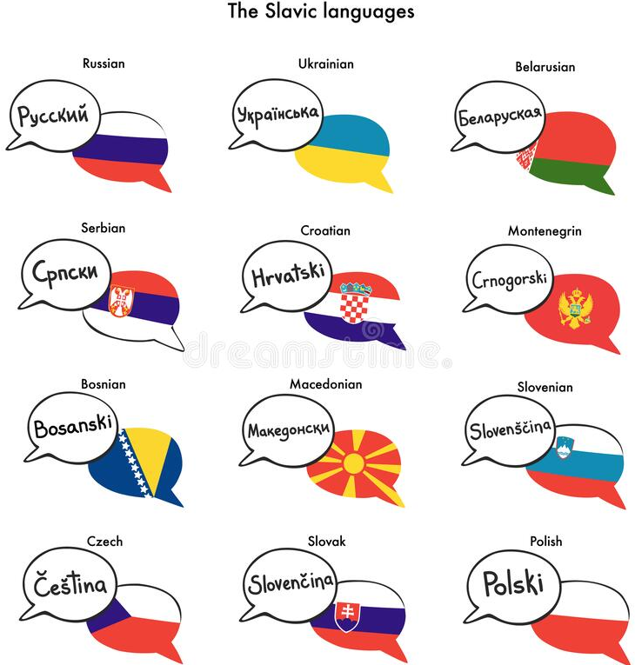
3. Methodology
3.1. Semantic classification of mais and maar
Fundamental semantic classification of mais and maar following the three-dimensional conception of the notion of contrast
Concession
Correction
Opposition
→ Pero, aber
→ Sino, sondern
→ А
(Anscombre & Ducrot, 1977)
(Anscombre & Ducrot, 1977)
(Mauri & Manzelli, 2008)
Notes:
This three-dimensional view of the notion of contrast is the basis of our three-dimensional semantic classification of ‘mais' and 'maar’. We see here the traditional distinction in French: there are two kinds of "mais", described by Anscombre and Ducrot. The categories of "mais" described by these authors are translated into two different morphemes in Spanish and German. It is interesting that we can extend this logic to justify the category of opposition as well. We must then look at the Slavic languages, which use a distinct morpheme for 'but', often characterised by the letter 'a'.

Slide 10
3. Methodology
3.1. Semantic classification of mais and maar
Monolingual studies FR (Corpus de Référence du Français Contemporain) and DU (SoNaR corpus)
Functional concessive and corrective subcategories
Concession | Correction | Opposition
Simple | Simple | Simple
Additive | Correlative
Non-verbal (oral)
Non-verbal (written)
Notes:
This classification was tested in monolingual corpus studies, and it appeared to us that it was relevant to distinguish some functional categories of "mais" and "maar", referring mainly to Adam's work, mainly linked to the concession,

Slide 11
3. Methodology
Concession | Correction | Opposition
Simple He is a Republican, but he is honest. (Lakoff, 1971) | Simple Pierre is not French but Danish. (Birkelund, 2009) | Simple Jan is tall, but Piet is short. (Foolen, 1993)
Additive This book is interesting but it is also a nice edition. (Lamiroy & Van Belle, 1995) | Correlative Luc drank not only the wine but also the beer. (Muller, 1991)
Non-verbal (oral) But do something! (Adam, 1990)
Non-verbal (written) […] le branle furieux des roues. // Mais Claude était monté sur le banc, d'enthousiasme. (Rabatel, 1999)
Notes:
Here you have a comprehensive overview of the semantic analysis of 'mais' and 'maar' in this study. For ease of use, I have translated the examples used in English (except for one, as it is not possible to use 'but' in this case).
First, we have the simple concession, where one fact is supposed to prevent another fact from happening, but it did not have that effect. Then we have the additive concessions, where 'purpose' is combined with 'also'. In the last two concessive categories, 'but' does not act on the elements within the discourse, but on the progression of the discourse itself. It can be oral or written. These "buts" are typically found at the beginning of sentences, or even paragraphs, and allow the story to progress, to introduce new elements.
Then we have the corrective “but”, where something presented as totally wrong is replaced by something else.
And finally, we have the oppositive “but”, where we compare two things that are presented in this context as opposites,

Slide 12
3. Methodology
3.1. Semantic classification of mais and maar
Parallel studies (Dutch Parallel Corpus, DU→FR//FR→DU)
Identification of three possible translation strategies
Literal translation | Other marker | Unmarked relationship (Corminboeuf, 2014)
(maar → mais) | (maar → cependant) | (maar → ø)
Notes:
Once the monolingual studies were completed and our semantic classification of 'mais' and 'maar' was done, we could move on to the parallel studies (in the Dutch Parallel Corpus). We then developed the following table, which summarises the three different possible translation strategies for the markers we are studying.
The first is the literal translation, where 'maar' is simply translated by its French equivalent 'mais'. The second strategy is to translate 'maar' by a marker other than 'mais' in French, and the third strategy occurs when the marker appears to be untranslated, resulting in what Corminboeuf calls an unmarked relationship. In reality, the original idea of the sentence is still there, but it is expressed in another way, either by a verb or by a phrase. 12MIN 45

Slide 13
3. Methodology
3.2. Didactic experiment
Participants:
12 professional translators (at least 5 years experience as DU→FR translators, and 75% of financial income from translation, PACTE, 2008)
19 final year students at the translation faculty of the University of Mons
Native French speakers translating from Dutch into French
Notes:
Translators who wished to participate in the experiment had to be considered as professional translators according to the PACTE criteria, i.e. the translator must have been working as a translator for at least 5 years from Dutch into French, and translation must represent at least 70% of his/her financial income. The students were in their final year at the translation faculty of the University of Mons and had Dutch in their language combination. Students and professionals had to have French as their mother tongue.

Slide 14
3. Methodology
3.2. Didactic experiment
Text:
Journalistic text (488 words) in authentic Dutch
Contains various occurrences of maar (most typical Dutch contrastive marker)
1 hour 30 minutes, all tools allowed except MT
Reflective survey on the translation strategies used by participants
Concession | Correction | Opposition
Simple (5) | Simple (1) | Simple (2)
Additive (1) | Correlative (1)
Non-verbal (oral) (1)
Non-verbal (written) (1)
Notes:
When it comes to the methodology of the experiment itself, the experiment consisted of the translation of an authentic Dutch text into French. The text was 488 words long, and the time allowed for translation was 1.5 hours (a time that was calculated according to the average duration of the translation exams at the University of Mons). The text contained authentic occurrences of "maar" covering different semantic categories of the marker.

Slide 15
4. Results
4.1. Students’ results
Notes:
Je décrirai ici les principales tendances monolingues des étudiants

Slide 16
4. Results
4.2. Professionals’ results
Notes:
Je décrirai ici les principales tendances monolingues des professionnels

Slide 17
4. Results
4.3. Similarities and differences
Similar tendencies between students and professionals:
Simple concessions and additive concessions are mostly translated literally
Simple and correlative corrections are generally translated by an unmarked relationship
Oral non-verbal concessions show different, but not significant, strategy statistics (p = 0,22)*
*Fisher Exact Test, results are significant when p < 0.05

Slide 18
4. Results
4.3. Similarities and differences
Two significant differences:
Professional translators use literal translation less often than students to translate oppositive maar (p = 0,028)*
Professional translators use literal translation more often than students to translate written non verbal concessive maar (p = 0,0056)*
*Fisher Exact Test, results are significant when p < 0.05

Slide 19
4. Results
4.3. Similarities and differences
Notes:
To make it clearer, I have listed them again here. We see that professional translators use the other markers strategy at least three times more than students.

Slide 20
5. Conclusions
Most translational strategies between students and professionals are similar
Majority of literal translations for simple concessions and additive concessions; unmarked relationships for corrections
Oral non-verbal concessions are an "in-between" (majority of unmarked relationships for students, but majority of literal translations for professionals), but not significant

Slide 21
5. Conclusions
Two semantic categories of "maar" differ from the others by showing significant differences in the use of translational strategies
Oppositive maar (greater variety of markers, and more unmarked relationships among professionals)
Written non-verbal concessive maar (literal translation never used by students, 40% for professionals)

Slide 22
5. Conclusions
Next steps:
Look at the variety of the “other markers” strategy
Conduct the same experiment for other markers covering the same contrastive semantic categories
Investigate the justification of the participants (link between strategies and explanations of the participants?)

Slide 23
6. References
Adam, J.-M. (1990). Eléments de linguistique textuelle. Liège: Mardaga.
Anscombre, J.-C. & Ducrot, O. (1977). Deux mais en français ? Lingua, 43(1), 23-40.
Birkelund, M. (2009). Pierre n’est pas français mais danois. Une structure polyphonique à part. Langue Française, 164, 123-135.
Corminboeuf, G. (2014). L’identification des relations de discours implicites : le cas de l’adversation. Présenté au Congrès Mondial de Linguistique Française, Berlin.
Dupont, M. (2019). Conjunctive Markers of Contrast in English and French. From Syntax to Lexis and Discourse (Doctoral dissertation, Université catholique de Louvain).
Foolen, A. P. (1993). De Betekenis van Partikels. Een dokumentatie van de stand van het onderzoek met bijzonder aandacht voor maar (Doctoral dissertation, Katholieke Universiteit Nijmegen).
Lakoff, R. (1971). If’s, and’s and but’s about conjunction. In Charles J. Fillmore & D. Terence Langendoen (Eds.), Studies in Linguistic Semantics (pp. 3-114). New York: Holt.

Slide 24
6. References
Lamiroy, B. & Van Belle, W. (1995). Connectives of contrast and concession in Dutch and French. Leuvensche Bijdragen, 84(3), 397-418.
Mauri, C., & Manzelli, G. (2008). Mappe semantiche tra sincronia e diacronia: l'evoluzione delle strategie congiuntive e avversative nelle lingue slave. Linguistica e Filologia, 26, 75-103.
Müller, C. (1991). La négation en français. Syntaxe, sémantique et éléments de comparaison avec les autres langues romanes. Genève: Droz.
PACTE. (2008). First results of a Translation Competence Experiment: ‘Knowledge of Translation’ and ‘Efficacy of the Translation Process’. In J. Kearns (Ed.), Translator and Interpreter Training: Issues, Methods and Debates (pp. 104-126). London: Continuum.
Perrez, J. (2006). Connectieven, Tekstbegrip en Vreemdetaalverwerving. Een studie van de impact van causale en contrastieve connectieven op het begrijpen van teksten in het Nederlands als vreemde taal (Doctoral dissertation, Université Catholique de Louvain).
Rabatel, A. (1999). Mais dans les énoncés narratifs, un embrayeur du point de vue et un organisateur textuel. Le français moderne, 67(1), 49-61.

