Slide 1




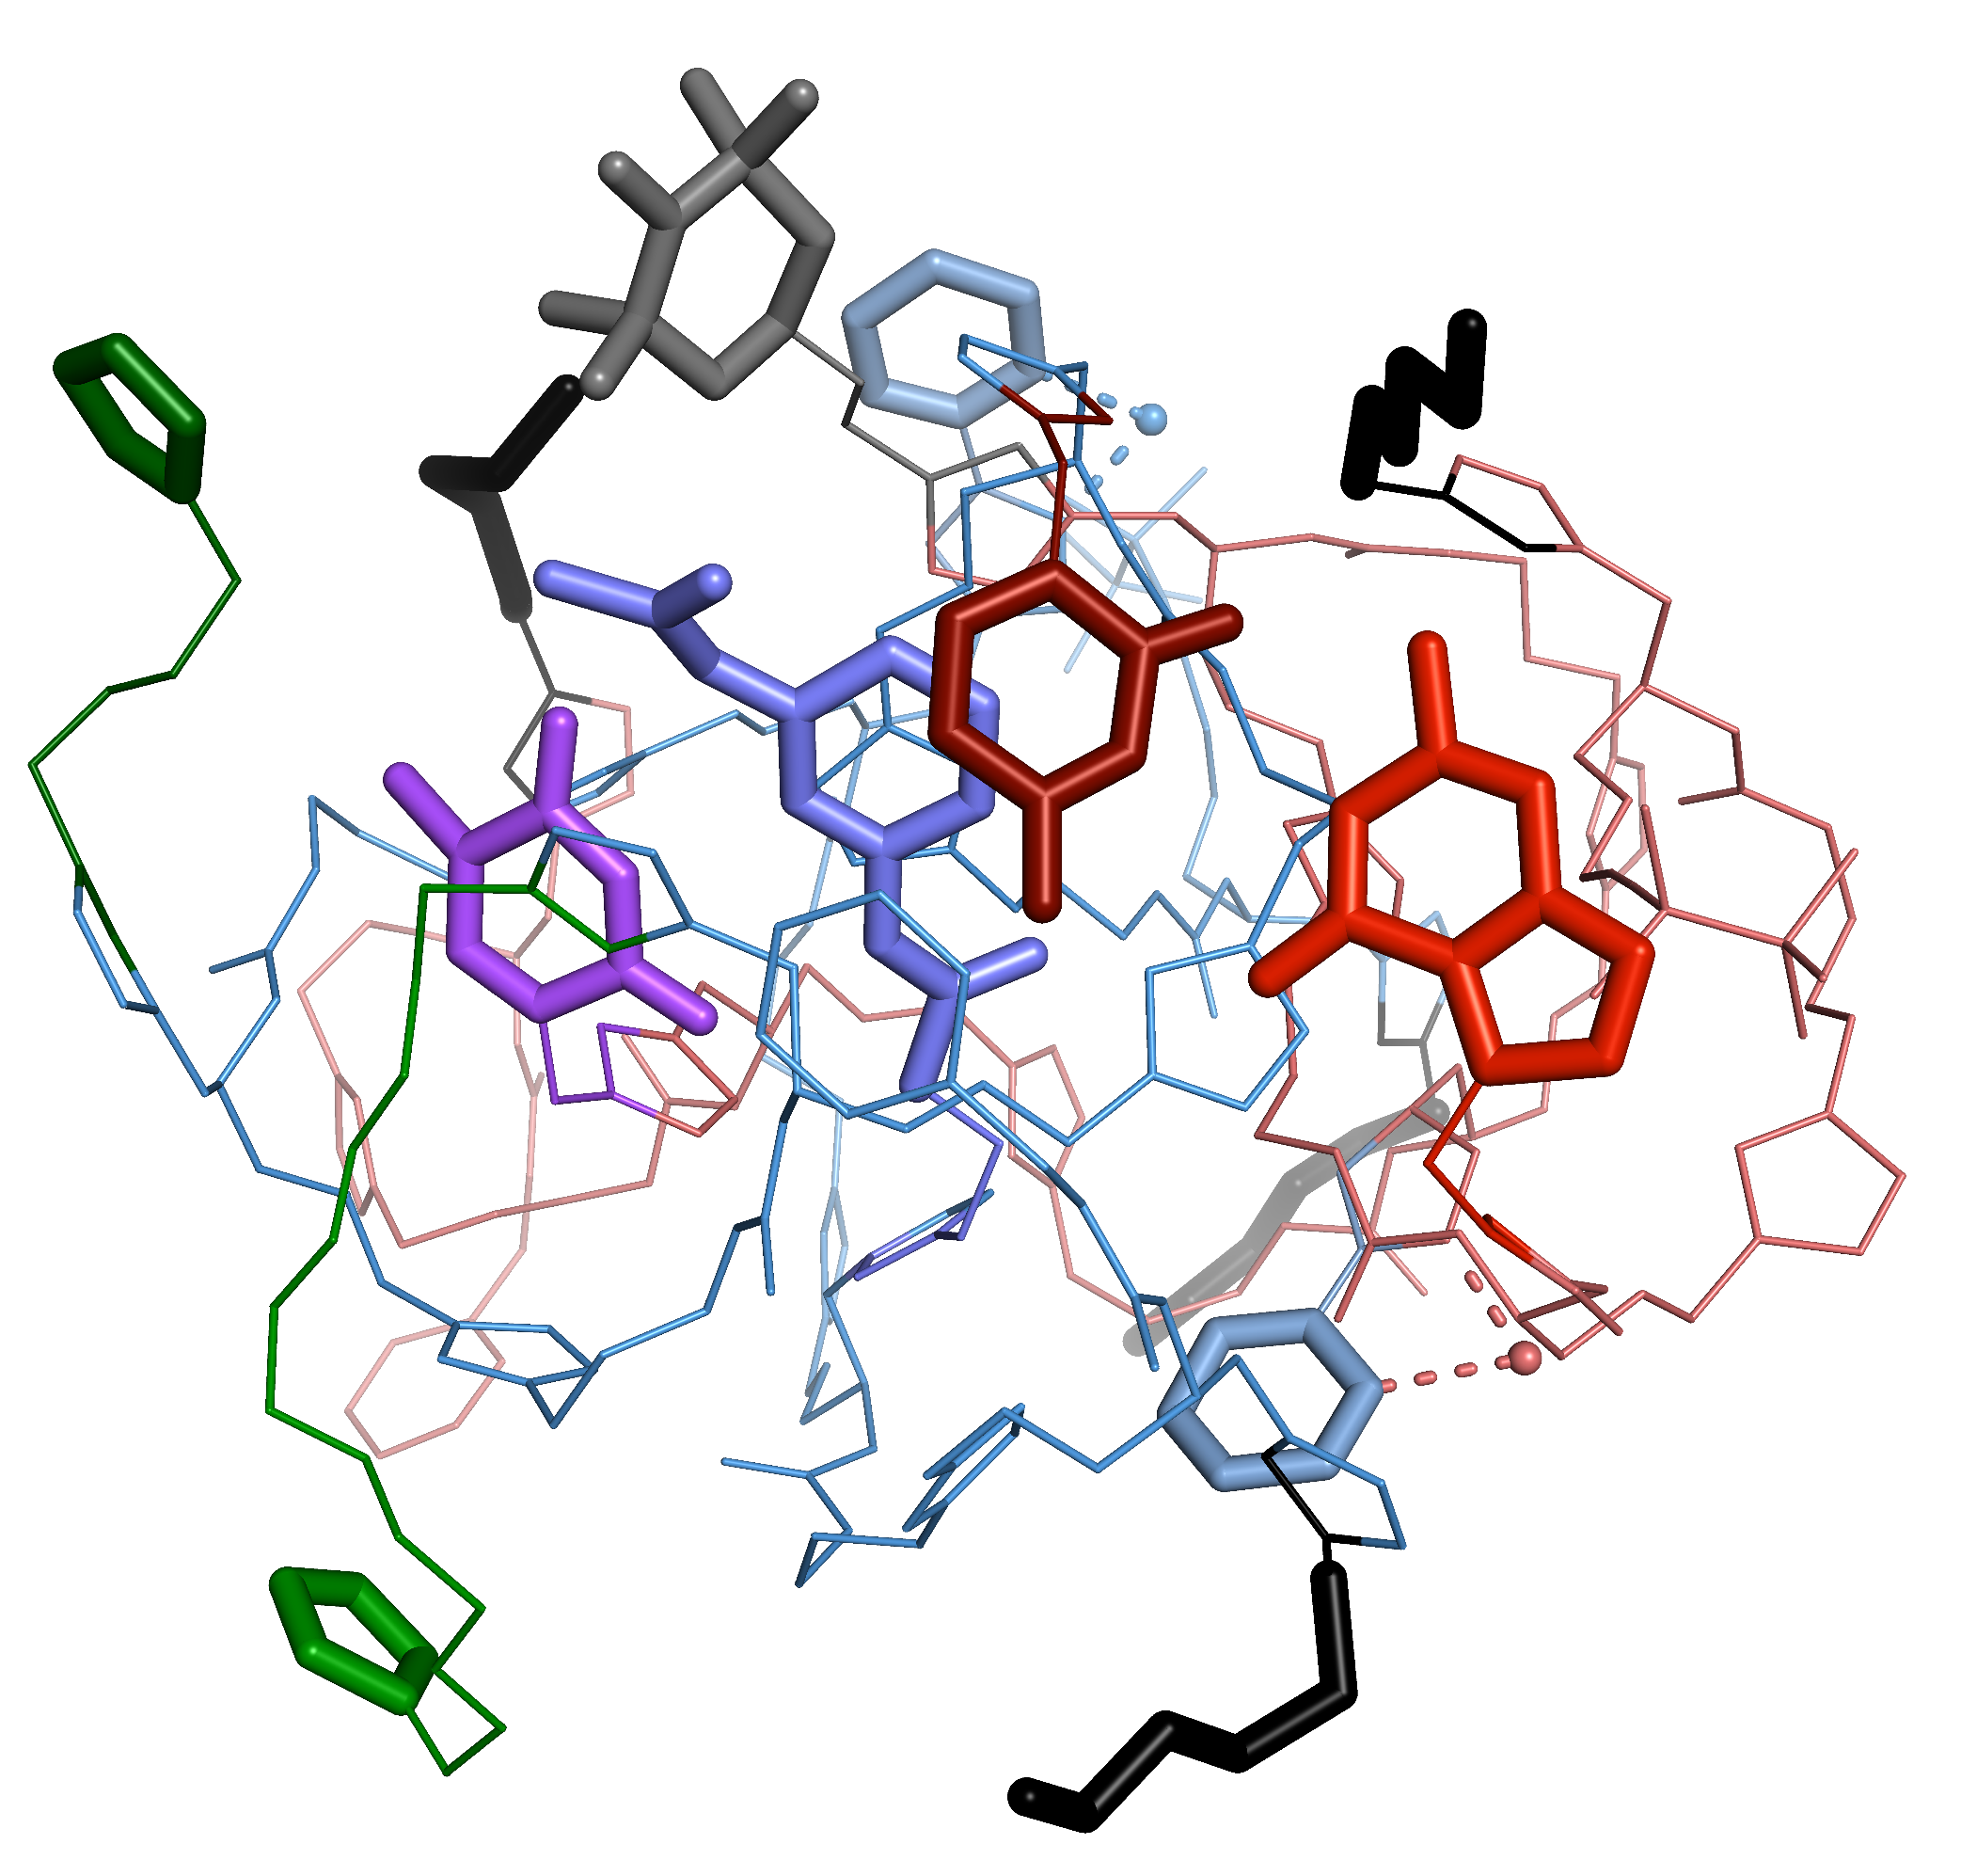
Understanding the Self-Assembly of Precision Catalytic Oligomers through Molecular Dynamics Simulations
David Dellemme,ª Qian Qin,^{b} Mathieu Fossépré,ª Karine Glinel,^{b} Alain M. Jonas^{b} and Mathieu Surinª
a) Laboratory for Chemistry of Novel Materials, CIRMAP, University of Mons, 20 Place du Parc, Belgium
b) Institute of Condensed Matter and Nanosciences, Bio- and Soft Matter, Université catholique de Louvain, 1 Croix du Sud, Belgium
Sequence-defined oligomers Preorganized functional units
Simulation methodology
2D structure
AMBER suite of programs^{[1]}
GAFF 2.11 force-field^{[2]}
Implicit solvation (acetonitrile)
Simulation length = 10 µs, timestep = 1 fs
Snapshot saved each ns
10,000 conformations X 2 independant replicas
Multifunctional catalytic system: TEMPO, Pyridyltriazole copper ligand, Imidazole
Supramolecular assembly of the chains Encounter of the catalytic moieties Catalytic activity
3D snapshot
Per-residue decomposition of the interactions
Hydrogen-bonds
Binding enthalpy
O_{b}
O_{b}
O_{a}
O_{a}
O_{a}
O_{b}
O_{a}
O_{b}
Network^{[3]}
Modular network
Compact, globular, disordered duplex
Nucleobase derivatives are involved in the most persistent and most stabilizing interactions
Networks = average views of the system (only the contacts maintained ≥ 10 % of the time are kept)
Conclusion
References
A catalytically active system was designed through the use of self-assembled precision macromolecules
Assembly occurs through various interactions but mostly between the nucleobase derivatives
Molecular dynamics simulations allow us to investigate the structure and interactions of a supramolecular complex at the atomic scale
[1] R. Salomon-Ferrer, D. A. Case, R. C. Walker, Wiley Interdiscip. Rev. Comput. Mol. Sci. 2013, 3, 198.
[2] J. Wang, R. M. Wolf, J. W. Caldwell, P. A. Kollman, D. A. Case, J. Comput. Chem. 2004, 25, 1157.
[3] S. Kardas, M. Fossépré, V. Lemaur, A. E. Fernandes, K. Glinel, A. M. Jonas, M. Surin, J. Chem. Inf. Model. 2022, 62, 11.
This communication is supported by the French Community of Belgium in the framework of a FRIA grant

