Slide 1
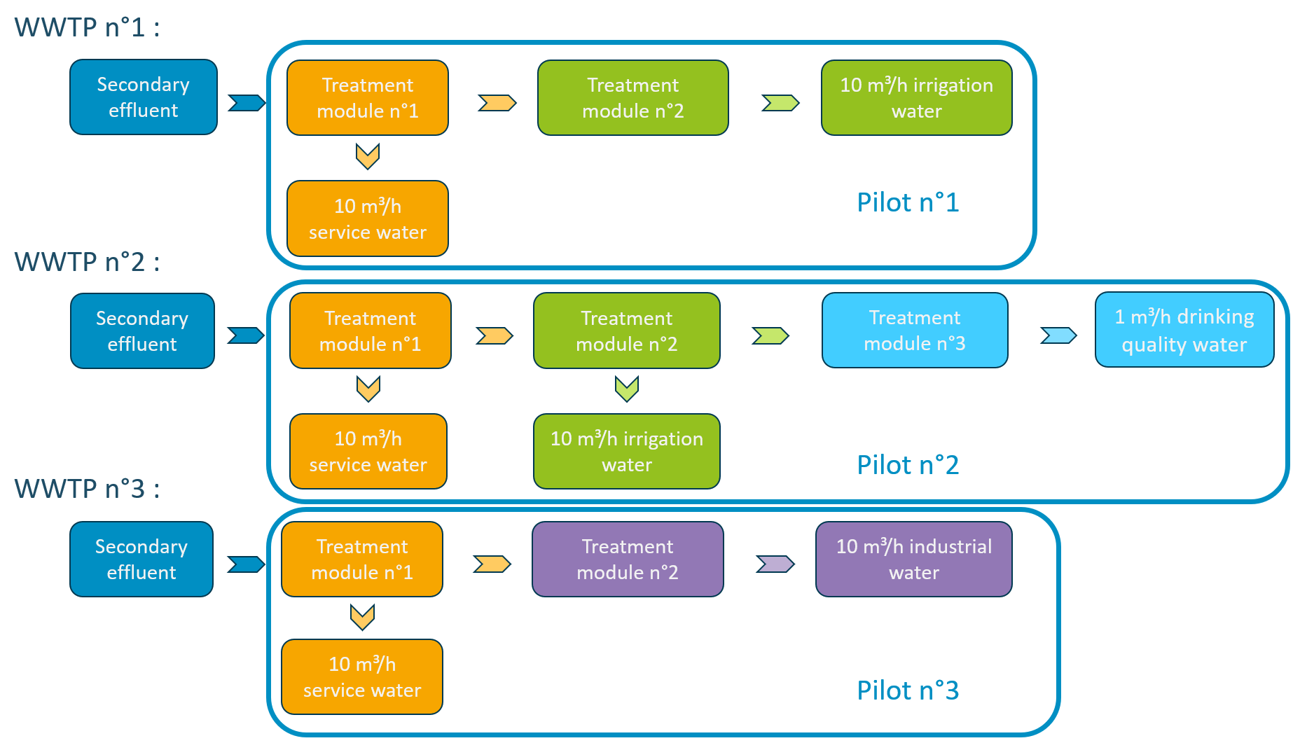
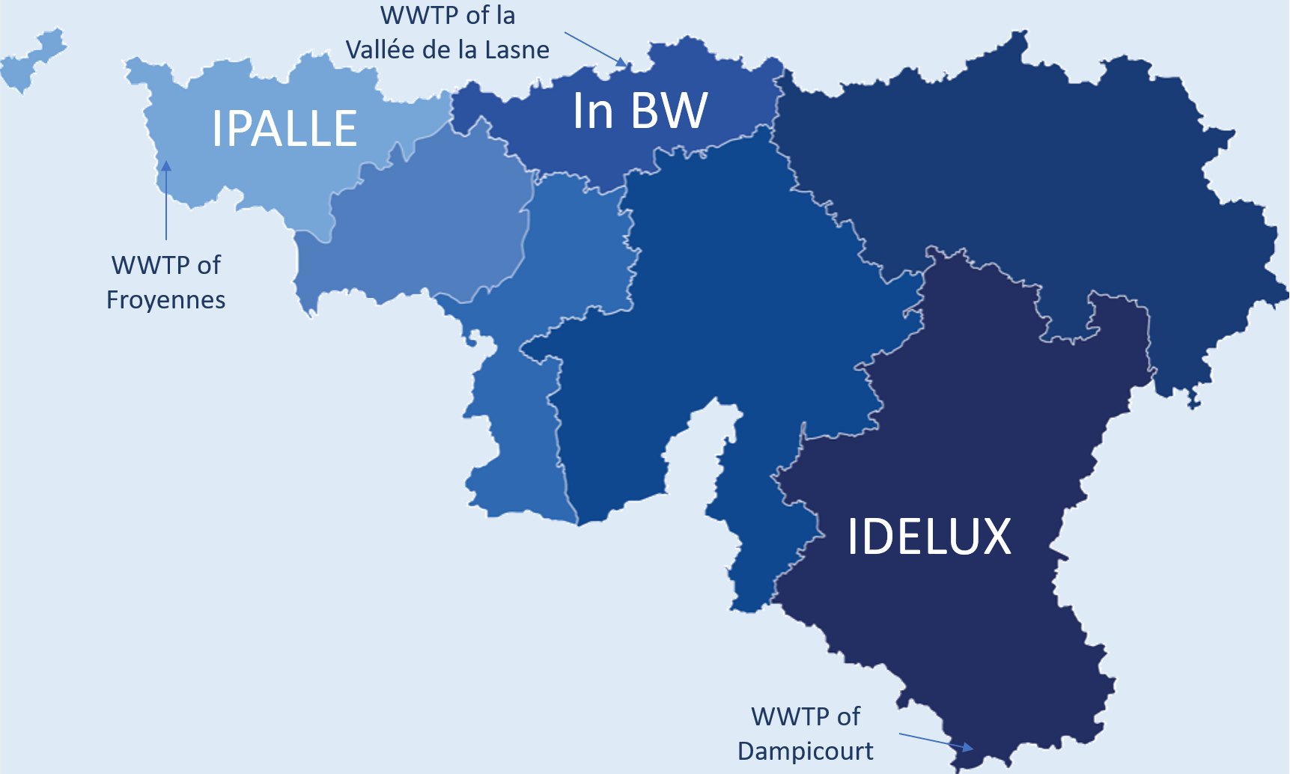
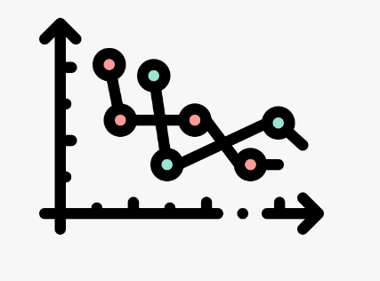
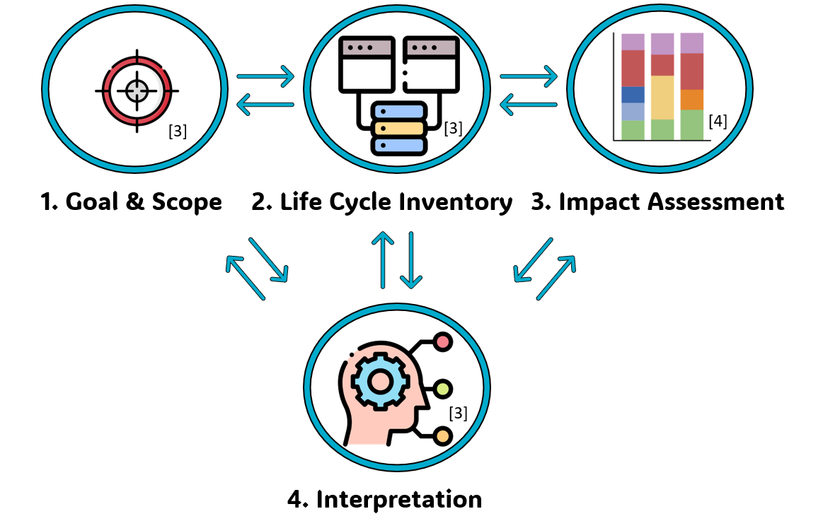
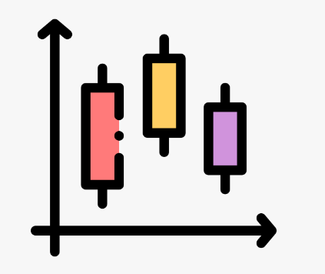
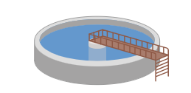
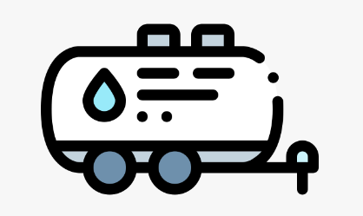
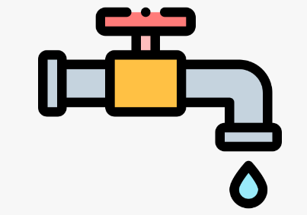
Feasibility study about treated municipal wastewater reuse in Wallonia
Estelle Lewillion and Anne-Lise Hantson
Chemical and Biochemical Process Engineering Department, Faculty, University of Mons, 56 rue de l’Epargne, 7000 Mons, Belgium
estelle.lewillion@umons.ac.be
Introduction
Despite its bad weather reputation, Belgium faces a high level of water stress. Its water availability is one of the lowest in Europe, with less than 2,000 m³/inhabitant/year [1]. Therefore, three REUSE-related pilot projects have been approved within Wallonia's Recovery Plan to deal with this issue [2]. Their goal is to assess treatment methods for urban wastewater treatment plants secondary effluent to enable specific reuse as service water, irrigation water, industrial water or drinking water. The pilot installations will be compact, containerized and will be tested in situ at three distinct wastewater treatment plants.
Feasibility study steps
1. Preliminary study
2. Technical assessment
3. Economic assessment
4. Life cycle analysis
Secondary effluent data from the project's WWTPs gathering, assessment and comparison to legislative standards
Definition of treatment capacity needed for each water quality
Identification of potential treatment options
Microbiological and physico-chemical parameters of recycled waters analysis during a 1-year study
Statistical calculations and comparison to regulatory standards to confirm the achievement of suitable quality for the intended uses
Comparison of the CAPEX and the OPEX of water production processes
Calculation of the minimum cost of water needed to meet the cost-effectiveness of pilots over their lifetime
Comparison to the production cost of more conventional water sources.
LCA of 1m³ of recycled water production and comparison to tap water and WWTP effluent production on SimaPro software
Pinpointing the life cycle phase of the pilots contributing the most to their environmental impact
Identifying the least pollutant production method for a given water type
[3]
[3]
[3]
[4]
[3]
[3]
[3]
Expected outcomes :
Service water : Legionella pneumophila ≤ 1000 UFC/L
Irrigation water : E. coli ≤ 10 CFU/100mL, BOD5 ≤ 10 mg/L, TSS ≤ 10 mg/L, turbidity ≤ 5 NTU among others
Industrial water : E. coli ≤ 7000 CFU/100mL, COD ≤ 40 mg/L, SS ≤ 20 mg/L, Cl- ≤ 100 mg/L and Ptot ≤ 2 mg/L
Drinking water : quality equivalent to conventional tap water
An acceptable price to produce these non-conventional water types
Validation of the most cost-effective treatment chain for producing service and agricultural water
Verification of the environmental impact of the processes tested
Validation of the most eco-friendly treatment chain for producing service and agricultural water
Providing recommendations for the establishment of a legal framework for REUSE in Wallonia
Discussion
Our partners
References
[1] Thoeye, C., et al., (2005), Overview and background of water reuse practice in Flanders, Belgium [Technical Workshop: The Integration of Reclaimed Water in Water Resource Management].
[2] Plan de relance de la Wallonie. (s. d.). Consulté le 10 juillet 2023, à l’adresse https://www.wallonie.be/fr/plans- wallons/plan-de-relance-de-la-wallonie
[3] Icons made by Freepik from www.flaticon.com
[4] Icons made by BioRender from www.biorender.com

