Slide 1
FC-RELAX
Synthesis and relaxometric studies of Mn-complexes associated to silica nanoparticles.
Project supervisors:
Prof. Sophie Laurent
Dr. Celine Henoumont
Dr. Dimitri Stanicki

Slide 2
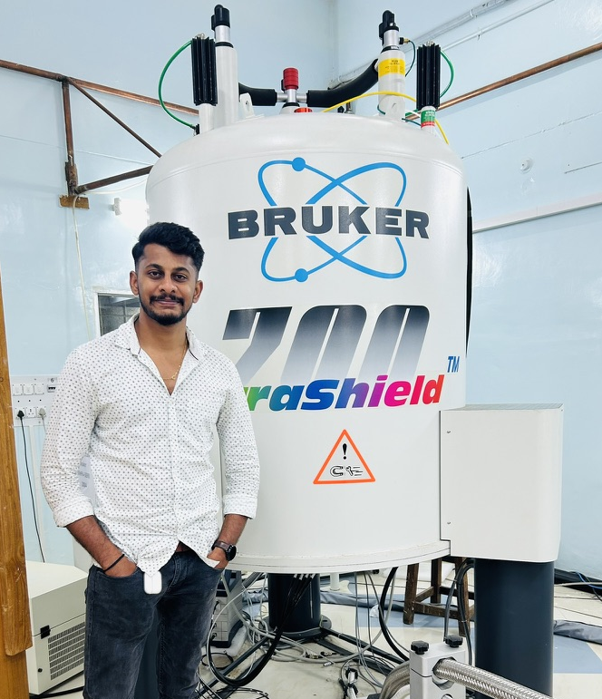



Introduction.
Name Surname- Guru kiran K R
Qualification-Msc in organic chemistry.
From- NMR research centre,
IISC Bangalore, India.
• First training event – April 14-21, 2024 •

Slide 3
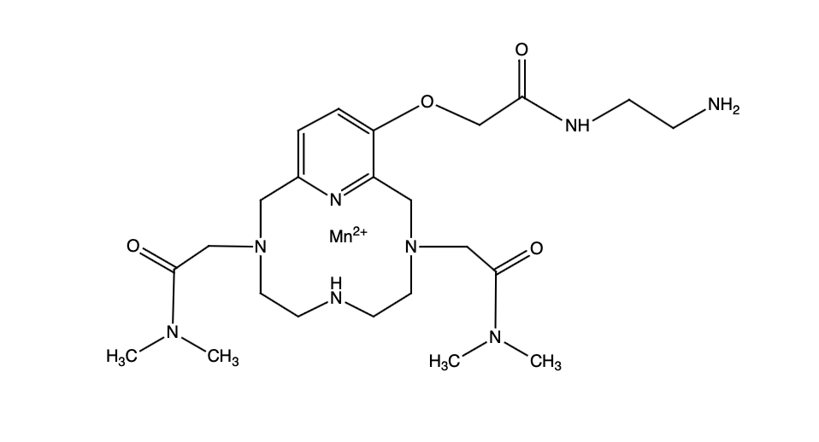
Aim.
Further Mn complexes will be coupled to silica nanoparticles, at the surface or inside the nanoparticles and a detailed relaxometric study of the different systems will be performed.
Objectives- The aim of the project is to develop highly efficient Mn-complexes as MRI contrast agents which are indeed suitable alternative to the gadolinium complexes which have toxicity issue.
+
3
NMR relaxometry
for biomedicine and
advanced materials

Slide 4
Task 1
Synthesis of stable pyclen-based Mn complexes as contrast agents.
Design synthesis, analyze structure, measure stability via spectroscopy and relaxometric studies.
NMR relaxometry
for biomedicine and
advanced materials

Slide 5
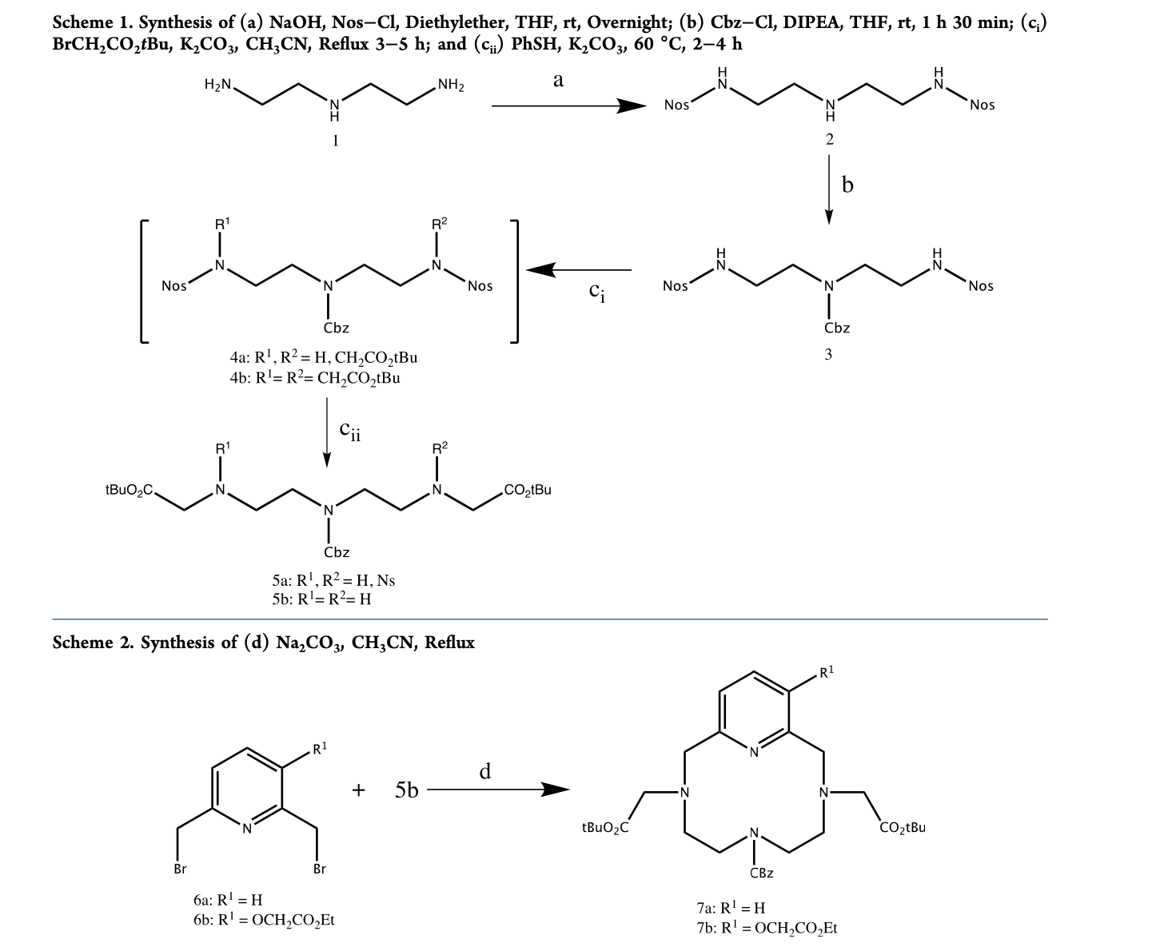
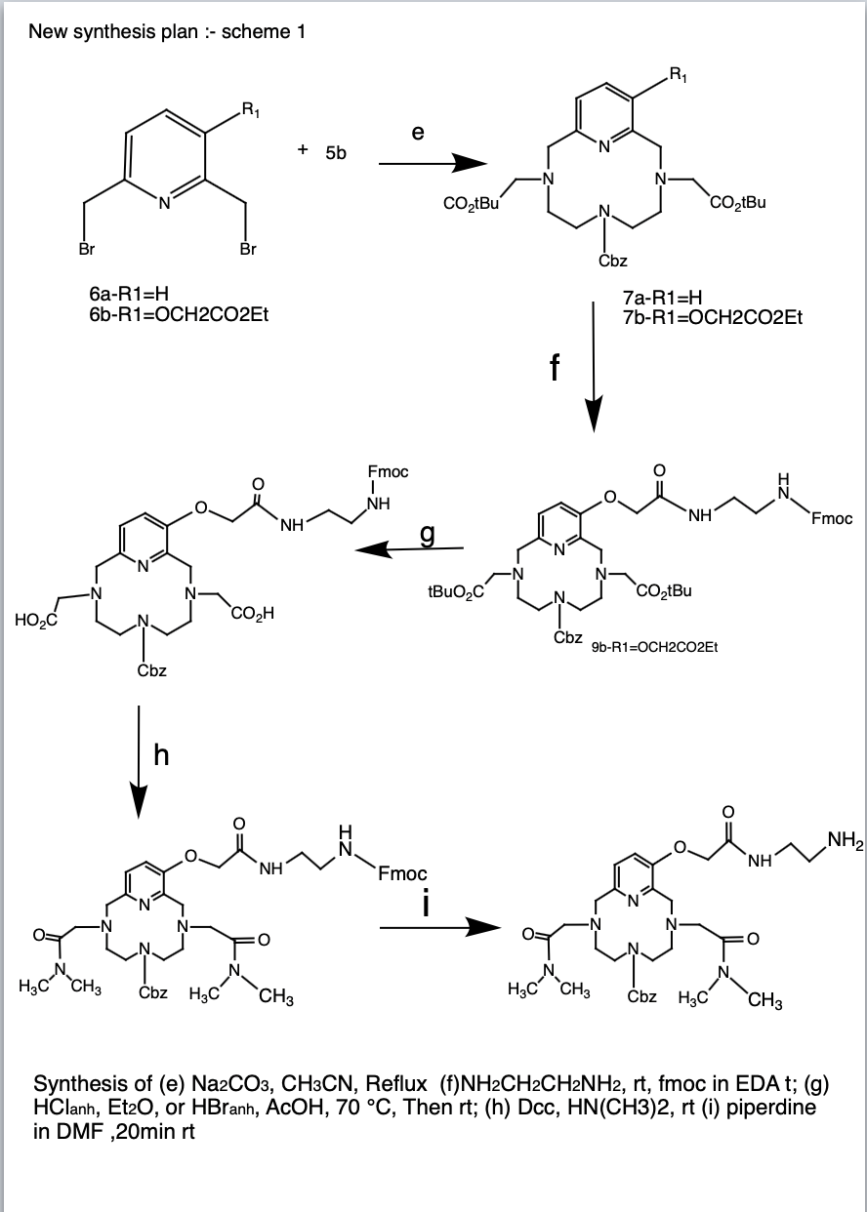
Synthesis plan
NMR relaxometry
for biomedicine and
advanced materials

Slide 6
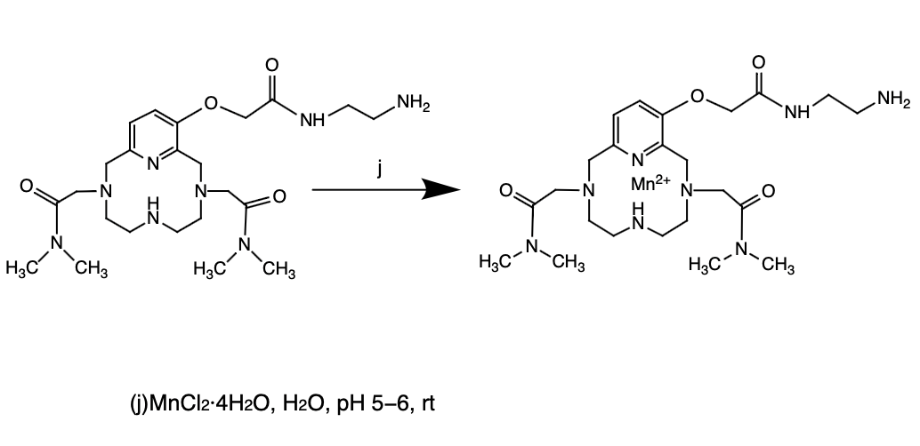
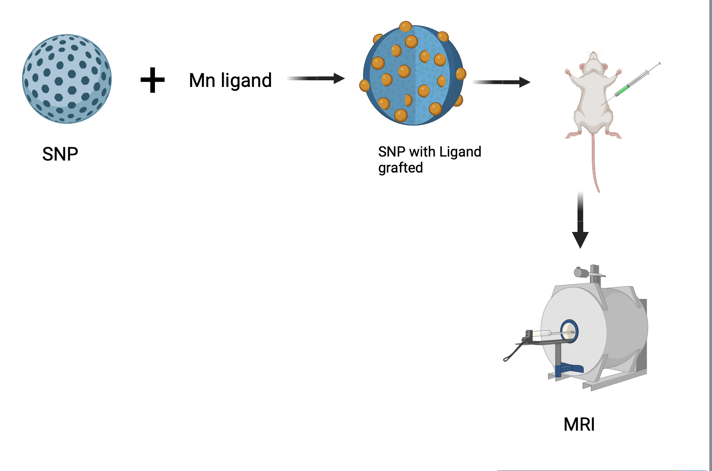
Synthesis Plan and Test.
Nano particles grafting
Final product
NMR relaxometry
for biomedicine and
advanced materials

Slide 7
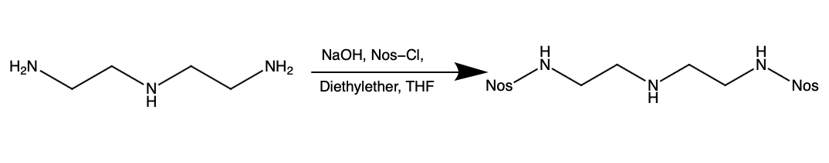
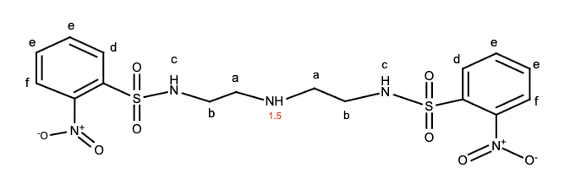
Results & Discussion- step-1 ;lower part (2-Nitro[N(2{2[(2-nitrophenyl)- sulfonylamino]ethylamino})-ethyl]benzenesulfonamide )
e
a
b
f
c
d

Slide 8
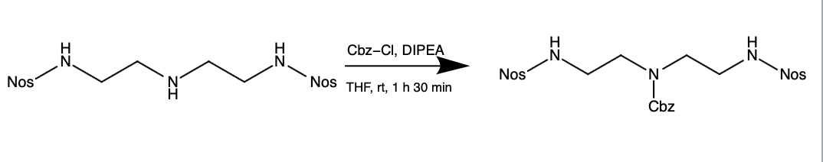
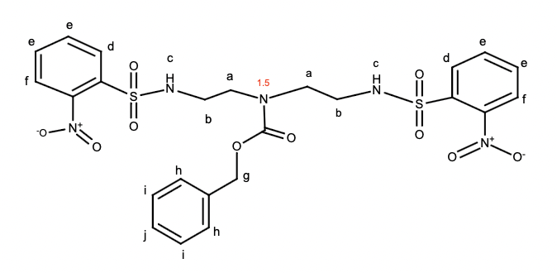
Step-2. (Benzyl N,N-Bis(2-((2-nitrophenyl)sulfonylamino)ethyl)- carbamate Compound )
j
e
d
g
h
c
b
a
f
NMR relaxometry
for biomedicine and
advanced materials

Slide 9
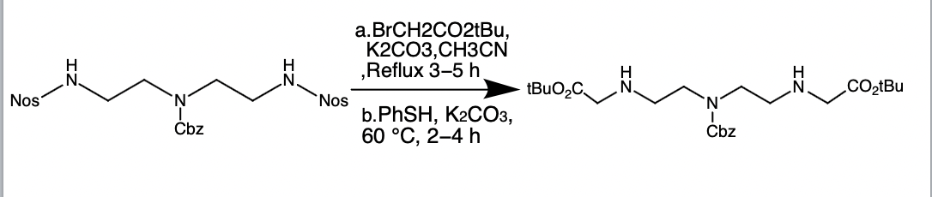
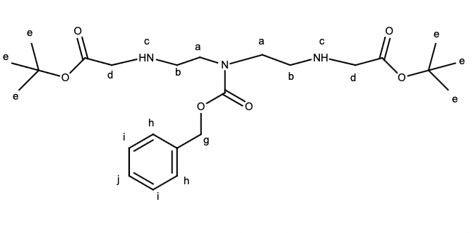
Step-3.(Di-tert-butyl 2,2′-((((Benzyloxy)carbonyl)azanediyl)bis(ethane- 2,1-diyl))bis(azanediyl))diacetate )
j
i
h
g
a
b
d
e

Slide 10
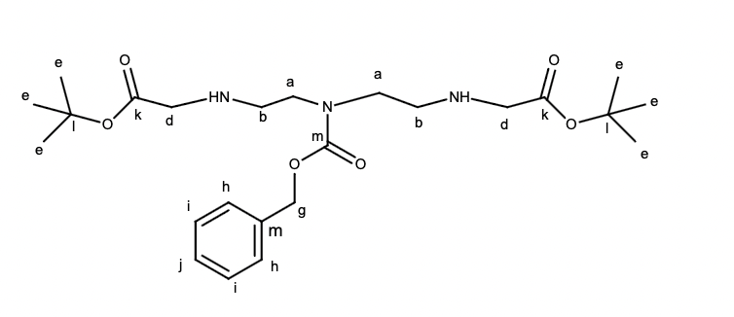
13-C NMR.
j
i
k
n
m
h
l
g
d
a
b
e

Slide 11
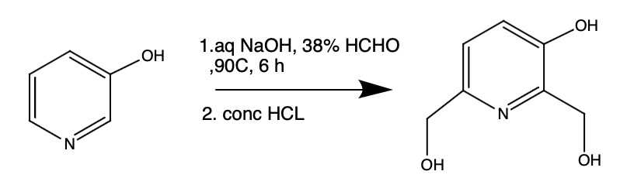
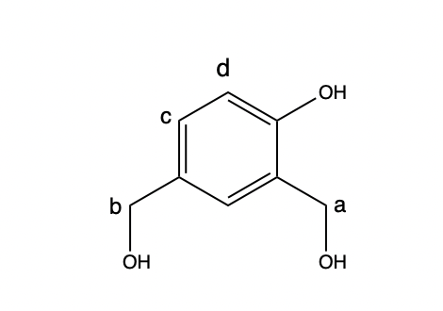
Step-1-Upper part (2,6-Bis(hydroxymethyl)pyridin-3-ol )
d
c
b
a

Slide 12
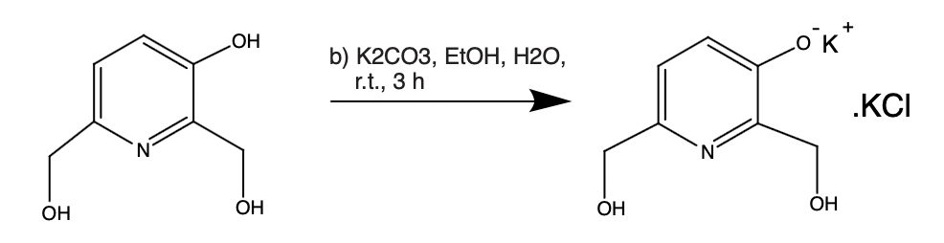
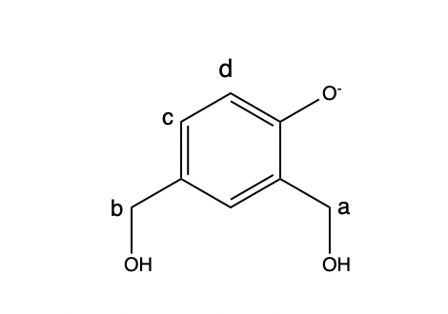
Step-2 (Potassium 2,6-Bis(hydroxymethyl)pyridine-3-olate)
d
c
b
a

Slide 13
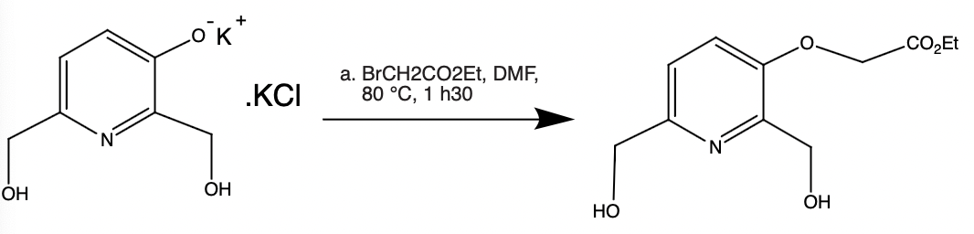
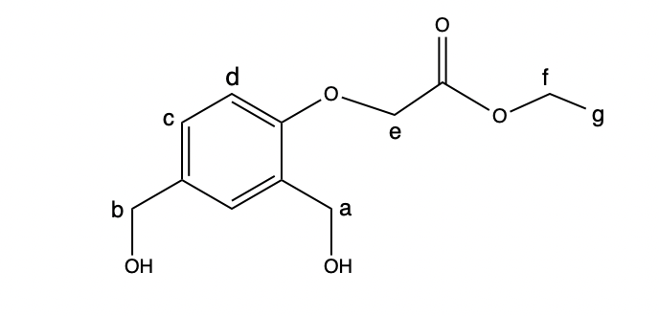
Step-3 (Ethyl 2-{[2,6-Bis(hydroxymethyl)-3-pyridyl]oxy}acetate)
a
e
g
d
c
b
f

Slide 14
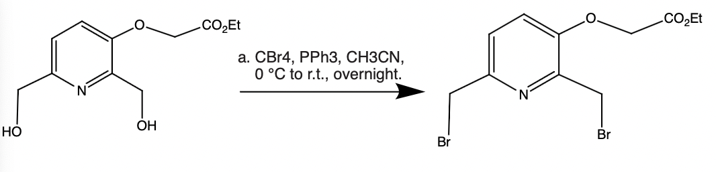
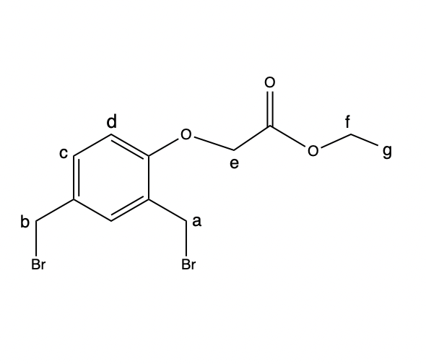
Step-4 (Ethyl 2-{[2,6-Bis(bromomethyl)-3-pyridyl]oxy}acetate)
e
g
b
d
c
a
f

Slide 15
TASK-2
Acquire relaxometric data for synthesized nano systems across magnetic fields (0.02 - 600MHz).
Conduct in vivo relaxometric study to thoroughly assess efficacy of nanosystems as MRI contrast agents.
Synthesis of various nanosystems based on silica nanoparticles encapsulated with different Mn-complexes.
Different parameters could be varied such as the size of the nanoparticles or the surface coating. Nanoparticles where the Mn-complexes are grafted at the surface of the particles will also be produced

Slide 16
CHARACTERISATION TECHNIQUES.
Spectroscopic techniques - Utilize NMR, UV-Vis spectroscopy and MASS spectrometry to comprehensively characterize Mn-complexes on silica nanoparticles, revealing structural and electronic insights.
Nanoparticle techniques- TEM, SEM, DLS assess silica nanoparticle size, morphology, and surface.
Biophysical Evaluation- NMR relaxometry evaluates Mn-complexes on silica nanoparticles as MRI contrast agents, vital for diagnostic applications.

Slide 17
EXPECTED RESULTS
Silica nanoparticles coupled with Mn-complexes externally or internally.
Expect increased relaxivity due to rotational correlation time increase (surface grafting) or nanoconfinement (encapsulation).
Conduct detailed relaxometric study to confirm hypotheses and enhance systems.

Slide 18
PLANNED SECONDMENTS.
Engaging in the synthesis and analysis of Mn and Gd complexes at BRACCO for 3 months(July-2024).
Conducting relaxometric studies of Mn-complexes on phantoms using whole-body FC imaging at the University of Aberdeen for 2 months (March-2025).
Researching protein corona of silica nanoparticles using high-resolution relaxometry at École Normale Supérieure Paris for 2 months (Nov-2025).
Olsztyn-Florence collaboration: Developing relaxation theory for paramagnetic systems in confined environments.

Slide 19
List of participating organisations
Consortium Member | Dept./Division /Laboratory | Scientist-in-Charge
1. Università degliStudi di Firenze(UNIFI). | Department of Chemistry, Magnetic Resonance Centre(CERM). | Giacomo Parigi.
2. Uniwersytet Warminsko-Mazurski in Olsztyn. | Department of Physics and Biophysics. | Danuta Kruk.
3. Université de Mons. | General, Organic and Biomedical Chemistry. | Sophie Laurent.
4. Instituto Superior Tecnico | Department of Physics. | Pedro Sebastiao.
5. University of Rostock | Department of Chemistry. | Ralf Ludwig.
6.University of Aberdeen | Department of Biomedical Physics. | Lionel Broche.
7.Ecole normale supérieure | Department of Chemistry | Fabien Ferrage.
8. Stelar s.r.l.u. |  | Gianni Mario Ferrante.
9. Bracco Imaging S.p.A. | Department of Chemistry | Zsolt Baranyai.
`10. Resonance Systems GmbH. | R&D | Leonid Grunin

Slide 20
Acknowledgements
European Union HORIZON-MSCA-DN-2021,
project FC-RELAX no. 101072758

Slide 21


