Slide 1
Beyond Linguistics Borders: Teaching Chinese as a Foreign Language in French-speaking Belgium
Manon HAYETTE
University of Mons, ChinEAsT Laboratory

Slide 2
Advent of Chinese teaching in French-speaking Belgium
Creation of the Belgium-China Association in Brussels in 1957 => at first, not centred on cultural and education matters.
In the 1980s, in the wake of the opening and reform policy, the arrival of the first generation of Chinese language teachers in Belgium, originally French-speaking Chinese students.
Zhang Guoxian (1954 – …) included teaching curricula aimed for adults within the Belgium-China Association after the founding of the Belgian-Chinese Chamber of Commerce, which has focused on economic matters.
In September 2006, the Confucius Institute opened its doors in Brussels, within the walls of the Belgium-China Association => institutionalization of Chinese language teaching.

Slide 3
Chinese teaching in French-speaking Belgium universities
At first, Chinese language teaching is only included within translation training programs.
First, in 2005: the then “Institut supérieur des traducteurs et interprètes”, now included in a faculty within the Université libre de Bruxelles, in collaboration with Institut libre Marie Haps and Institut supérieur Cooremans => founded by Xu Jianping (student of Zhang Guoxian’s) and Éric Florence
Second, in 2015: Faculty of Translation and Interpreting – School of International Interpreters, within the University of Mons => founded by Zhang Guoxian
Teaching starts from zero.

Slide 4
Chinese teaching in French-speaking Belgium universities
More recently (from the 2010s), Chinese language programs are created as part of China studies curricula (“Master in Modern Languages and Letters”)
Université libre de Bruxelles (2012) => founded by Vanessa Frangville
Université de Liège (2024) => founded by Andreas Thele, aimed at training both in Chinese and in Japanese.
These two Masters request a prior knowledge in Chinese and are more focused of literature and humanities than on language or communication competencies.

Slide 5
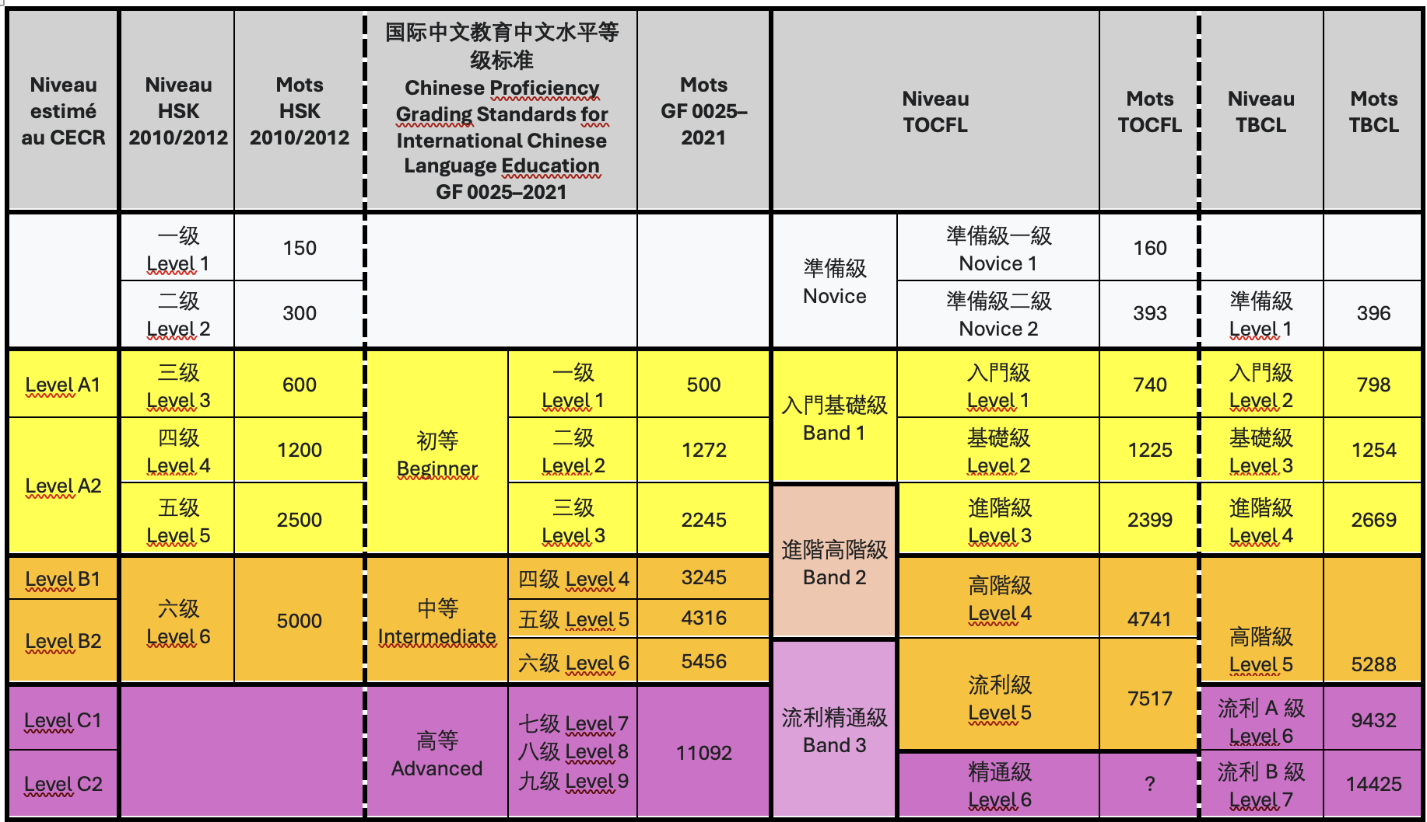
Benchmarks for Chinese teaching

Slide 6
Vocabulary teaching methods
Structuro-Global Audio-Visual Methodology (SGAV) => UMONS
Focused on the global understanding of the situation dialogue through audiovisual sources
Repetition of structures (drill exercises) without any explanations or definitions
Vocabulary lists and bilingual dictionaries (paper or online)
No context given; examples are rare;
Tend to privilege so-called equivalences;
Mentioning of all the possible meanings with no care of diachronic evolution

