Slide 1


A Multi-Criteria Decision Analysis Framework for Asset Management of Medical Equipment in Crisis Context
Molk Souguir
Lucas Equeter & Pierre Dehombreux
Machine Design and Production Engineering Unit
Faculty of Engineering - University of Mons
ESREL - Stavanger June 2025

Slide 2
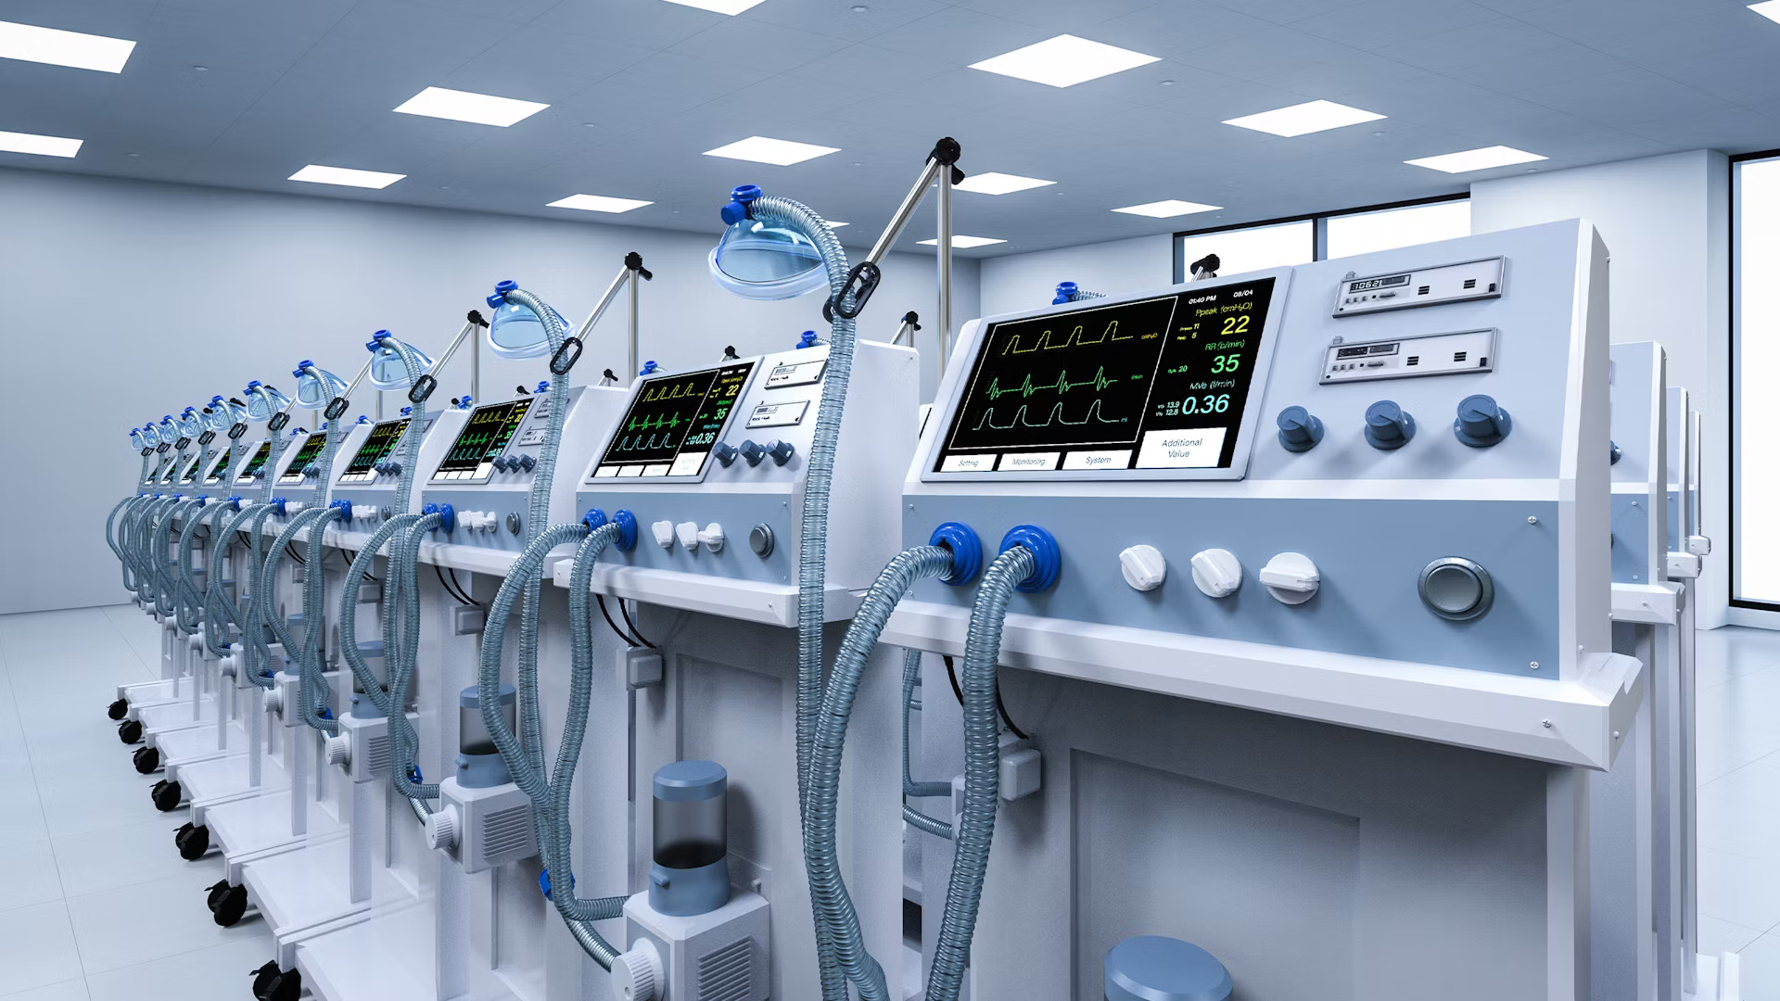

Research goals
Study the effect of delay of the replacement of medical equipment (ventilators case) on the hospital’s investment and maintenance policy.
Design of a multi-criteria decision-making tool to help the management of maintenance in hospitals .
Study the effect of a crisis on the decision-making process and contribute to the hospital’s readiness in case of it.

Slide 3


Introduction
Medical equipment fleet in a mid to large-sized hospital.
Failures

Slide 4
Introduction
Medical equipment fleet in a mid to large-sized hospital.
Failures
Criteria
Decision

Slide 5
Introduction
Medical equipment fleet in a mid to large-sized hospital.
Failures
Criteria
Decision
Budget
Cost
Safety
...

Slide 6
Introduction
Medical equipment fleet in a mid to large-sized hospital.
Failures
Criteria
Decisions
Budget
Investment
policy
Maintenance
policy
Cost
Safety
...

Slide 7




MultiCriteria Decision Analysis Methods
Several scenarios
Several criteria
Complicated methods
Multiple data sets
Difficult decision

Slide 8
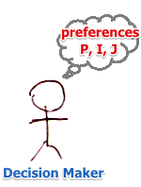
Multicriteria Decision Analysis
A set of tools designed to help decision-makers evaluate and prioritize multiple alternatives, according to several criteria.
A multicriteria process consists in:
comparing, ranking or sorting m actions/alternatives
using different points of view simultaneously
individually described by n criteria
each with a qualitative or quantitative expressions

Slide 9



Validation of MCDA approach by CHwapi
The utility of MCDA methods in medical equipment management in hospitals has been validated by : the hospital financing this PhD project.
Purchase department
Maintenance department
Infrastructure department
IT department
Medical staff
The criteria (from literature)
Suggesting :
Other criteria
Other applications for the MCDA methods in a hospital
For a
previous
model
Decision alternatives
Methodology
Notes:
In a previous model presented to the hospital’s committee representing the medical staff, the purchase department and the technical departments, The criteria found and in literature, the different decision alternatives and results were approved and the methodology was adopted by the hospital for further decisions.

Slide 10


Medical equipment management
1
2
3
Techno-economic study of the CCU chain
Experimental study
Cu/ZnO/ZnO₂
Investment
policy
Types of maintenance
Modes of maintenance

Slide 11
1
2
3
Techno-economic study of the CCU chain
Experimental study
Cu/ZnO/ZnO₂
Equipment purchase strategy
Budget planning
Investment
policy
Types of maintenance
Modes of maintenance

Slide 12
1
2
3
Experimental study
Cu/ZnO/ZnO₂
Corrective maintenance
Scheduled preventive maintenance
Investment
policy
Types of maintenance
Modes of maintenance

Slide 13
1
2
3
Techno-economic study of the CCU chain
Internal maintenance: Handled by the hospital’s technical staff.
External maintenance: Outsourced to the supplier.
Shared maintenance:
- Split between hospital staff and the supplier.
- Depends on contract terms.
Investment
policy
Types of maintenance
Modes of maintenance

Slide 14
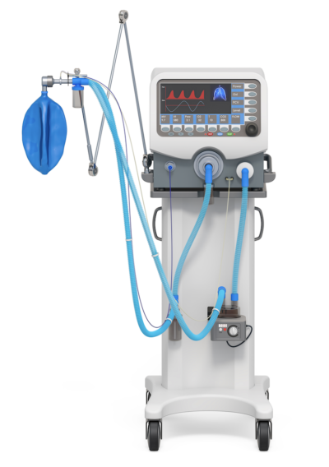
Case study: Medical Intensive care unit ventilators
Situation description
The situation
The equipment fleet is about to reach its lifespan
➔ time to take the replacement decision
What would be the effect of the decision on the hospital’s function in a :
Normal situation ?
Crisis situation ?

Slide 15

Decision Alternatives
While defining the problem of a decision-making situation, it is important to identify the possible solutions or decision alternatives.
This steps is important because it leads to:
The identification of the necessary criteria that affect the decision making
An efficient evaluation for these criteria for an optimal decision-making process.
Notes:
After defining the problem of a decision-making situation, it is important to identify the possible solutions or decision alternatives that present the choices to the decision maker from which one will be picked. This steps is important because it leads to the identification of the necessary criteria that affect the decision making along with guaranteeing the proper evaluation for these criteria for an optimal decision-making process.

Slide 16

Alternative
End of lifespan
A
life span of 8 years
life span of 8 years
year 8
year 10
Replacing the entire equipment fleet after 8 years
Investment policy
The preventive maintenance is handeled by the supplier during the lifespan of the equipment.
Internal corrective maintenance
External scheduled preventive maintenance
Maintenance policy

Slide 17
Alternative
End of lifespan
B
life span of 8 years
+ 2 years
life span of 10 years
year 8
year 10
Replacing the entire equipment fleet after 10 years
Investment policy
Year8-y10
2 years of full internal corrective and preventive maintenance
8 years of Internal
corrective maintenance and
external scheduled
preventive maintenance
Maintenance policy
Y10-y18

Slide 18
Alternative
End of lifespan
C
life span of 8 years
year 8
year 10
Replacing 25% of equipment fleet after 10 years
Replacing 75% of equipment fleet after 8 years
Investment policy
(Keeping 25% of the equipment for extra 2 years)
Y8-y16
Y16-y18
8 years of Internal corrective maintenance and
External scheduled preventive maintenance for 75% of equipment
2 years of full internal corrective and preventive maintenance for 25% of the equipment (beyond its designed lifespan)
Maintenance policy

Slide 19
Criteria
The selected criteria for this decision-making process are :
Cost of ownership(€)
Patient safety
Uniformity
Clinical and technology features
Procurement and logistics
Staff satisfaction

Slide 20
Criteria evaluation: Cost calculation
Quantitative Evaluation
These are data related to the preventive and corrective maintenance of a ventilator:
Failure Type | Spare part cost (€) | Repair Duration (Per Unit) | Responsible Staff | Hourly salary | Weibull Parameters
Internal Battery Failure | 260 | 30 minutes | Biomedical Engineer | 60€/h | β= 1,8 , η= 4,26 years
Flow Sensor Error | 70 | 20 minutes | Biomedical Technician | 50€/h | β= 1,8 , η= 2,22 years
Corrective
maintenance
Intervention | Frequency | Estimated Time per Unit | Total Time for 60 ventilators/ 1 intervention (h) | Responsible Staff | Hourly salary
Preventive inspection and testing : Inspect physical damage, run a performance check, test sensors and alarms, clean filter | Every 1 year | 2 hours | 120 hours | Biomedical Engineer | 60€/h
Internal Battery Replacement | Every 2 years | 30 minutes | 30 hours | Biomedical Engineer | 60€/h
Flow Sensor Replacement | Every 1 year | 20 minutes | 20 hours | Biomedical technician | 50€/h
Scheduled
Preventive
maintenance

Slide 21

Criteria evaluation: Cost calculation
The cost of 1 ventilator is 30.000 € .
Over the 8 years of lifespan of a ventilator, the PM cost is included in the purchase contract, so the total maintenance cost = CM Cost.
➔The preventive maintenance cost will only be added to the sum of costs when the equipment is still in service for more than the recommended lifespan (The PM becomes internal on that interval of time, it is no more covered by the supplier)
Note : The input values are realistic but do not correspond to the hospital’s real data which remains confidential.

Slide 22
Patient safety criterion evaluation
Qualitative Evaluation
Patient safety criterion: The potential maintained equipment should not lead to injury or even death of patients.
This criterion is important for risk estimation . It measures the way the equipment was able to minimize the risks for the patient.
Description | Score | Evaluation
The equipment is not safe and not reliable for the treatment and might cause a discomfort, an inconvenience or delay in the treatment have side effects on the patient that might lead to death | 0 | Unacceptable
The equipment is reliable for treatment but might cause a discomfort, an inconvenience or delay in the treatment or have side effects on the patient. | 2,5 | Poor
The equipment is totally safe for the patient and does not cause injury or death threat to the patient but might be uncomfortable and cause an inconvenience or delay in the treatment. | 5 | Average
The equipment is totally safe for the patient and does not cause injury or death threat to the patient but might be uncomfortable | 7,5 | Good
The equipment is totally safe and comfortable for the patient and does not cause discomfort, injury or death threat to the patient | 10 | Excellent
The score description table of the patient safety criterion

Slide 23
Uniformity criterion evaluation
Uniformity criterion: This criterion describes the compatibility of the equipment to the hospital installations, tools and other similar equipment.
Description | Score | Evaluation
The equipment is not compatible with the rest of the fleet of equipment and hospital installations. | 0 | Unacceptable
The equipment is not compatible with some of the fleet of equipment and requires installation adjustments | 2,5 | Poor
The equipment is compatible with some of the fleet of equipment and hospital installations | 5 | Average
The equipment is compatible with the rest of the fleet of equipment and requires installation adjustments | 7,5 | Good
The equipment is compatible with the rest of the fleet of equipment and installations. | 10 | Excellent
The score description table of the uniformity criterion

Slide 24
Technology and clinical features criterion evaluation
Technology and clinical features criterion : This criterion describes how modern the equipment features are. It describes the clinical and technological features effectiveness on the treatment of the patient and on the use of the equipment by the medical staff.
Description | Score | Evaluation
The equipment is outdated and has obsolete features that delays the patient’s treatment and causes difficulties for the user. | 0 | Unacceptable
The equipment has features for effective treatment but causes discomfort for both the patient and the user and interruptions or delays in treatment. | 2,5 | Poor
The equipment has modern features regarding the flow of use and information display and effective clinical features for the patient’s treatment but causes discomfort to the patient and the user. | 5 | Average
The equipment is up to date and has the most modern features regarding the flow of use and information display and effective clinical options for the patient’s treatment but requires effort from the user. | 7,5 | Good
The equipment is up to date and has the most modern features regarding the flow of use and information display and effective clinical features for the patient’s treatment and the user’s comfort. | 10 | Excellent
The score description table of the technology and clinical features criterion

Slide 25
Procurement and logistics criterion evaluation
Procurement and logistics criterion : This criterion describes the purchase process and the logistics of acquiring equipment the maintenance planning management.
Description | Score | Evaluation
The fleet has equipment renewable at different variable intervals with different suppliers with a different maintenance management plan for multiple sub-groups of the equipment fleet including repairs, moving and storage. | 0 | Unacceptable
The fleet has equipment renewable at different fixed intervals with different purchase contracts with the supplier with a different maintenance management plan for all the fleet of the equipment including repairs, moving and storage. | 2,5 | Poor
The fleet has equipment renewable at different fixed intervals with the same purchase contract with the supplier with a different maintenance management plan for all the fleet of the equipment including repairs, moving and storage. | 5 | Average
The equipment fleet is renewable at a fixed interval with the same purchase contract with the supplier with a different maintenance management plan than recommended, for all the fleet of the equipment including repairs, moving and storage. | 7,5 | Good
The equipment fleet is renewable at a fixed interval with the same purchase contract with the supplier with a fixed maintenance management plan for all the fleet of the equipment including repairs, moving and storage. | 10 | Excellent
The score description table of the procurement and logistics criterion

Slide 26
Staff satisfaction criterion evaluation
Staff satisfaction criterion : This criterion describes how satisfied the medical, paramedical and technical staff with the equipment available for use. This is measured by the easiness of use, or management of the equipment according to the staff’s preferences.
Description | Score | Evaluation
The equipment is outdated and hard to use handle or maintain by the staff. | 0 | Unacceptable
The equipment is not compatible with the staff’s requests of new equipment models or old efficient equipment, but the fleet is homogenous and hard to use, handle and to maintain. | 2,5 | Poor
The equipment is not compatible with the staff’s requests of new equipment models or old efficient equipment, but the fleet is homogenous and moderately user friendly and maintainable. | 5 | Average
The equipment is compatible with the staff’s requests of new equipment models or old efficient equipment, homogenous fleet of equipment but might be hard to use and handle for some. | 7,5 | Good
The equipment is compatible with the staff’s requests of new equipment models or old efficient equipment, homogenous fleet of equipment and easy to use and handle. | 10 | Excellent
The score description table of the staff satisfaction criterion

Slide 27
Application
Normal situation, 10 years study
In these tables, the scores and values attributed to each criterion according to each alternative are presented, along with the criteria that we would prefer to maximize or minimize and their weights.
Criteria | Cost of ownership (€) | Patient safety | the technology and clinical features | Uniformity | Procurement and logistics | Staff satisfaction
Alternative A | 1.848.917 | 10 | 10 | 10 | 10 | 7,5
Alternative B | 1.891.117 | 7,5 | 5 | 10 | 7,5 | 5
Alternative C | 1.859.467 | 10 | 7,5 | 7,5 | 5 | 10
max/min | min | max | max | max | max | max
Rank | 1 | 2 | 4 | 6 | 5 | 3
Weight (Calculated by AHP) | 40.3% | 25.9% | 9.1% | 3.5% | 5.5% | 15.6%
Notes:
In order to find the best weights using AHP method, we introduced a matrix formed with pairwise ratios of criteria.
First, we ranked the criteria in preference order, then we defined the preference scale (Saaty scale) :
If rank difference = 1 2 : Adjacent judgment
If rank difference = 2 3 : Moderate importance
If rank difference = 3 5 : Strong importance
If rank difference ≥ 4 7 : Very strong importance

Slide 28
Results
Alternatives | Rank
Alternative A | 1
Alternative B | 3
Alternative C | 2
Alternatives | Rank
Alternative A | 1
Alternative B | 3
Alternative C | 2
Alternatives | Rank
Alternative A | 1
Alternative B | 3
Alternative C | 2
Alternatives | Rank
Alternative A | 1
Alternative B | 3
Alternative C | 2
AHP
ELECTRE II
MACBETH
PROMETHEE
Notes:
The ELECTRE methods : The outranking method
A family of decision-support methods whose distinctive is partial aggregation via the construction of comparative relationships for comparing the performance of each pair of solutions.
These methods are based on pairwise comparison of options, comparing pairs of options through an outranking relationship
In MACBETH, alternatives are evaluated based on predefined criteria, and their attractiveness is measured on a categorical scale.
PROMETHEE evaluates alternatives based on predefined criteria and measures their preference on a preference scale.

Slide 29
Application
Normal situation, 50 years study
In these tables, the scores and values attributed to each criterion according to each alternative are presented, along with the criteria that we would prefer to maximize or minimize and their weights.
Criteria | Cost of ownership (€) | Patient safety | the technology and clinical features | Uniformity | Procurement and logistics | Staff satisfaction
Alternative A | 11.044.585 | 10 | 10 | 10 | 10 | 7,5
Alternative B | 9.455.585 | 7,5 | 5 | 10 | 7,5 | 5
Alternative C | 10.647.335 | 10 | 7,5 | 7,5 | 5 | 10
max/min | min | max | max | max | max | max
Weight | 40.3% | 25.9% | 9.1% | 3.5% | 5.5% | 15.6%

Slide 30
Results
Alternatives | Rank
Alternative A | 1
Alternative B | 3
Alternative C | 2
Alternatives | Rank
Alternative A | 1
Alternative B | -
Alternative C | -
Alternatives | Rank
Alternative A | 2
Alternative B | 1
Alternative C | 3
Alternatives | Rank
Alternative A | 3
Alternative B | 2
Alternative C | 1
AHP
ELECTRE II
MACBETH
PROMETHEE

Slide 31
Results interpretation
Over 10 years analysis:
AHP, ELECTRE II, MACBETH, PROMETHEE preferred the alternative A over the other alternatives:
Despite that Alternative A Costs more than the other 2, It had higher scores for the rest of the criteria.
Over 50 years analysis:
AHP and ELECTRE II preferred Alternative A : Despite that Alternative A Costs more, It had higher scores for the rest of the criteria.
MACBETH preferred Alternative B (highest weight) for the lowest cost (significant difference between costs after 50 years than after 10 years).
PROMETHEE compromised between the criteria and preferred Alternative C.
Each method can give a different result according to its classification approach and degree of preference.
The ranking of alternatives is sensitive to the values of criteria scores.

Slide 32
Crisis situation
Situation:
A crisis that represents in a sudden increase of the number of patients in the ICU and requires the use of ventilators on a certain period of time.
Study the effect of crisis on the decision-making process.
Compare the results of the decision-making in a normal situation and in crisis to evaluate the effectiveness of the decisions on the hospital’s readiness for a crisis.

Slide 33
Application
Crisis situation, 10 years study
Criteria | Cost of ownership (€) | Patient safety | Uniformity | Procurement and logistics | Staff satisfaction
Alternative A | 1.848.917 | 10 | 10 | 10 | 7,5
Alternative B | 1.891.117 | 7,5 | 10 | 7,5 | 5
Alternative C | 1.859.467 | 10 | 7,5 | 5 | 10
max/min | min | max | max | max | max
Rank | 2 | 1 | 4 | 3 | 5
Weight | 26.2% | 44.4% | 8.9% | 15.2% | 5.2%

Slide 34

Effect of a crisis on decision making
A crisis affects the decision-making process :
Different priorities
Different criteria ranking
➔ Different weights
It depends on the type of the crisis and the objective of the decision !

Slide 35
Results
Alternatives | Rank
Alternative A | 1
Alternative B | 3
Alternative C | 2
Alternatives | Rank
Alternative A | 1
Alternative B | 3
Alternative C | 2
Alternatives | Rank
Alternative A | 1
Alternative B | 3
Alternative C | 2
Alternatives | Rank
Alternative A | 1
Alternative B | 3
Alternative C | 2
AHP
ELECTRE II
MACBETH
PROMETHEE

Slide 36
Application
Crisis situation, 50 years study
Criteria | Cost of ownership (€) | Patient safety | Uniformity | Procurement and logistics | Staff satisfaction
Alternative A | 11.044.585 | 10 | 10 | 10 | 7,5
Alternative B | 9.455.585 | 7,5 | 10 | 7,5 | 5
Alternative C | 10.647.335 | 10 | 7,5 | 5 | 10
max/min | min | max | max | max | max
Rank | 2 | 1 | 4 | 3 | 5
Weight | 26.2% | 44.4% | 8.9% | 15.2% | 5.2%

Slide 37
Results
Alternatives | Rank
Alternative A | 1
Alternative B | 3
Alternative C | 2
Alternatives | Rank
Alternative A | 1
Alternative B | -
Alternative C | -
Alternatives | Rank
Alternative A | 1
Alternative B | 2
Alternative C | 3
Alternatives | Rank
Alternative A | 1
Alternative B | 3
Alternative C | 2
AHP
ELECTRE II
MACBETH
PROMETHEE

Slide 38
Results interpretation
Crisis situation
Over 10 years analysis:
AHP, ELECTRE II, MACBETH, PROMETHEE preferred the alternative A over the other alternatives:
Despite that Alternative A Costs more than the other 2, It had higher scores for the rest of the criteria.
Over 50 years analysis:
AHP and ELECTRE II preferred Alternative A : Despite that Alternative A costs more, It had higher scores for the rest of the criteria.
Normal
situation
Over 10 years analysis:
AHP, ELECTRE II, MACBETH, PROMETHEE preferred the alternative A over the other alternatives:
Despite that Alternative A Costs more than the
other 2, It had higher scores for the rest of the criteria.
Over 50 years analysis:
AHP, ELECTRE II, MACBETH, PROMETHEE preferred the alternative A over the other alternatives:
The ranking of the other alternatives changed according to their scores.
Crisis
Overall, in a crisis:
A > C > B

Slide 39
Results interpretation
The analysis shows that :
Decisions
Are consistent with
Decisions
That should be
taken in:
Crisis situation
Normal situation
With:
Crisis criteria
Normal criteria
If the hospital takes the decisions suggested by the model for normal functioning period, it will be immune and ready for a crisis if it happens in the 10 or 50 next years.
The decisions suggested by the model are still in favor of the hospital and criteria independently from the crisis, since it takes into consideration its preferences
➔ Efficient tool and optimal results
Notes:
This shows that the decisions that are suggested in a normal functioning situation of a hospital are valid during a crisis according to a crisis situation criteria.

Slide 40
Conclusion
The choice of MCDA methods depends on factors such as the nature of the decision problem, the degree of preference required, the preference measurement scale.
The ranking of alternatives might be different from a method to another according to their degree of preference and classification process.
Criteria definition and evaluation according to each decision alternative are the most time-consuming step but a crucial one to obtain accurate results.
MCDA tools are effective in different problems types, including medical equipment management.
Molk SOUGUIR| Molk.souguir@umons.ac.be| ESREL 2025

Slide 41

Perspectives
The next steps are to add criteria like availability, obsolescence, user friendliness, criticality of the equipment.. to the model and compare the results.
Sensitivity analysis to study how responsive are the results to changes in the input data: criteria weights, scores.. And to assess the uncertainty related to these input variables.
Analyze hospital data related to logistics and procurement, maintenance and other decision affecting factors to obtain a more realistic view of the situation and be able to create the adequate investment and maintenance policy that balances the hospital’s daily normal needs and its readiness in case of a crisis.
The MCDA model only suggests the ranking of the alternatives, but the decision maker is the one responsible to choose and make the decision !
Molk SOUGUIR| Molk.souguir@umons.ac.be| ESREL 2025

Slide 42




Takk !
Thank you for your attention Questions - Answers
Molk.souguir@umons.ac.be
Faculty of Engineering of Mons
Machine Design and Production Engineering Lab

Slide 45
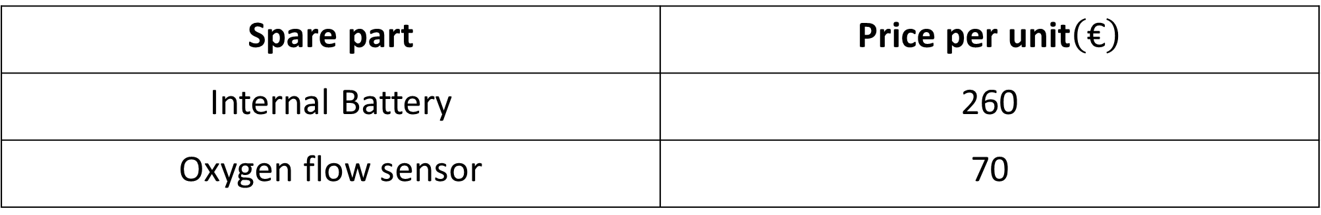
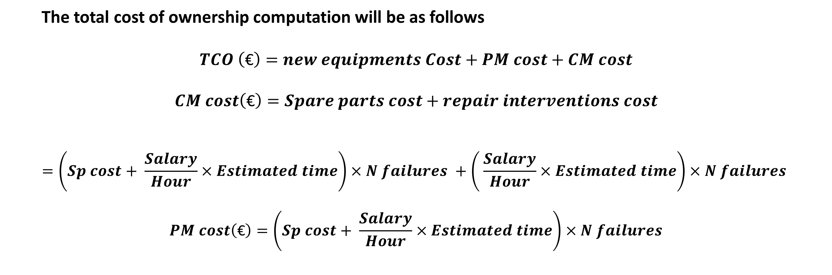
Criteria evaluation: Cost calculation
The total cost of ownership computation will be as follows
$$TCO \left(\text{€}\right)=new equipments Cost+PM cost+CM cost$$
$$CM cost\left(\text{€}\right)=Spare parts cost+repair interventions cost$$
$$=\left(Sp cost+ \frac{Salary}{Hour}×Estimated time\right)×N failures +\left( \frac{Salary}{Hour}×Estimated time\right)×N failures$$
$$PM cost\left(\text{€}\right)=\left(Sp cost+ \frac{Salary}{Hour}×Estimated time\right)×N failures$$
Spare part | Price per unit$\left(\text{€}\right)$
Internal Battery | 260
Oxygen flow sensor | 70

Slide 46
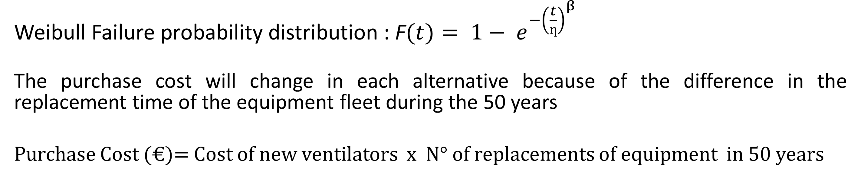
Cost calculation
Weibull Failure probability distribution : F$(t)= {1− e}^{−{\left(\frac{t}{ƞ}\right)}^{β}}$
The purchase cost will change in each alternative because of the difference in the replacement time of the equipment fleet during the 50 years
Purchase Cost (€)= Cost of new ventilators x N° of replacements of equipment in 50 years
Alternatives | N° of equipment replacements /50 years | Total Cost (€) | Calculation
Alternative A | 6 | 11.044.585 | 30000 x 60 x 6 =10.800.000€ + Maintenance cost (CM)
Alternative B | 5 | 9.455.585 | 30000 x 60 x 5 =9.000.000€ + Maintenance cost (CM+PM(50y))
Alternative C | 6 (for 45 ventilators) 5 (for15 ventilators) | 10.647.335 | 30000 x (45 x 6 + 15 x 5 )=10.350.000€ + Maintenance cost (CM+PM(50y))

