Slide 1


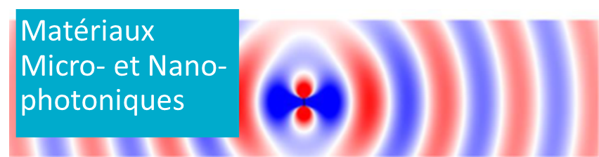
Impact of Hybrid Nanoparticle Aggregation on Optical Response, Heat Generation, and MRI Contrast
C. Rousseau¹ , Q.L. Vuong², Y. Gossuin², B. Maes¹ and G. Rosolen¹
1 Micro- and Nanophotonic Materials Group, Research Institute for Materials Science and Engineering, University of Mons
2 Biomedical Physics Unit, University of Mons
Notes:
Les propriétés optiques de quelques couches d'InSe

Slide 2
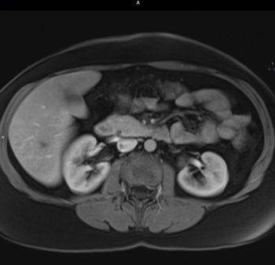
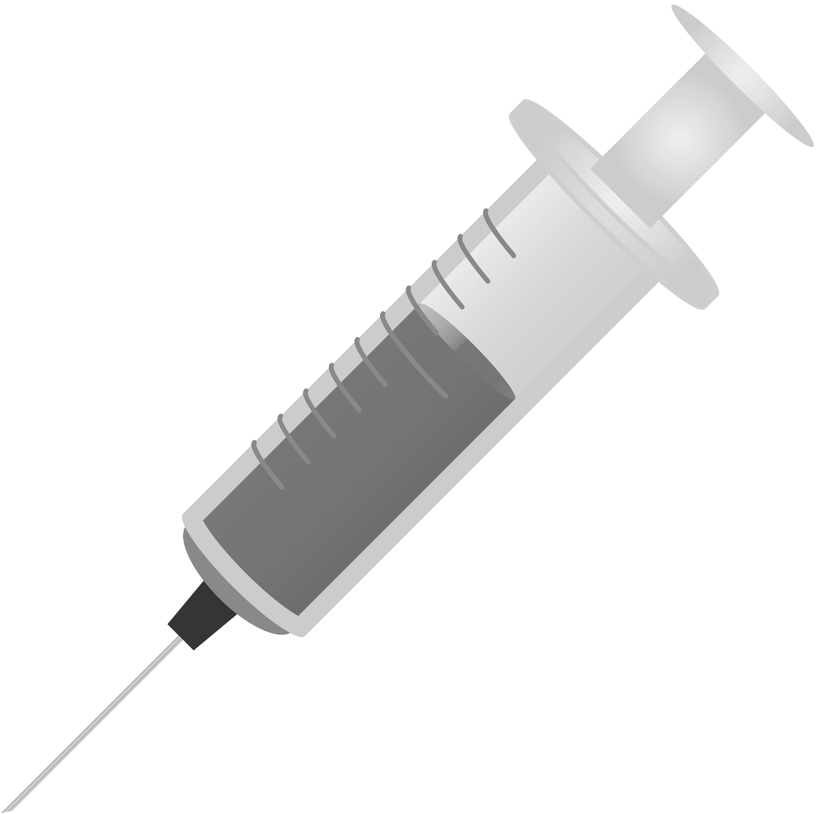
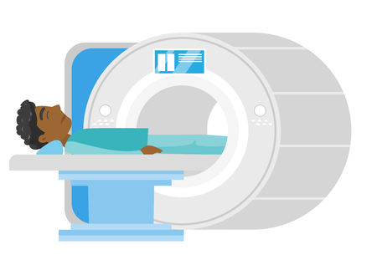
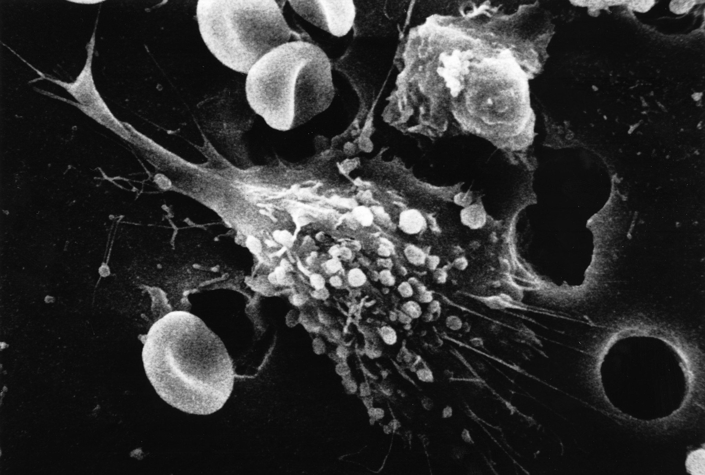

What is the research context?
Diagnostic phase: Magnetic Resonance Imaging (MRI)
Contrast agents
Treatment phase: Phototermal therapy (PTT)
NIR Laser
Photothermal agents

Slide 3
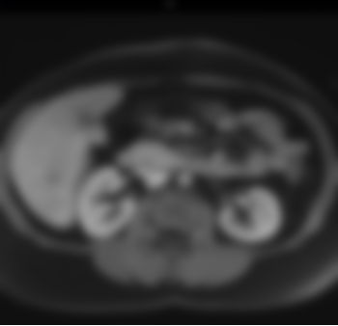


What is the research context?
Theranostic approach: MRI + PTT
NIR Laser
?
Contrast/Photothermal
agents
Underlying question:
“How will the use of phototherapy modify MRI images?”

Slide 4
What is the research context?
Theranostic approach: MRI + PTT
NIR Laser
?
Contrast/Photothermal
agents
Underlying question:
“How will the use of phototherapy modify MRI images?”
More precise question:
“How does laser illumination of a solution
modify its transverse relaxation rate (R₂)? ”

Slide 5
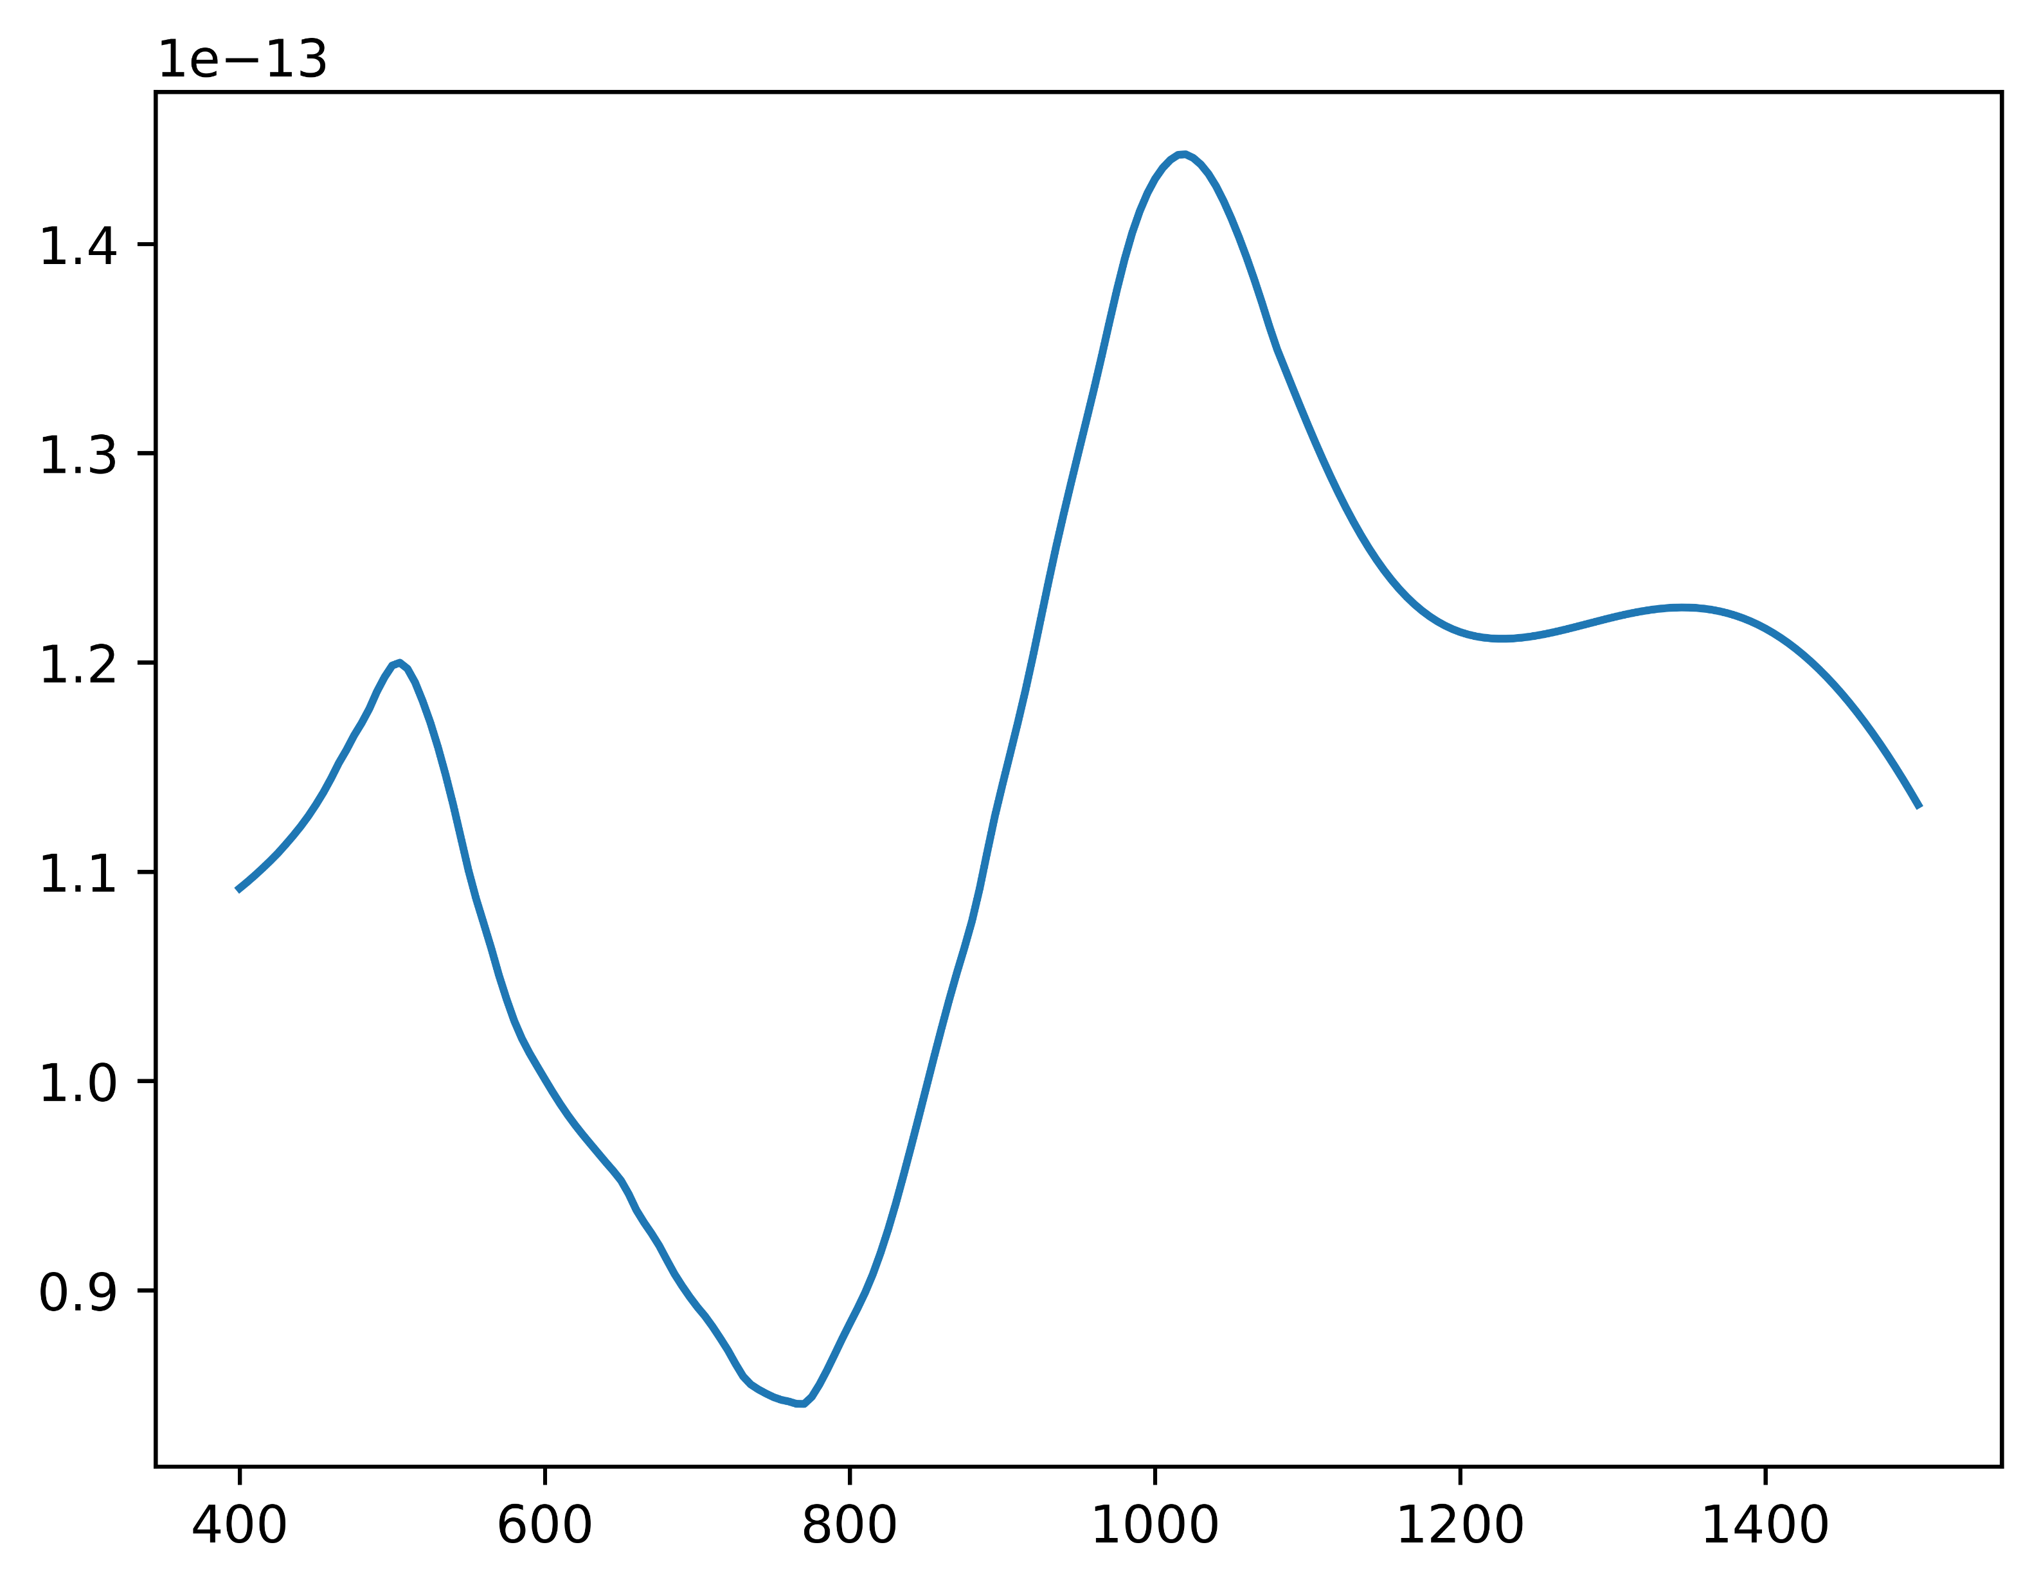



Hybrid nanoshell platforms are effective tunable Contrast/Photothermal agents
Plasmonic hybridization between nanosphere/nanocavity
Gold nanoshell: allow PTT ≈ + 6°C
$$Absorption cross section [m^{2}]$$
Magnetite core (Fe₃O₄): allow MRI
magnetite core radius: 150 nm
gold shell thickness: 20 nm
$$Wavelength [nm]$$
Biological window

Slide 6
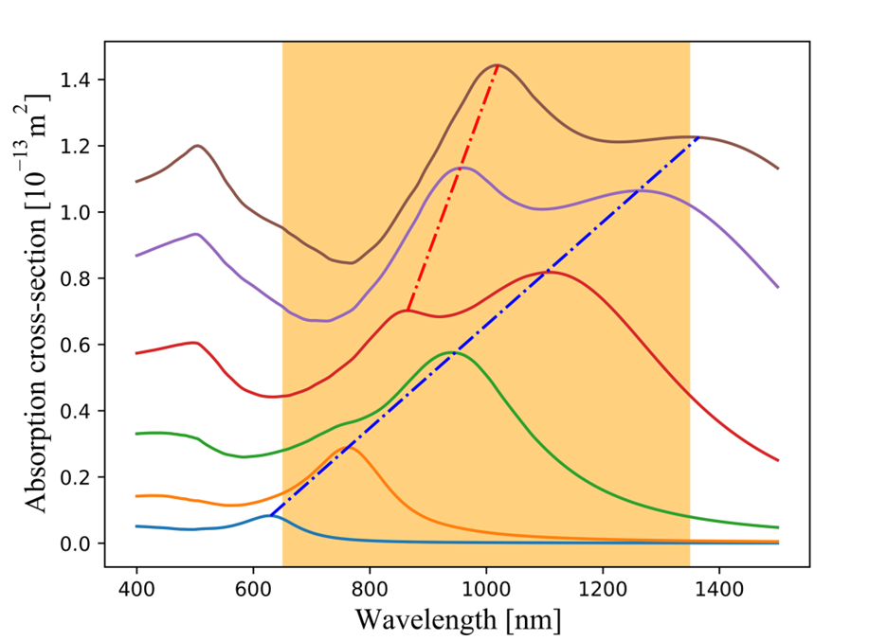
Optimization of nanoshell geometry
10 nm shell → higher absorption for a large gamme a radius core
Quadrupolar peaks
Dipolar peaks
Increasing core radius

Slide 7
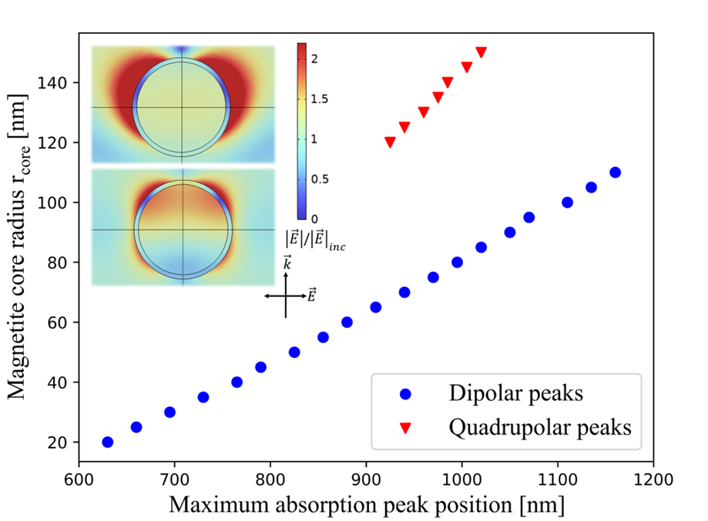
Optimization of nanoshell geometry
Best absorption peak chosen in the biological window

Slide 8
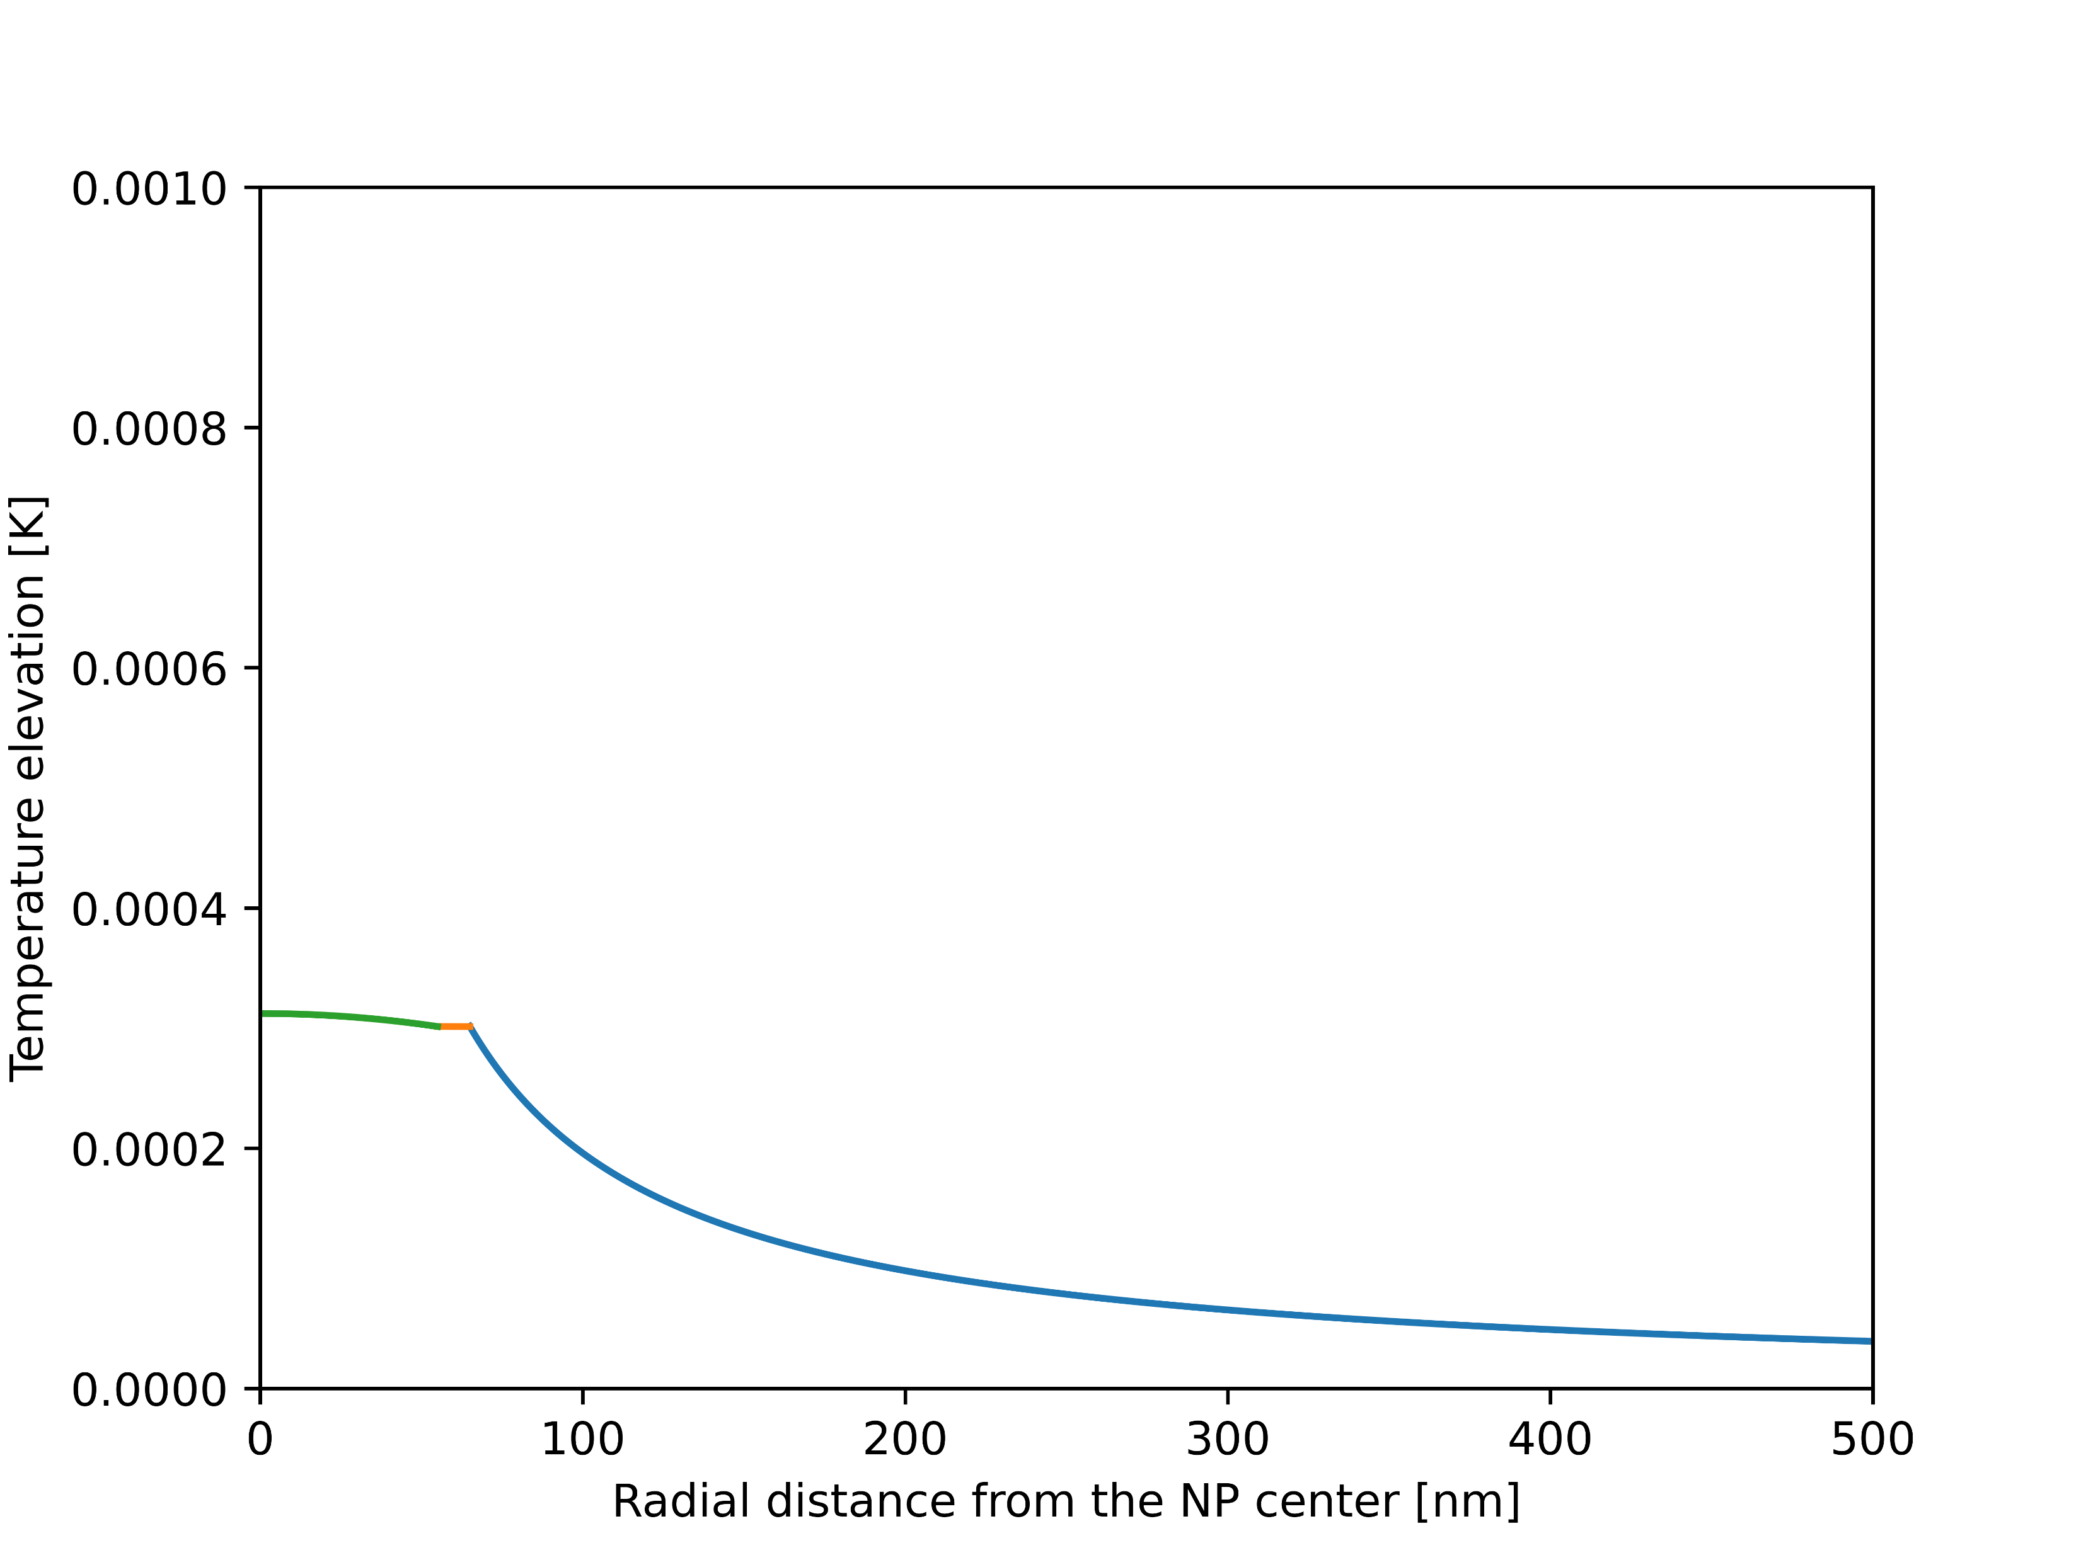
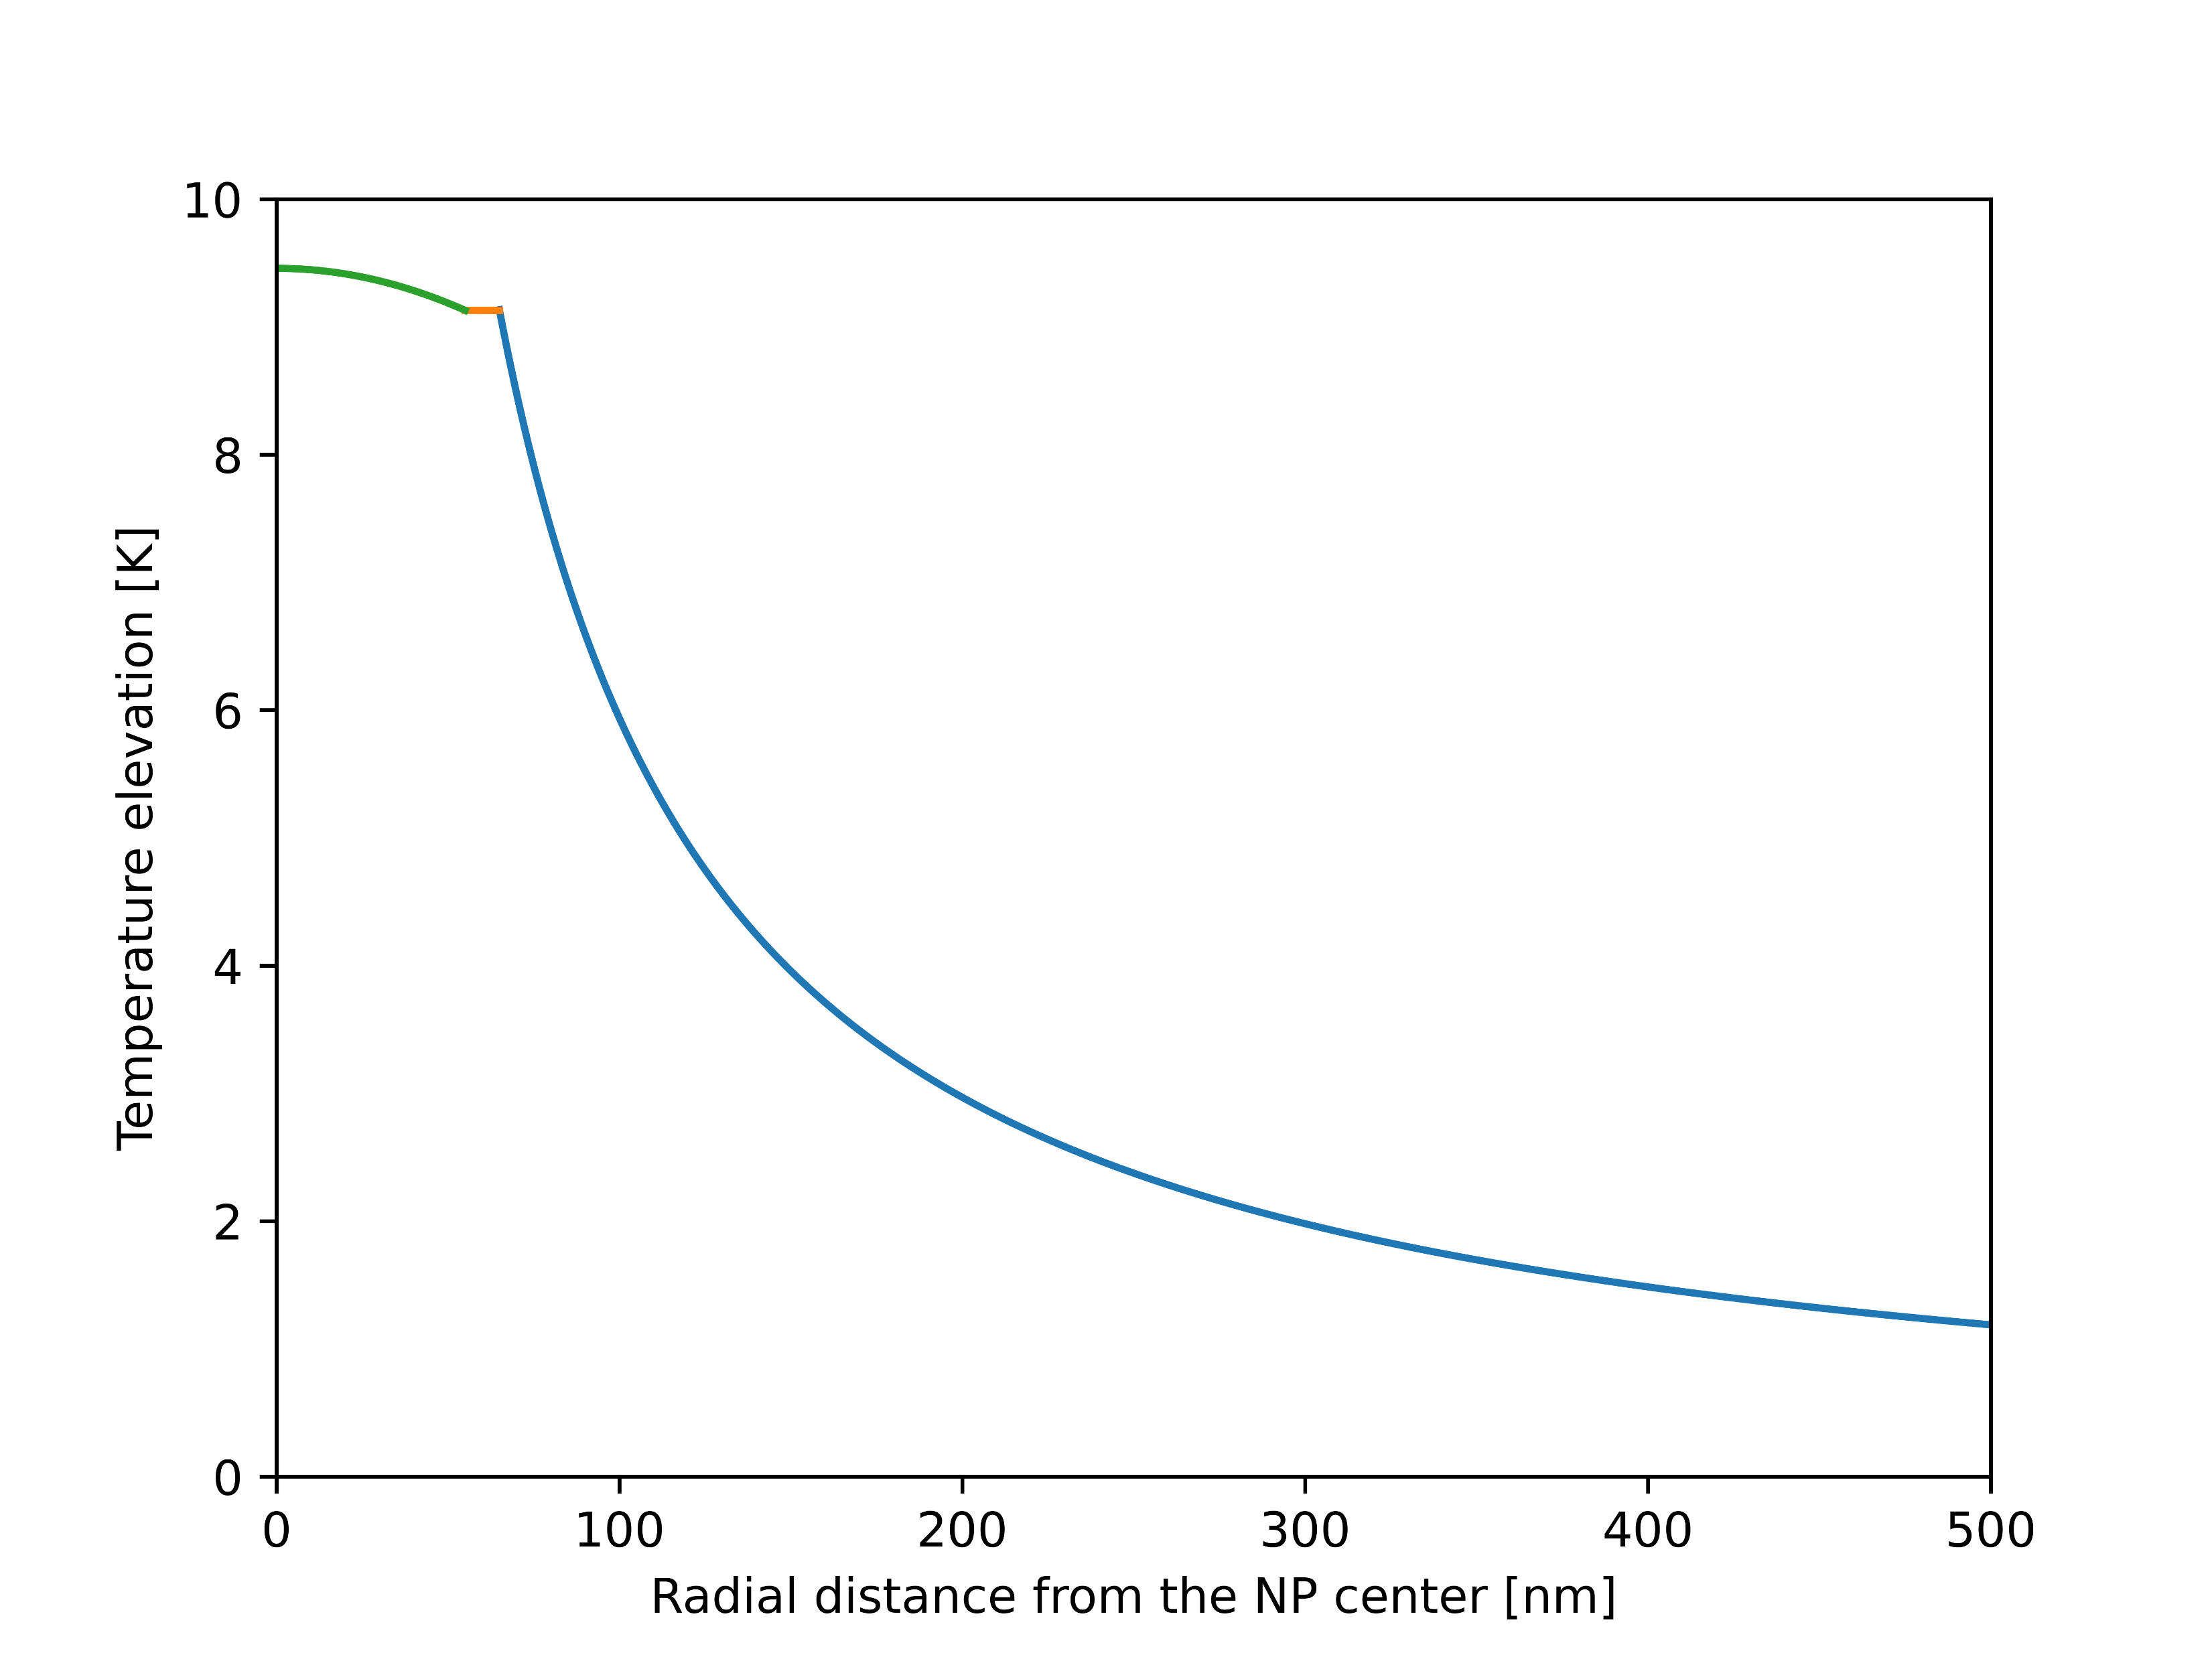

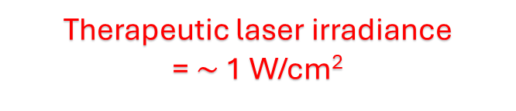
Is the therapeutic irradiance not enough for phototherapy?
Therapeutic laser irradiance
= $\sim$ 1 W/cm²
High laser irradiance
= 10000 W/cm²
magnetite core radius: 55 nm
gold shell thickness: 10 nm

Slide 9
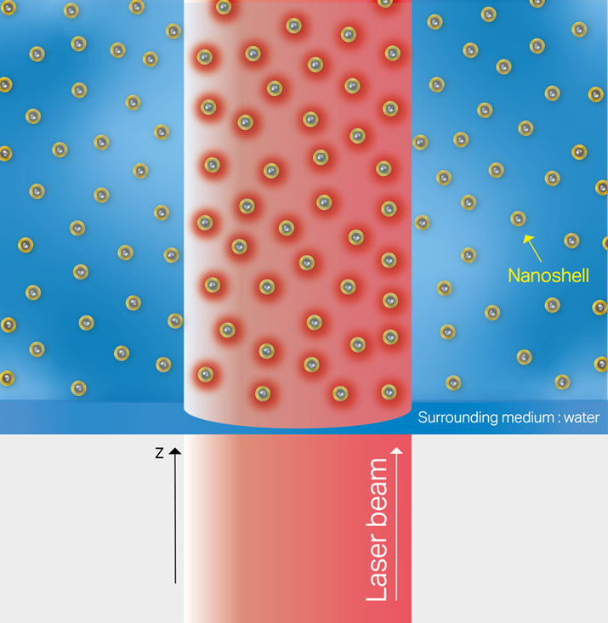
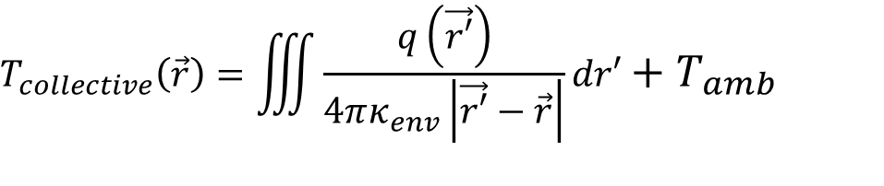
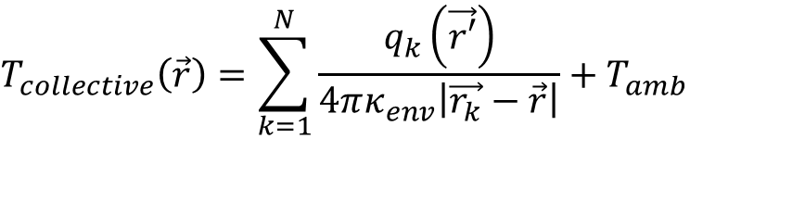

Collective thermal effects lead to a significant increase in temperature
$$T_{collective}\left(\vec{r}\right)=\sum_{k=1}^{N}{\frac{q_{k}\left(\vec{r′}\right)}{4πκ_{env}\left|\vec{r_{k}}−\vec{r}\right|}+T_{amb}}$$
$$T_{collective}\left(\vec{r}\right)=\iiint{\frac{q\left(\vec{r′}\right)}{4πκ_{env}\left|\vec{r′}−\vec{r}\right|}}dr′+T_{amb}$$
Laser beam
NPs concentration
Extinction cross section
$$q\left(\vec{r′}\right)=I_{0} (N σ_{abs}+A_{water}){ e}^{−{(σ}_{ext} N+A_{water}) z }$$
Absorption cross section
Distance in sample
Water absorption coefficient

Slide 10
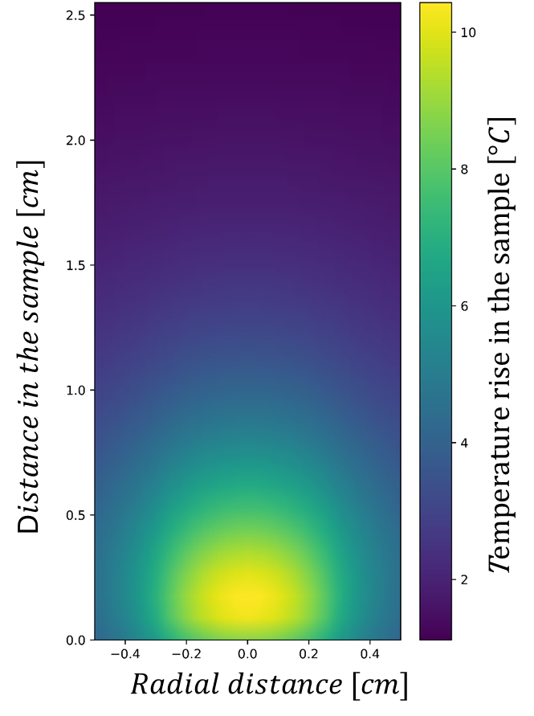
Collective thermal effects lead to a significant increase in temperature
Sufficient temperature elevation for photothermal therapy

Slide 11
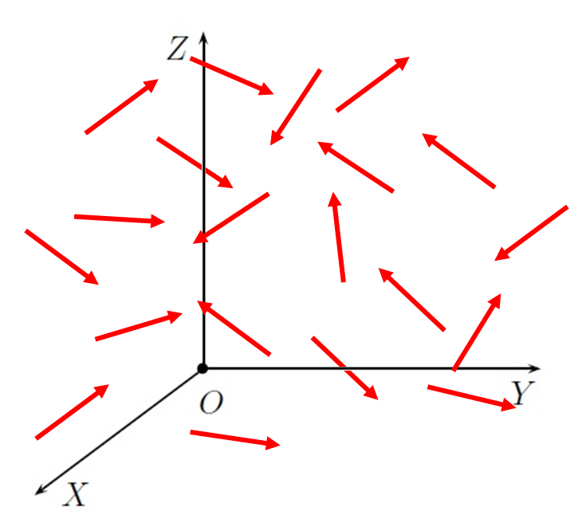
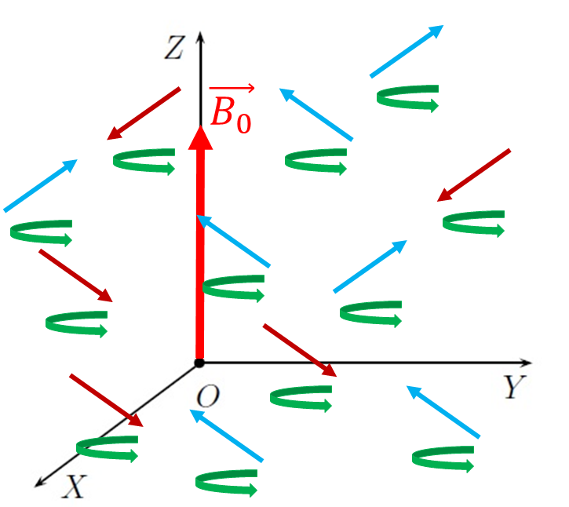
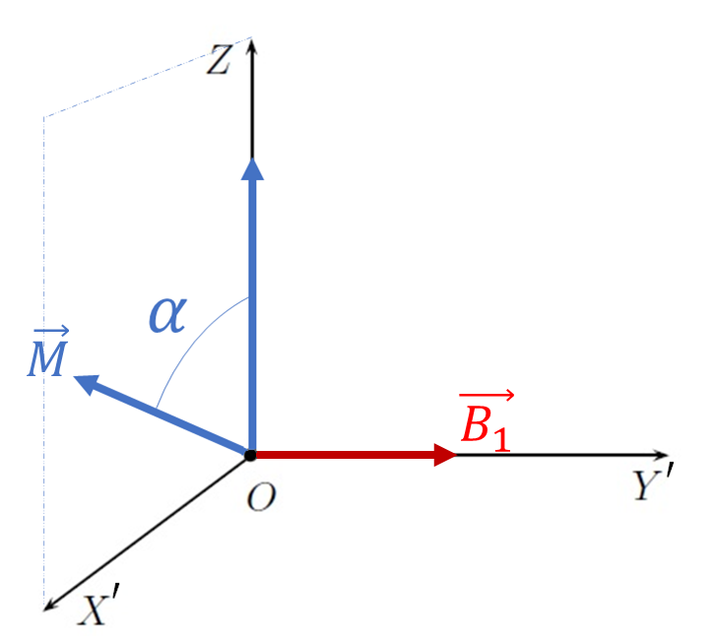
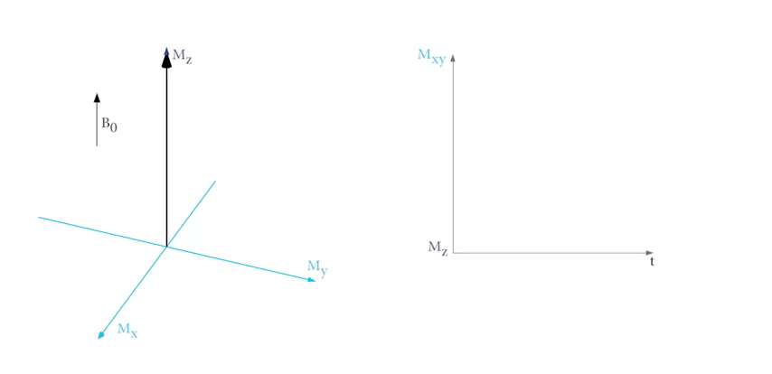
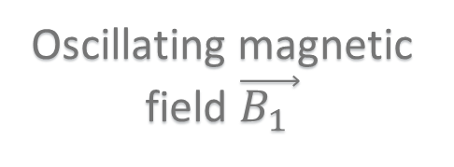
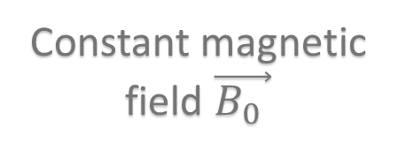


Nuclear magnetic resonance in 4 steps
Sample without
magnetic field
Constant magnetic
field $\vec{B_{0} }$
Oscillating magnetic
field $\vec{B_{1} }$
Relaxation
$\vec{M}$
Randomized magnetic moments
Resulting magnetization $\vec{M}$
System out of equilibrium
Return to magnetization equilibrium
MRI imaging based on the relaxation
( described by a relaxation rate)

Slide 12
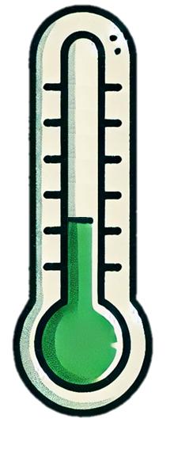

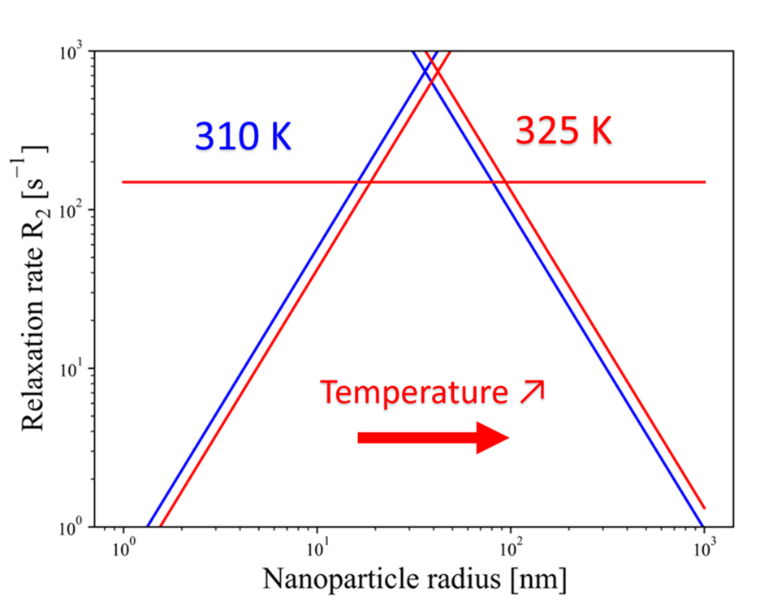
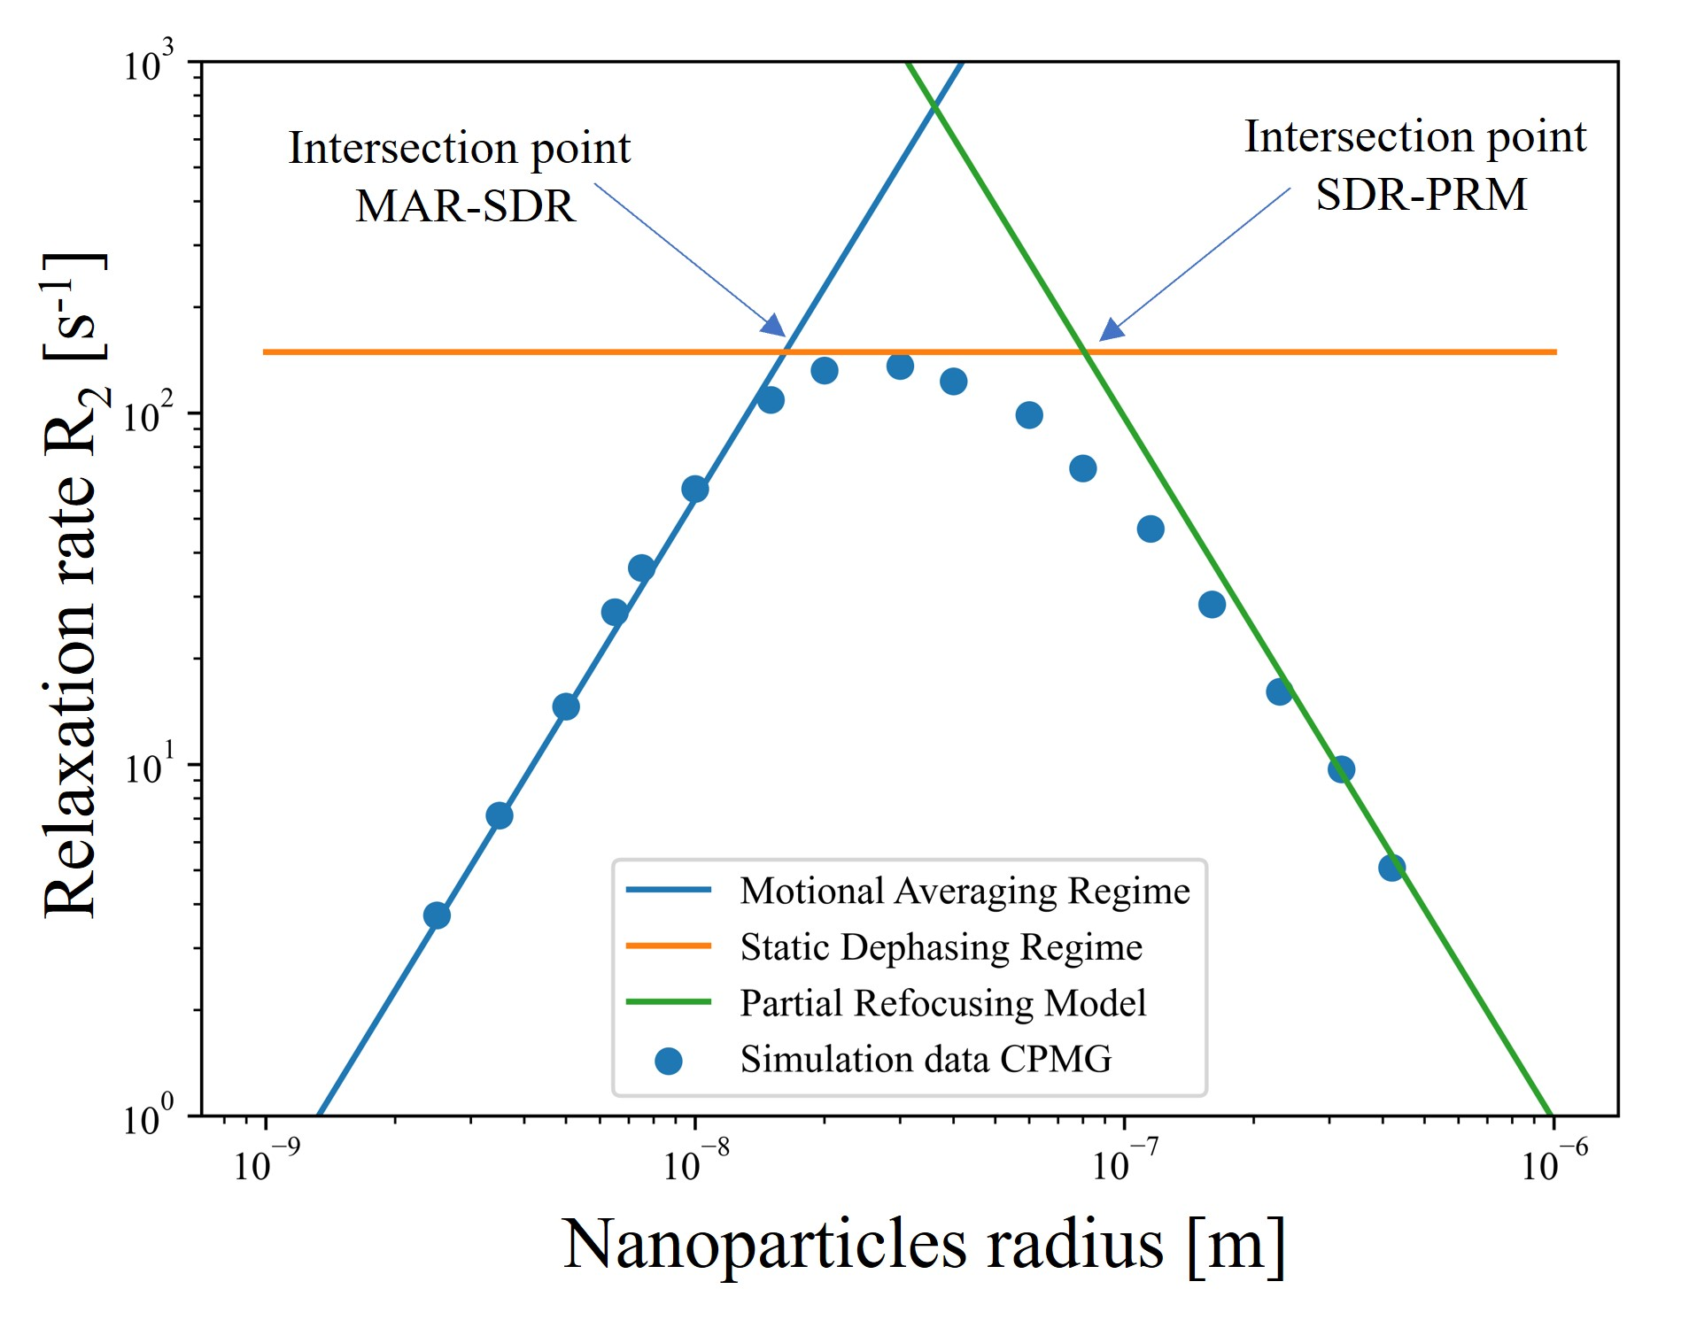
Influence on relaxation: nanoparticle size and medium temperature
Medium
temperature ↗
Increasing size

Slide 13
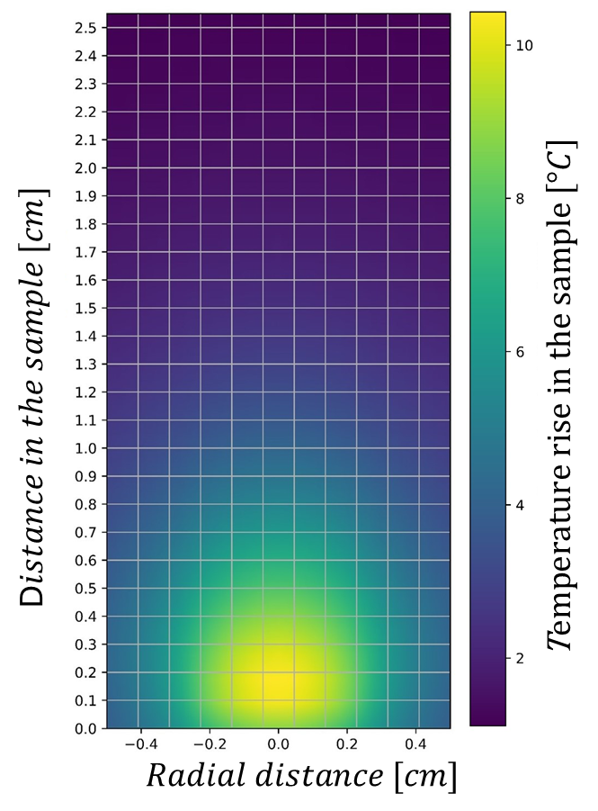
Calculation procedure of the relaxation maps
Calculation of the temperature elevation map
Voxel discretization procedure
Choice of the relaxation model for each voxel

Slide 14

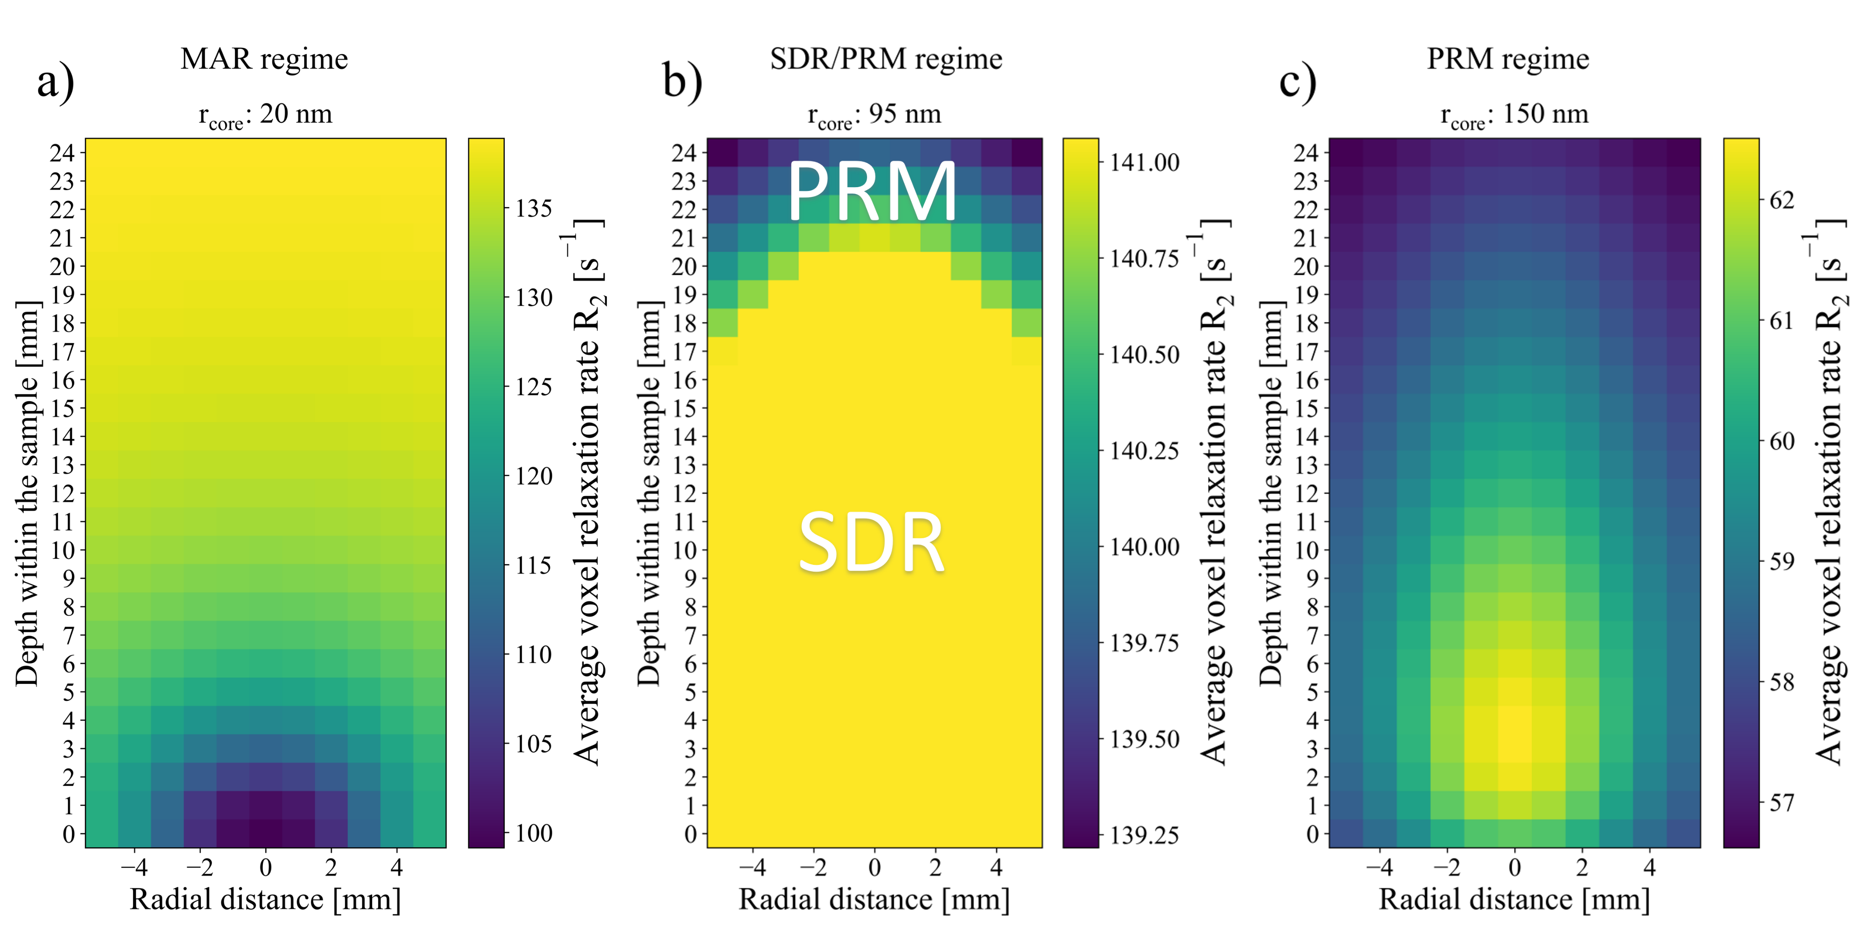
Relaxation maps due to laser illumination
Magnetite core : 20 nm
Gold shell : 10 nm
Magnetite core : 95 nm
Gold shell : 10 nm
Magnetite core : 150 nm
Gold shell : 10 nm
Up to 30% modification for a core radius around 20-25 nm !

Slide 15
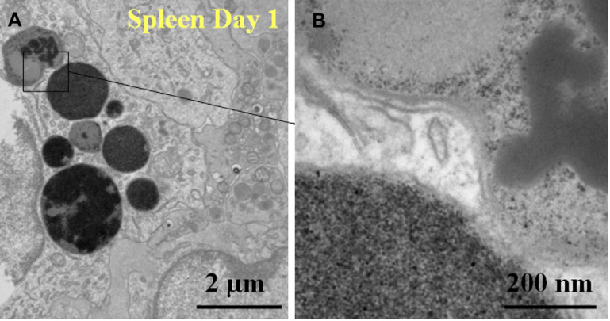
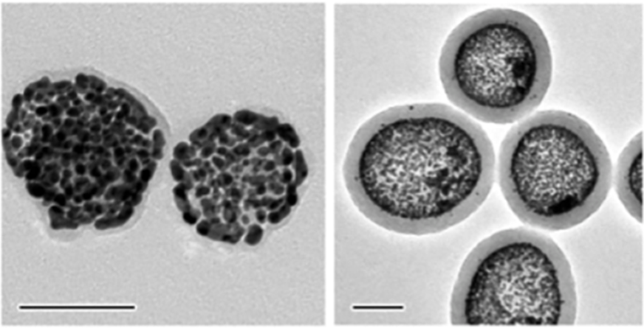
Two different types of aggregation
Natural aggregation
Designed aggregation
Michael Levy et al., Biomaterials 2011
Jinxing Chen et al, ACS Nano 2022
Is there an optimal degree of aggregation?

Slide 16
Studied nanoshell clusters
Magnetite core : 20 nm
Gold shell : 10 nm
Minimum approach distance = 1 nm

Slide 17
Studied nanoshell clusters
Magnetite core : 20 nm
Gold shell : 10 nm
Adjustment of aggregation through cluster stretching

Slide 18
Studied nanoshell clusters
Magnetite core : 20 nm
Gold shell : 10 nm
Calculation of the average temperature rise on the surface of the cluster

Slide 19
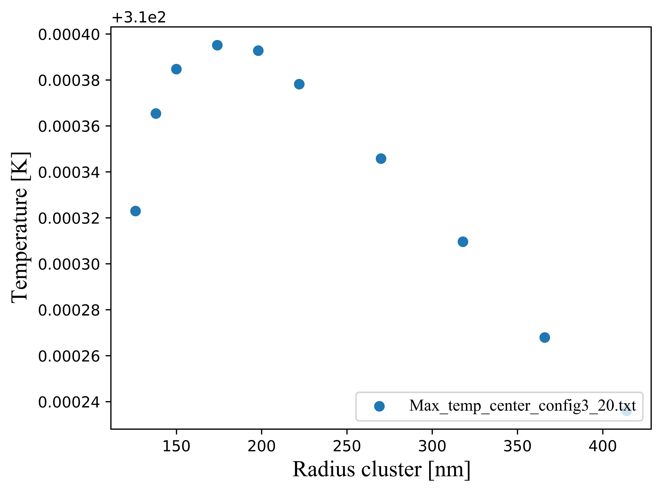
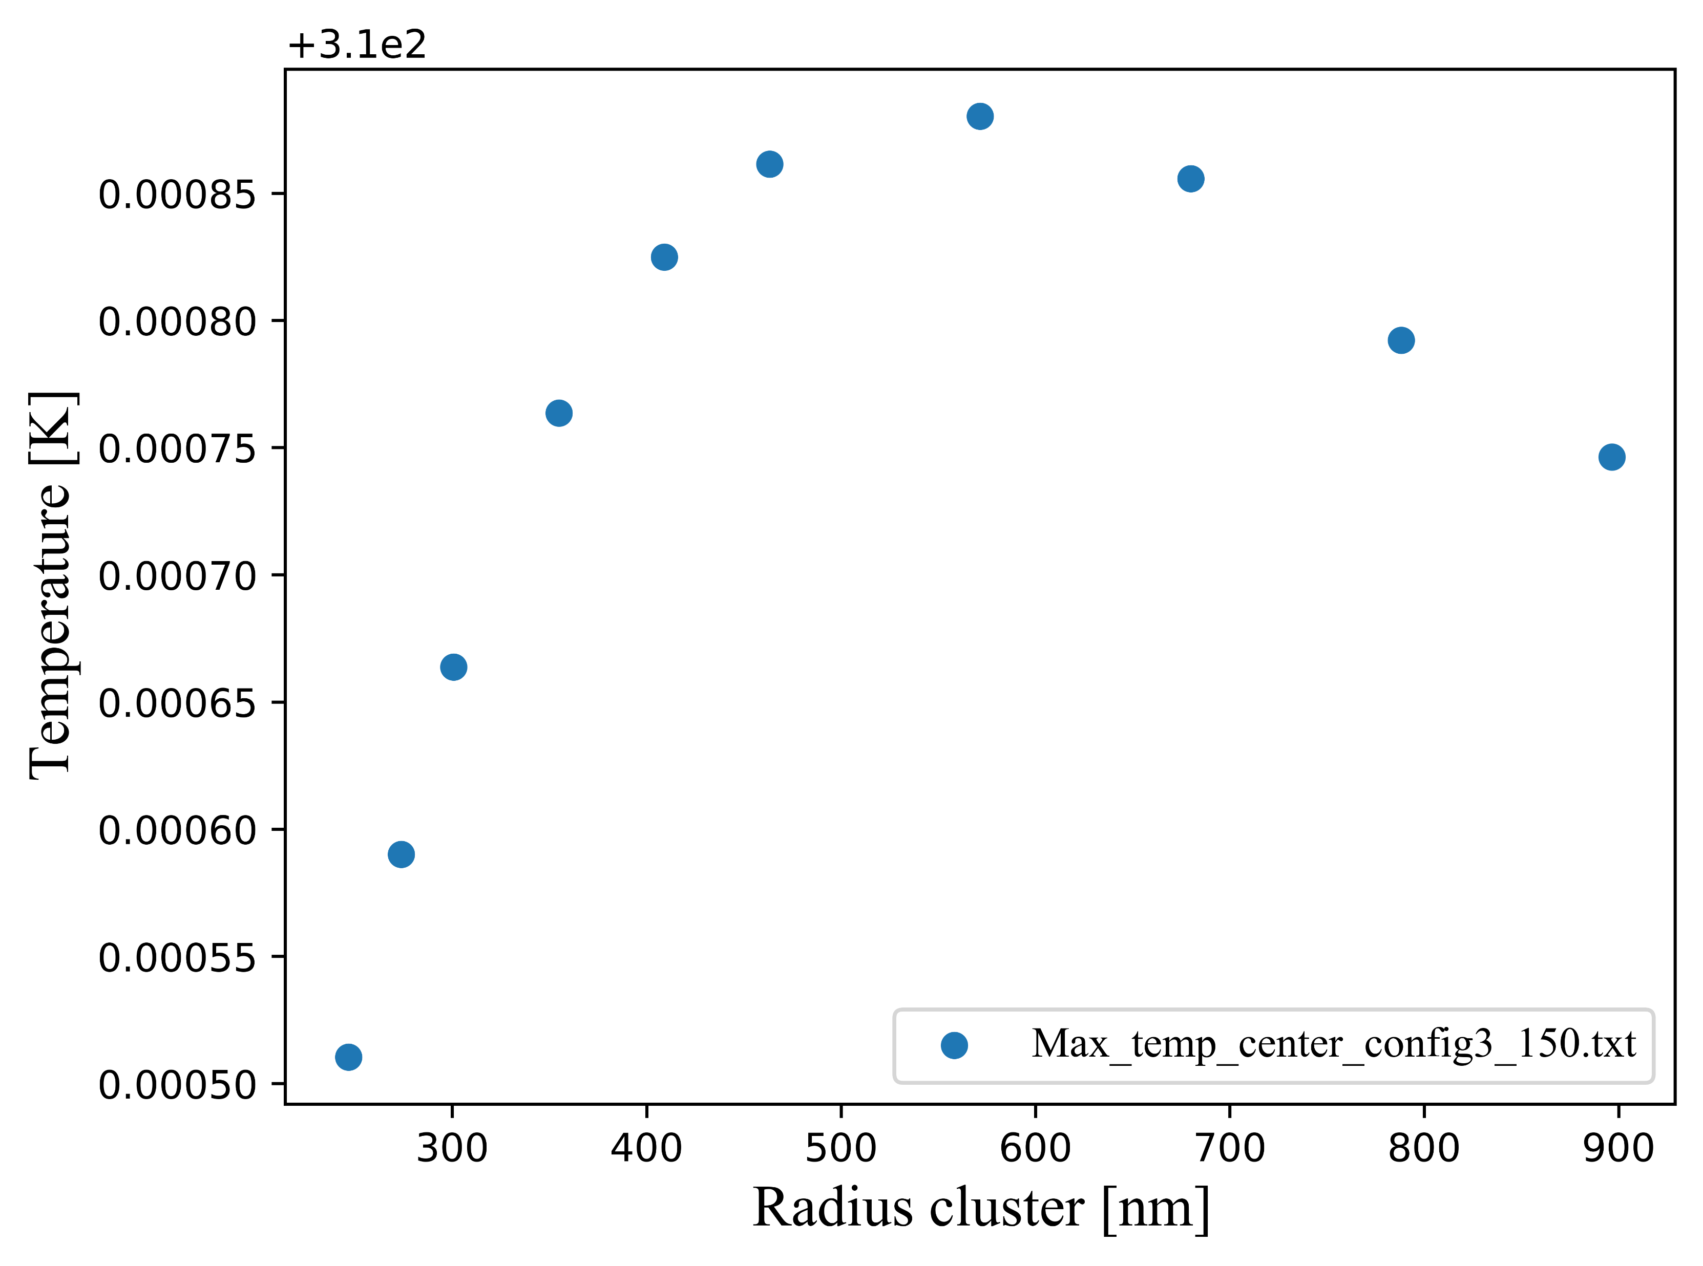
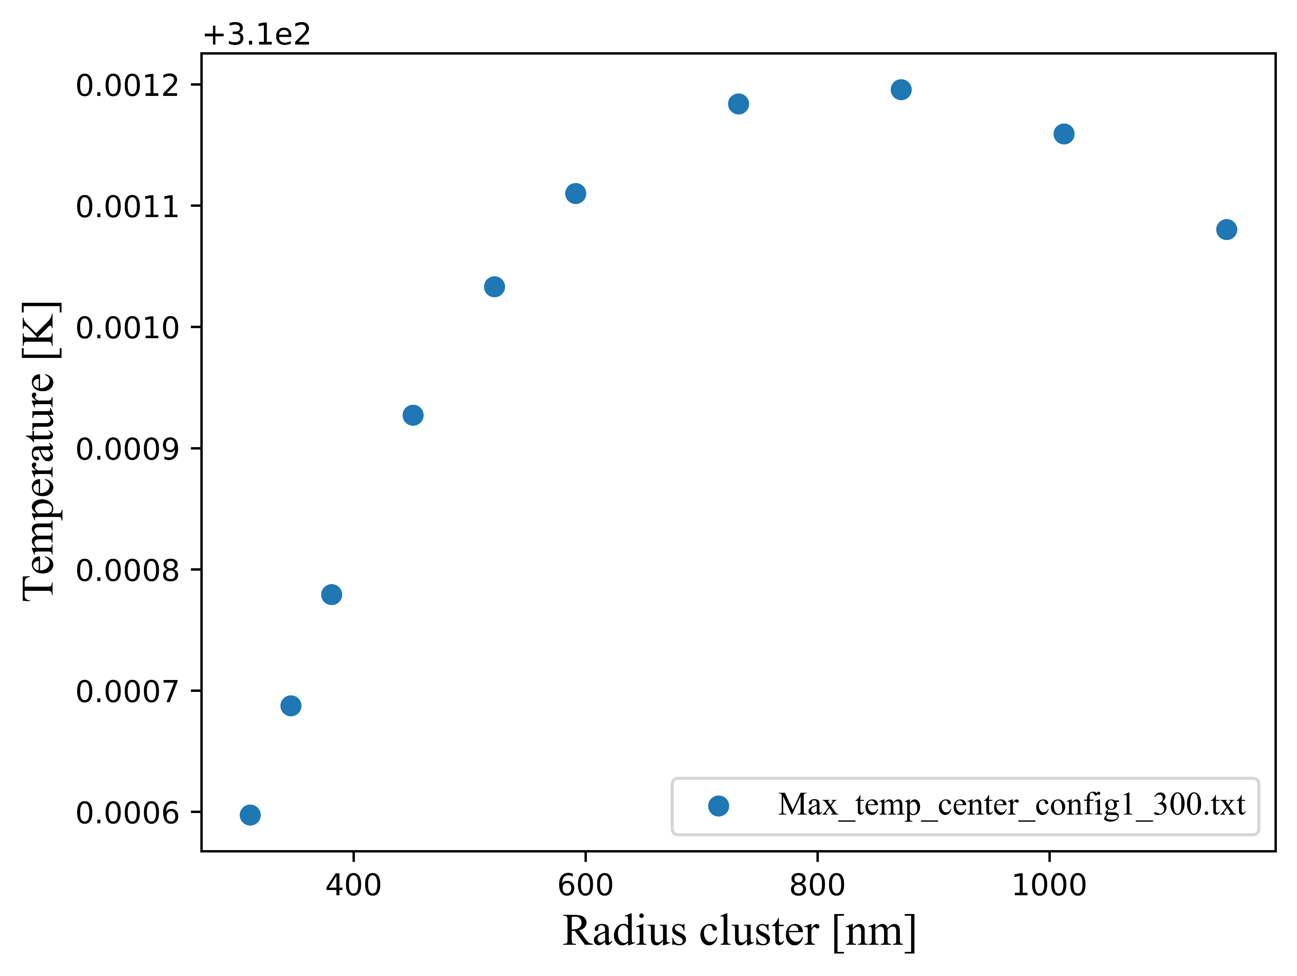
Optimal volume fraction to achieve a maximum temperature increase
20 x
150 x
300 x
The optimum position depends on the number
of NPs in the cluster

Slide 20
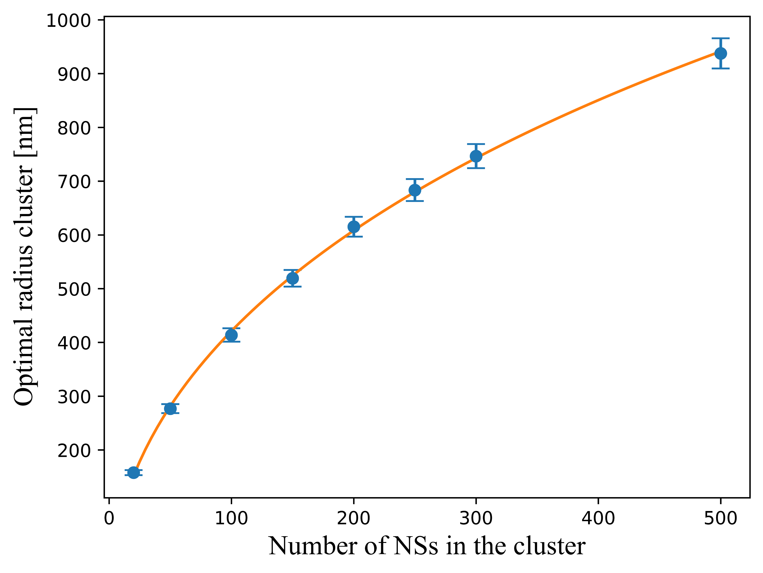
Optimal volume fraction to achieve a maximum temperature increase
Possibility of deriving a law to calculate the optimal radius of a cluster of N particles

Slide 21
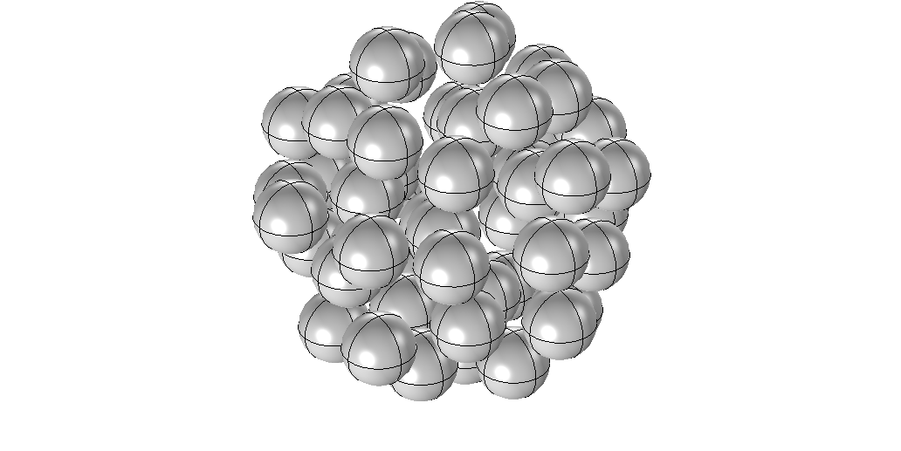
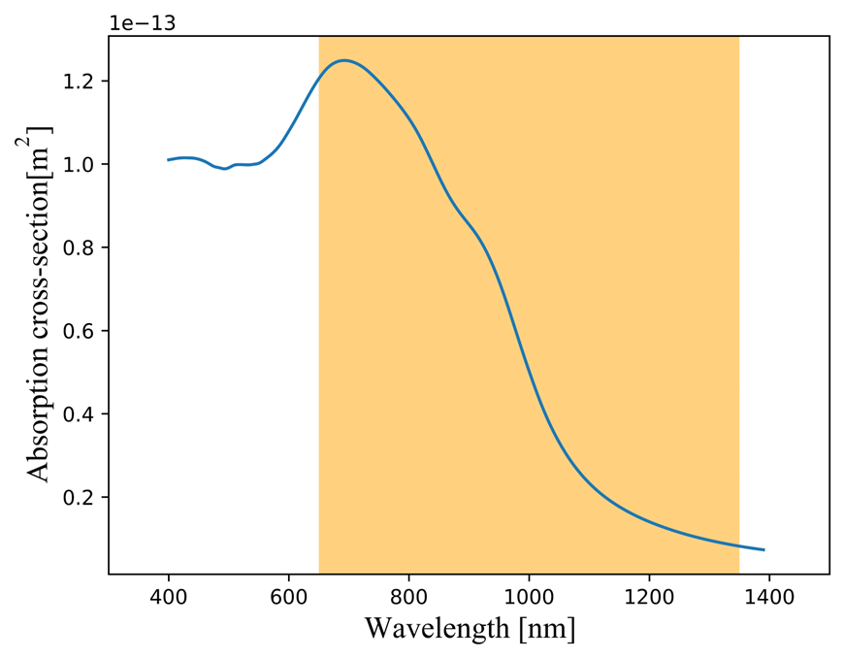
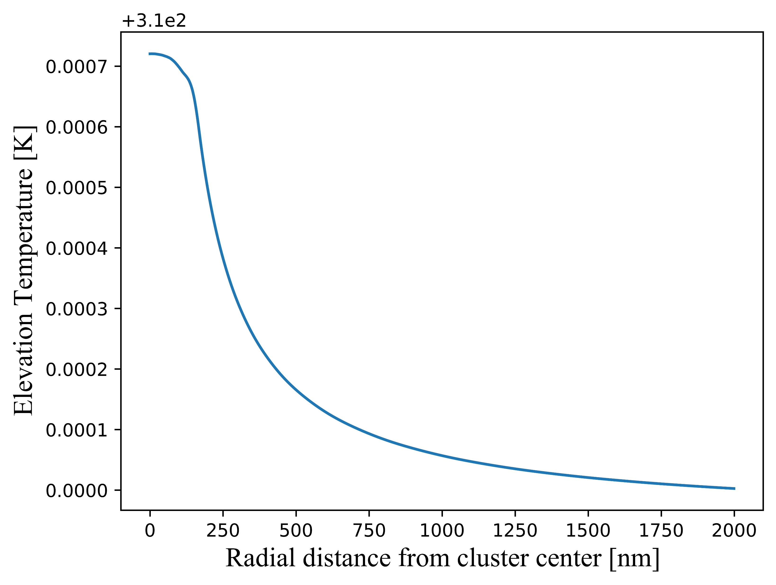
Cluster solution: mean optical and thermal response
+
+
+
+
+…
Biological window
Link with average absorption cross-section
50 x
Possibility to use the collective model for cluster solutions

Slide 22
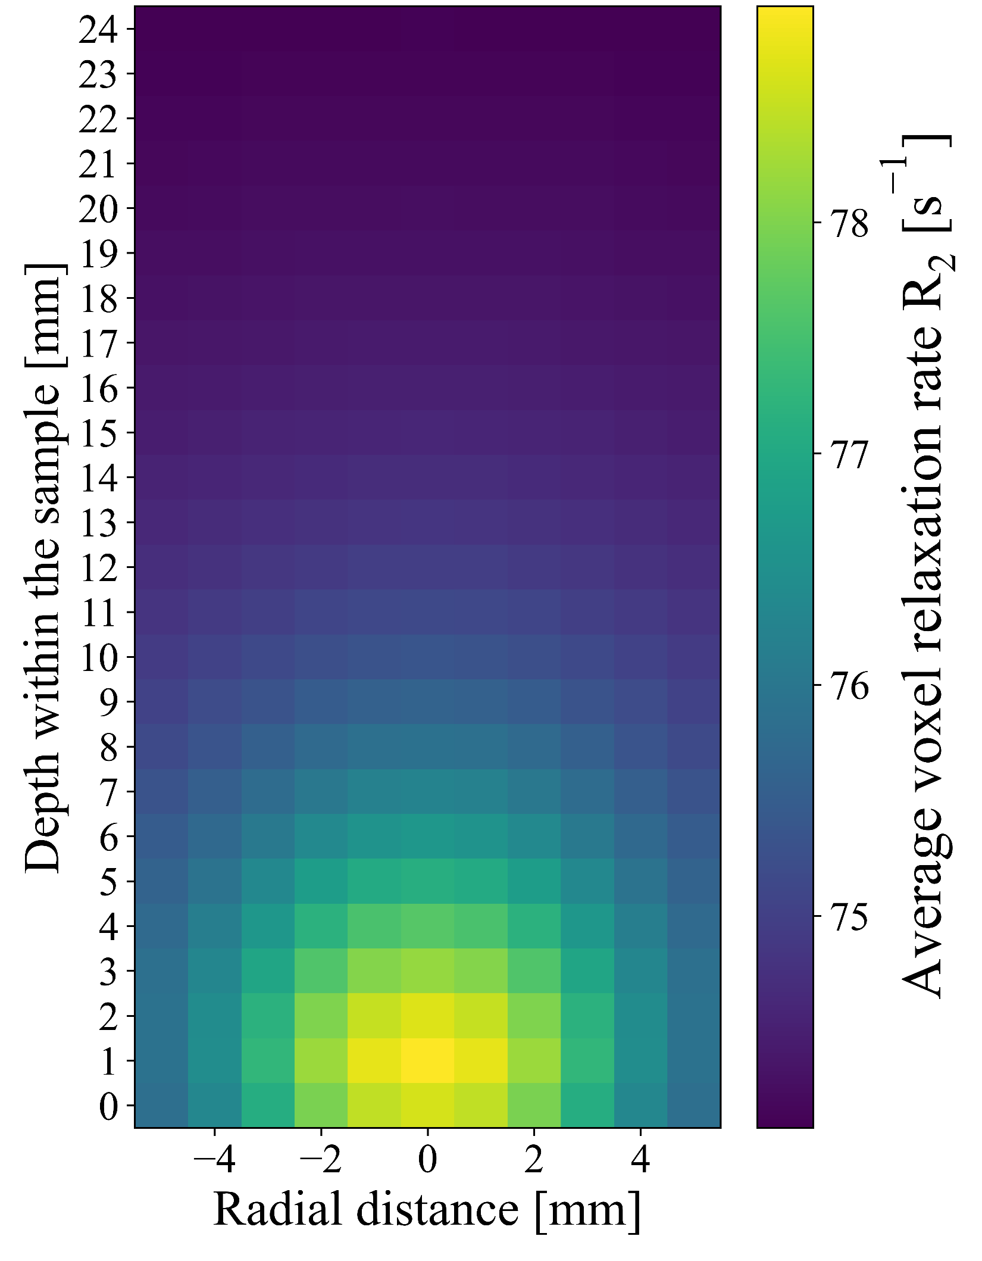
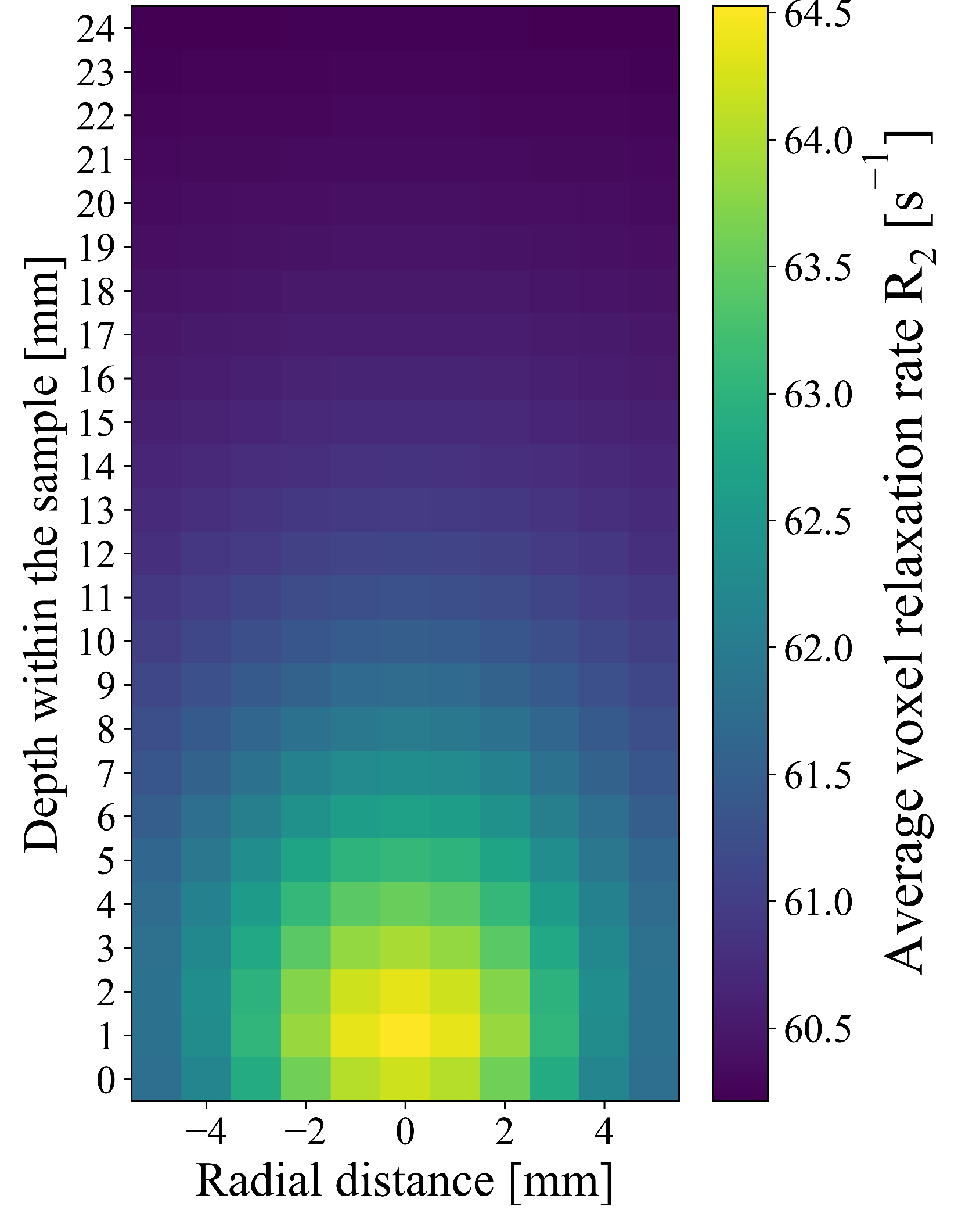
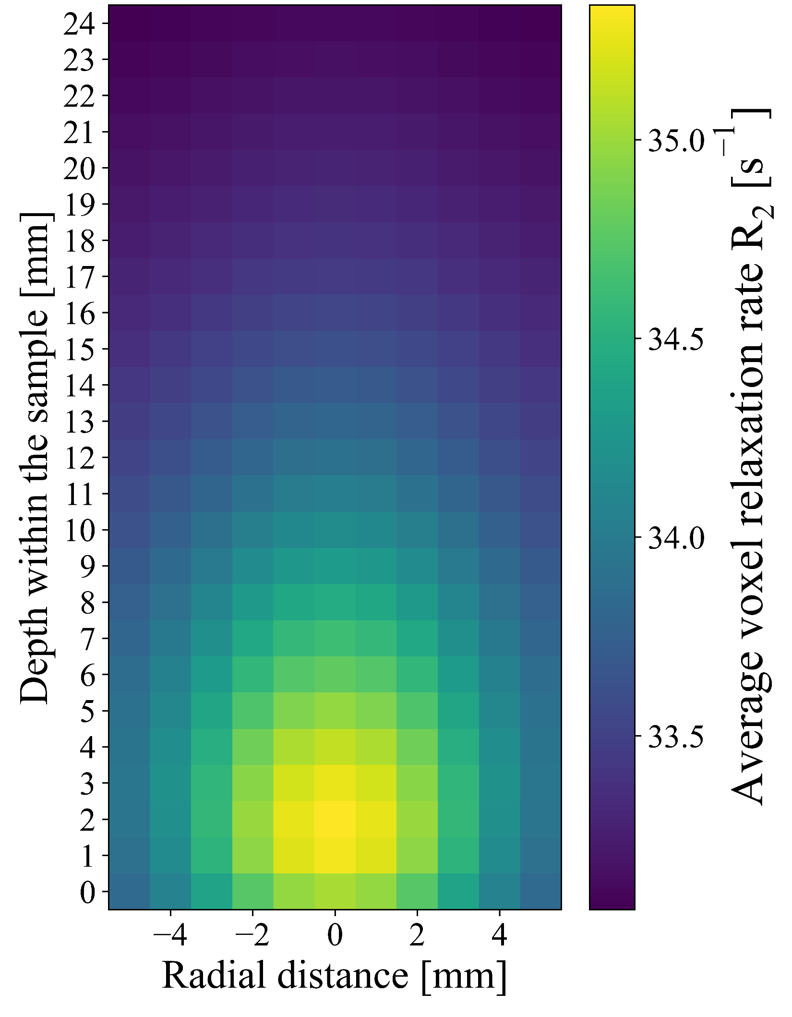
Tracking the separation of clusters by MRI?
50 x
100 x
500 x
Ambiant relaxation rate ≈ laser focus relaxation rate

Slide 23
Tracking the separation of clusters by MRI?
50 x
100 x
500 x
R₂ = 80
R₂ = 64
R₂ = 35
Up to 50% modification when dividing the number of NPs by 10!

Slide 24
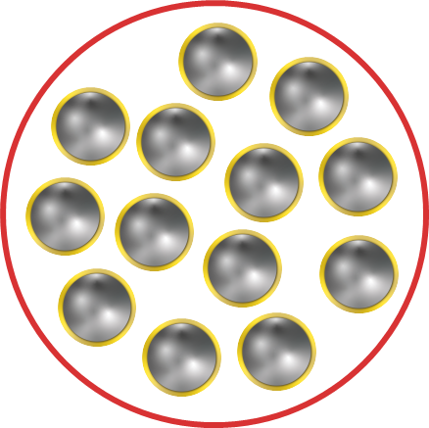
Conclusion
Framework for mapping changes in R₂
due to phototherapy
with Ns
Highlighting the potential for tracking cluster separation by MRI
VS
Optimal Ns geometry
20-25 nm radius core
10 nm thickness shell
Outlook
Adaptation of the framework to handle regions with different concentration levels
Consider a high scattering medium to mimic human tissues

