Slide 1




Alcanivorax borkumensis, a key player for the low-density polyethylene degradation
Alice Delacuvellerie
Proteomics and Microbiology Laboratory
University of Mons (Belgium)

Slide 2
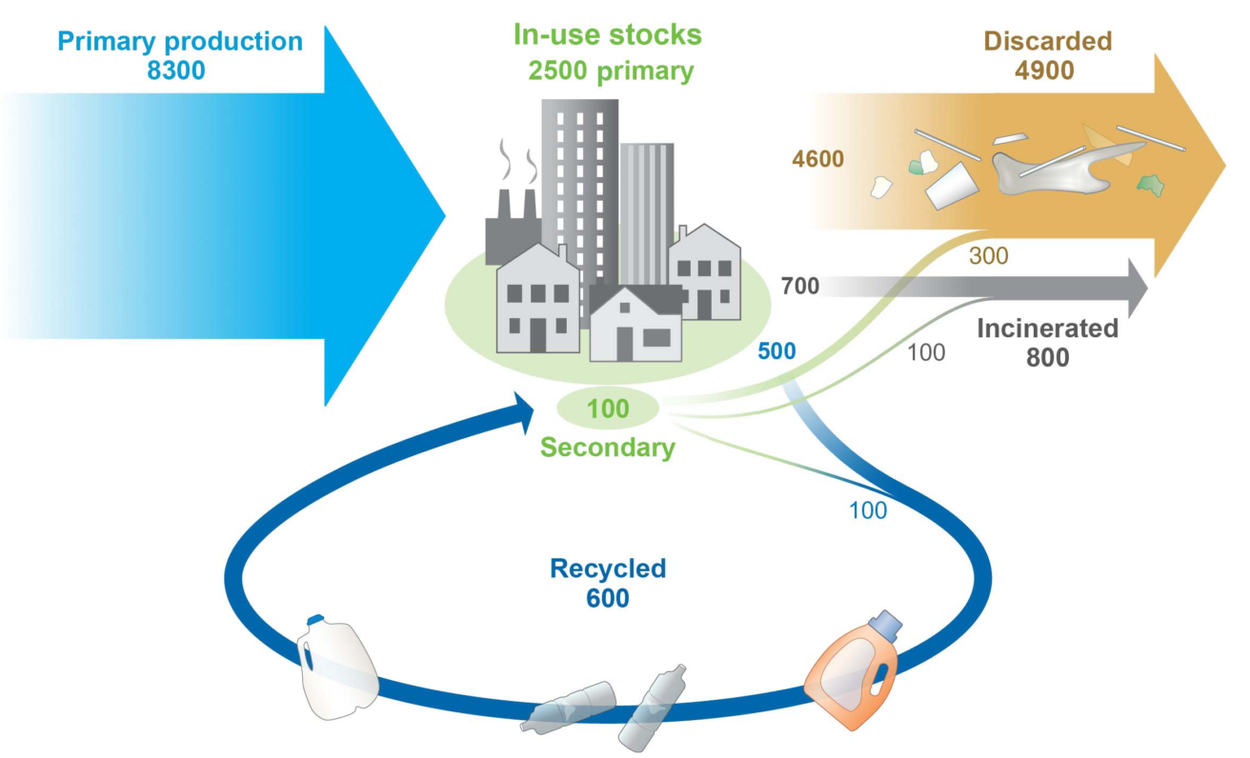
Introduction
(Geyer et al., 2017)
5 trillions of plastic pieces into oceans

Slide 3
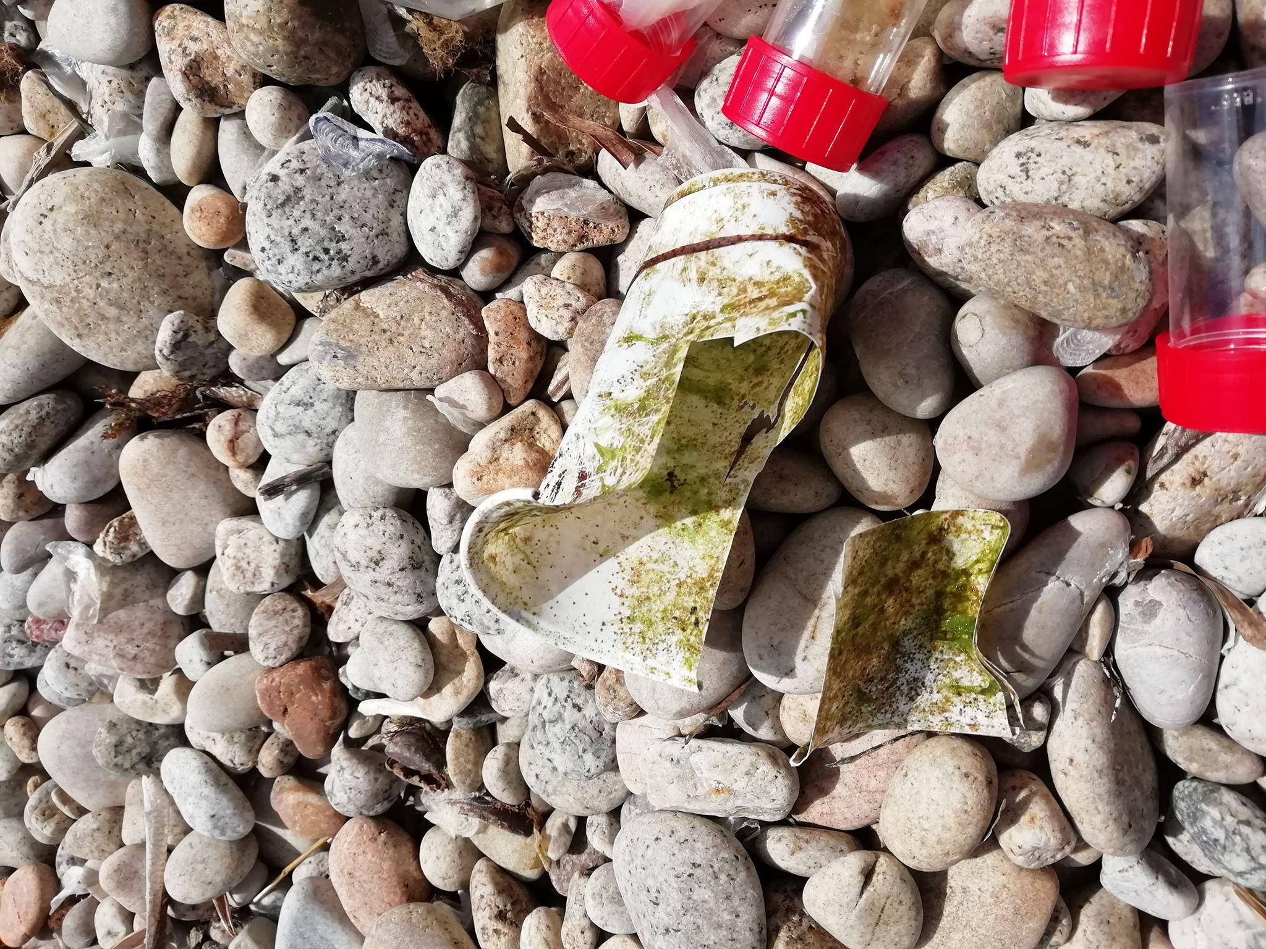
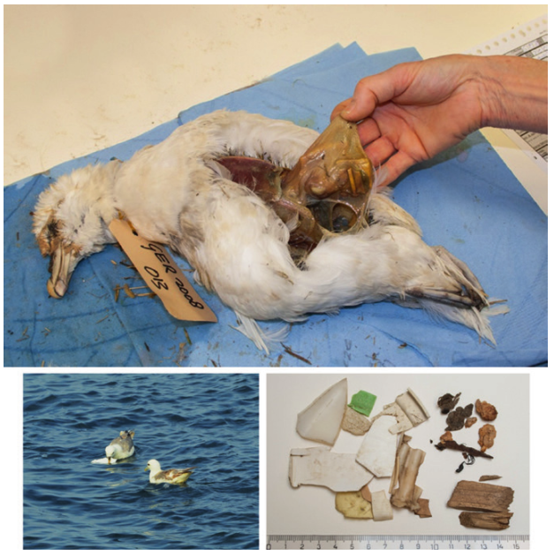
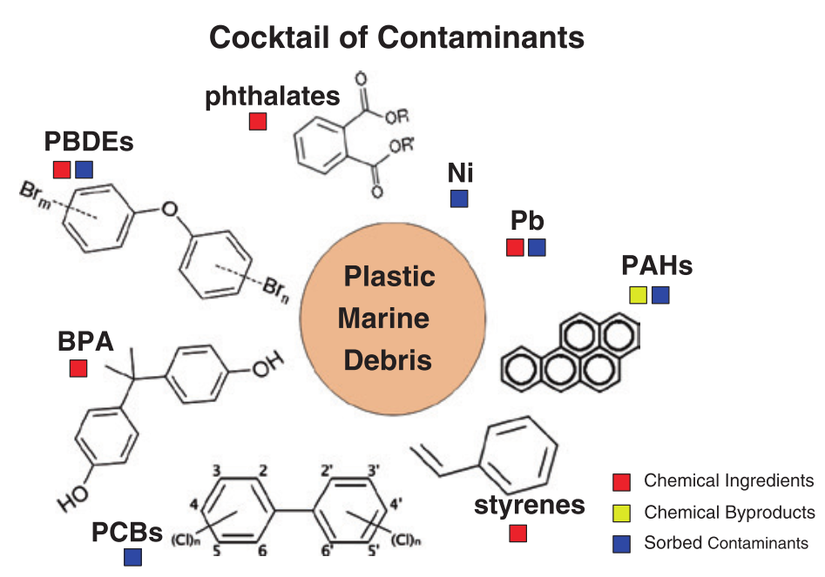
Introduction
© Delacuvellerie
(Kühn et al., 2015)
(Rochman, 2015)

Slide 4
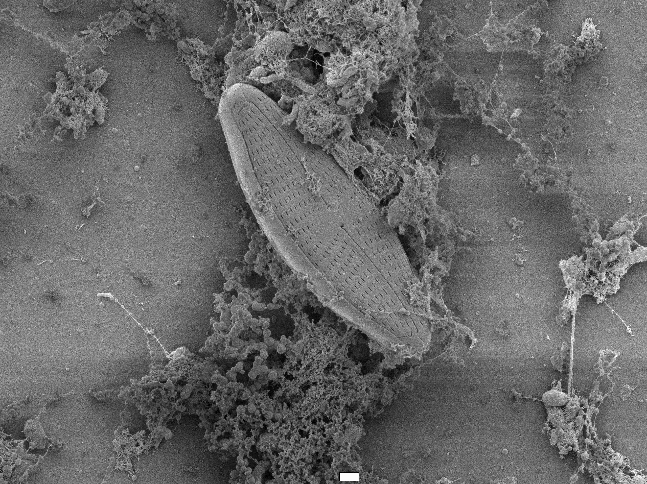
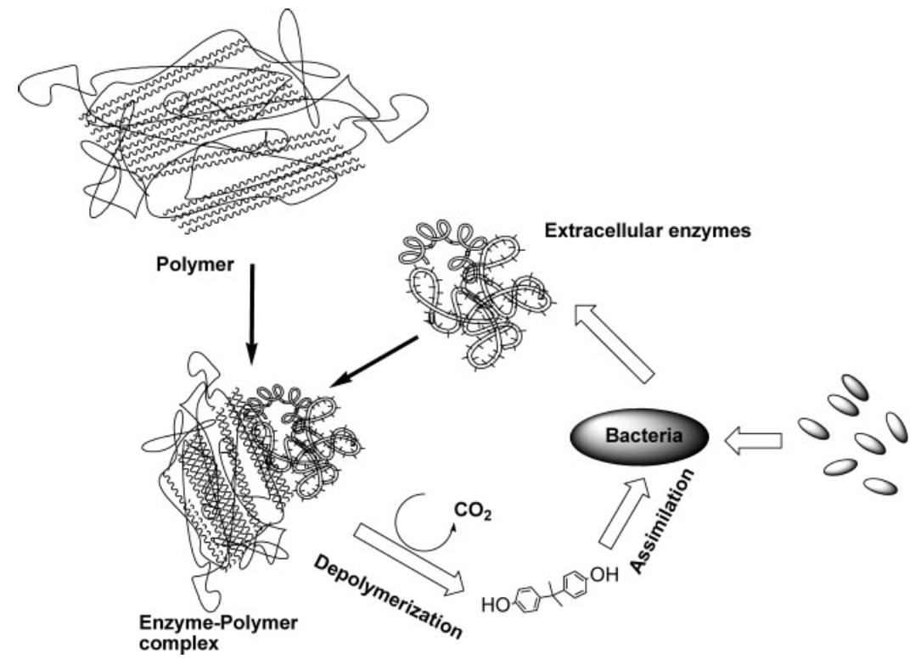
Introduction
© Delacuvellerie Alice
1 µm
Plastisphere
(Artham & Doble, 2008)
Understand their effects and roles in ecosystems
Understand their role in dispersal of pathogenic species
Study potential candidates for plastic degradation
New substrates
Dispersion
vectors
Carbon sources

Slide 5
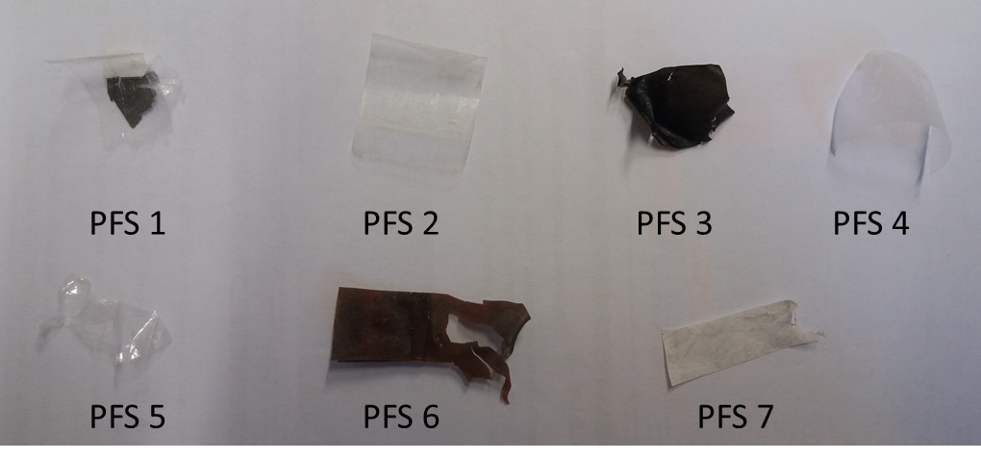
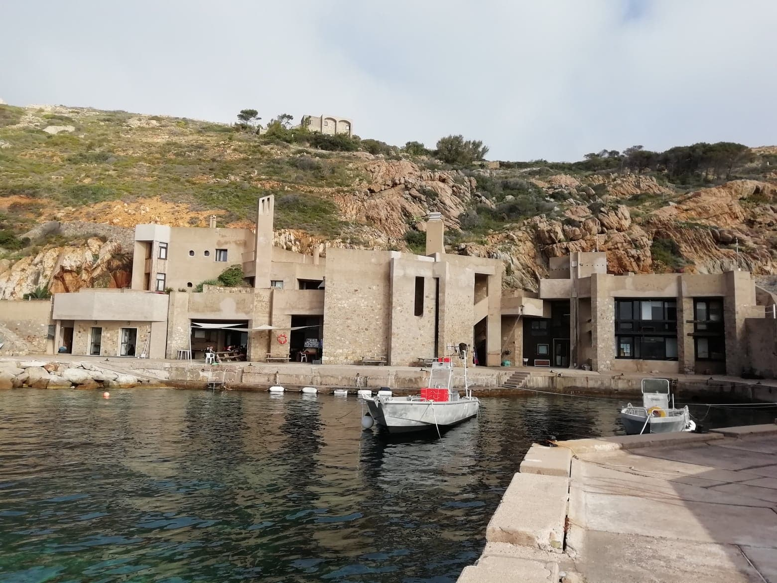
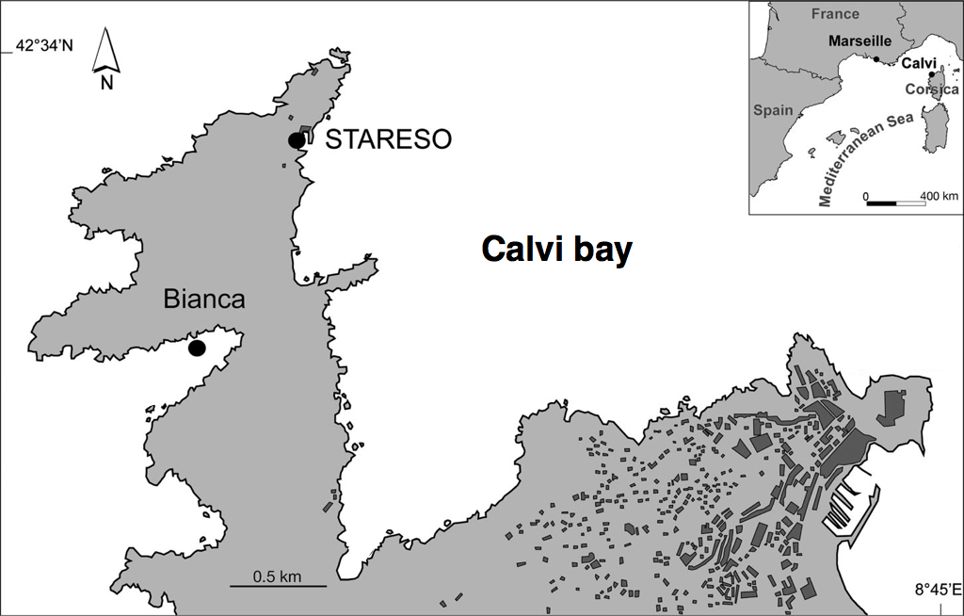

Methods
Floating plastics (PFS)
Sediment plastics (PH)
Sediment (SSH)

Slide 6
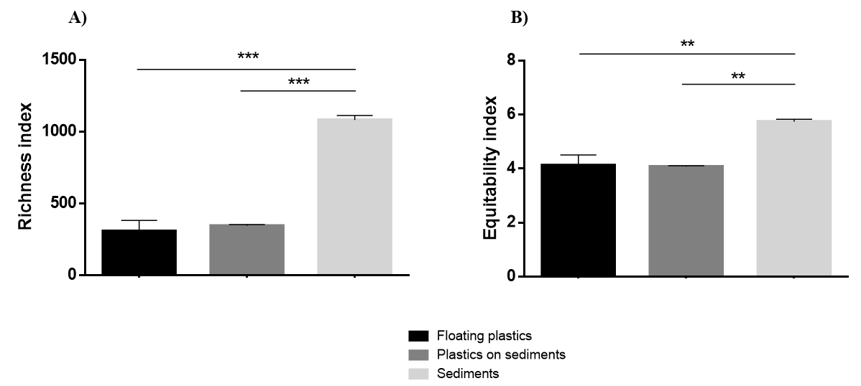
Bacterial community structure
Richness
Equitability
Distinctness bacterial community from plastics and sediments
Plastic is a disctinct environmental niche
A. Delacuvellerie et al., Hazardous materials, 2019

Slide 7
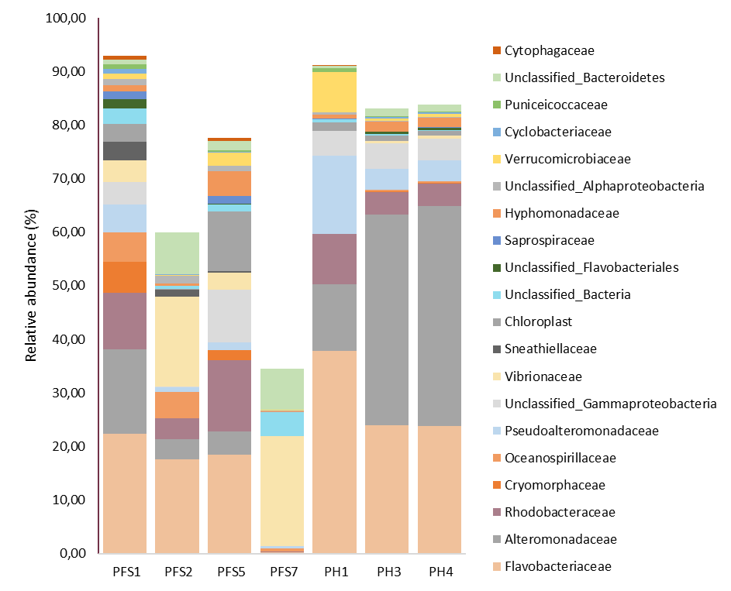
Bacterial community structure
Richness
Equitability
Floating plastics
Sediment plastics
A. Delacuvellerie et al., Hazardous materials, 2019

Slide 8
Enrichment cultures
Strong selection of 2 bacteria on LDPE:
Alcanivorax borkumensis
Microbulbifer sp.
LDPE
PS
PET
A. Delacuvellerie et al., Hazardous materials, 2019

Slide 9
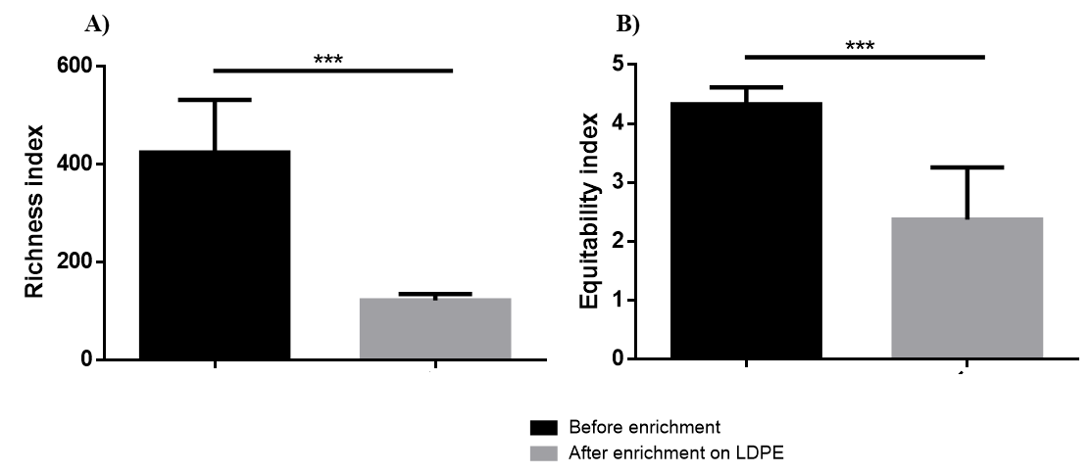
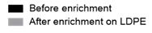
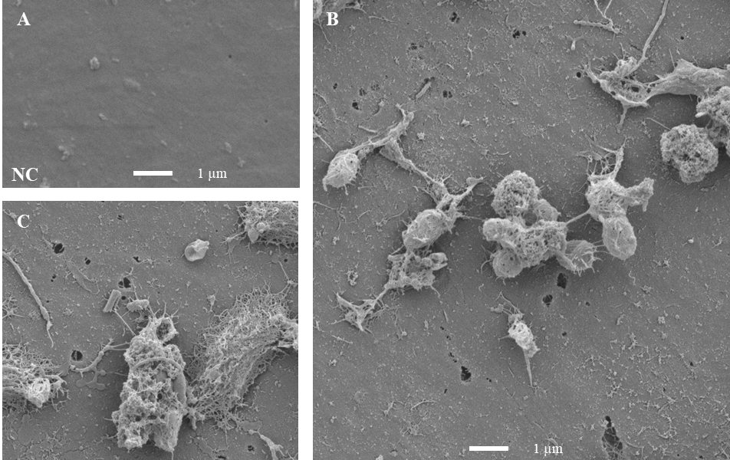
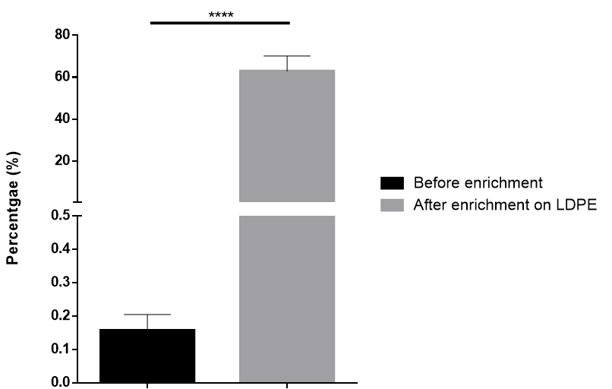
Enrichment cultures
Richness
Equitability
Percentage of A. borkumensis
1 µm

Slide 10
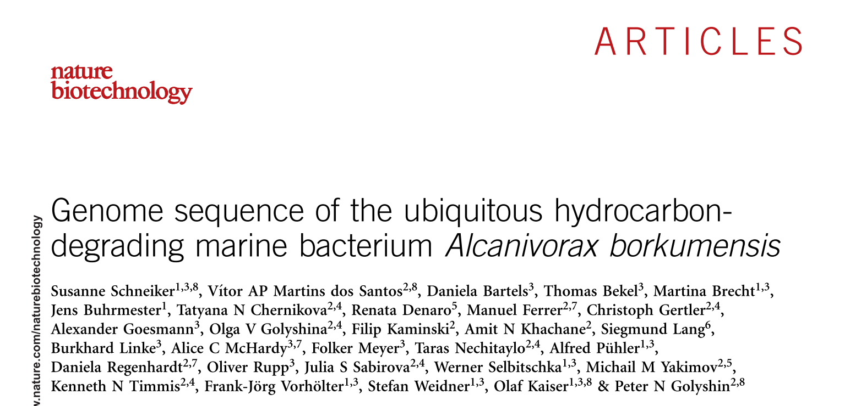
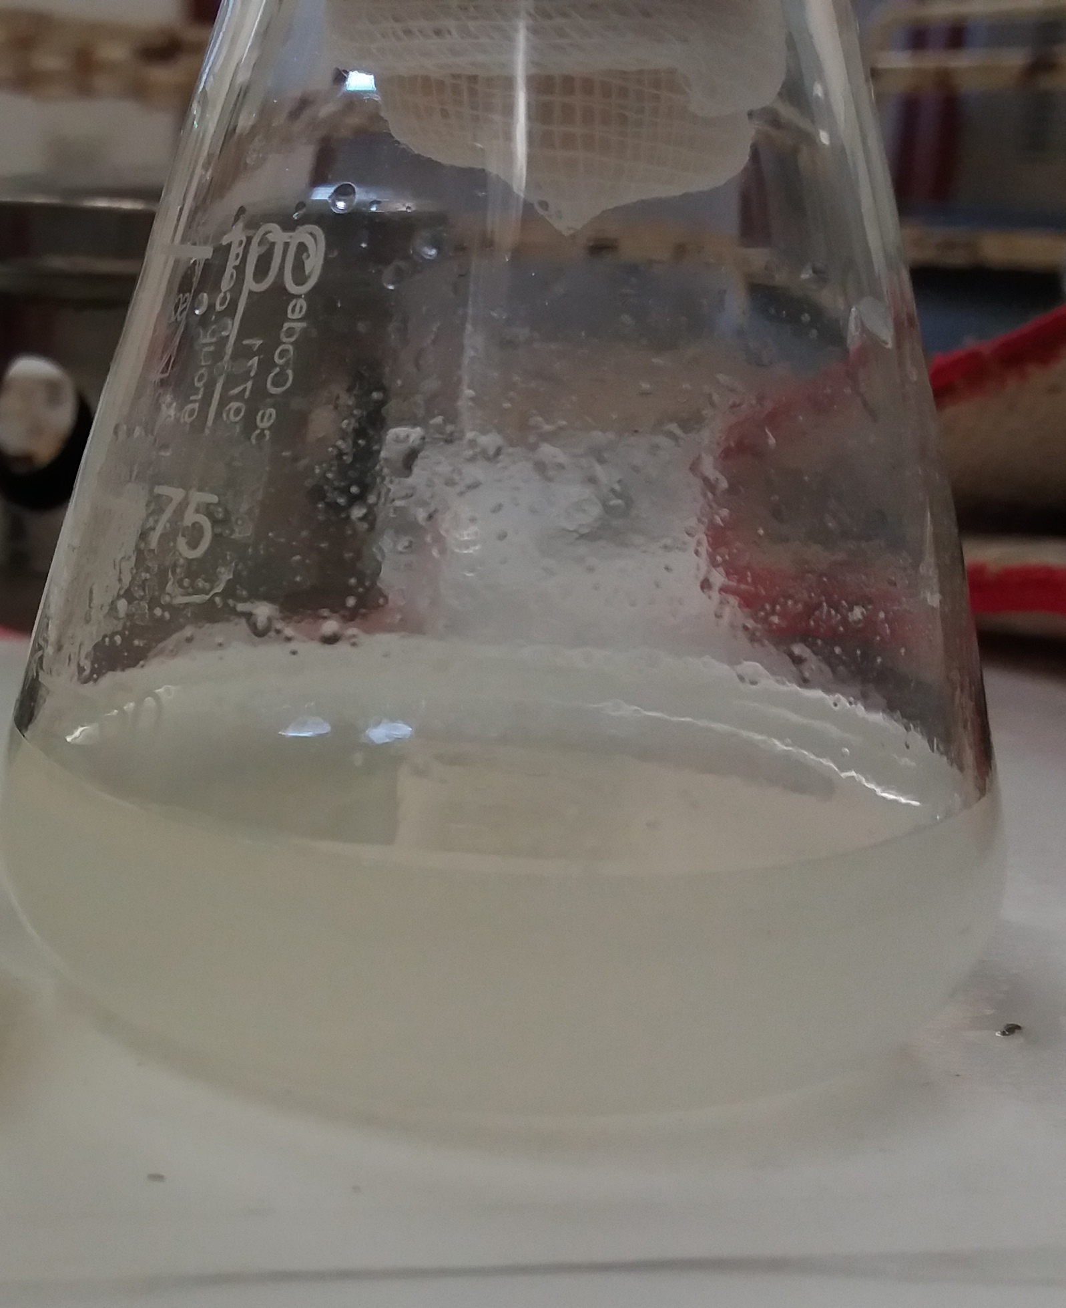
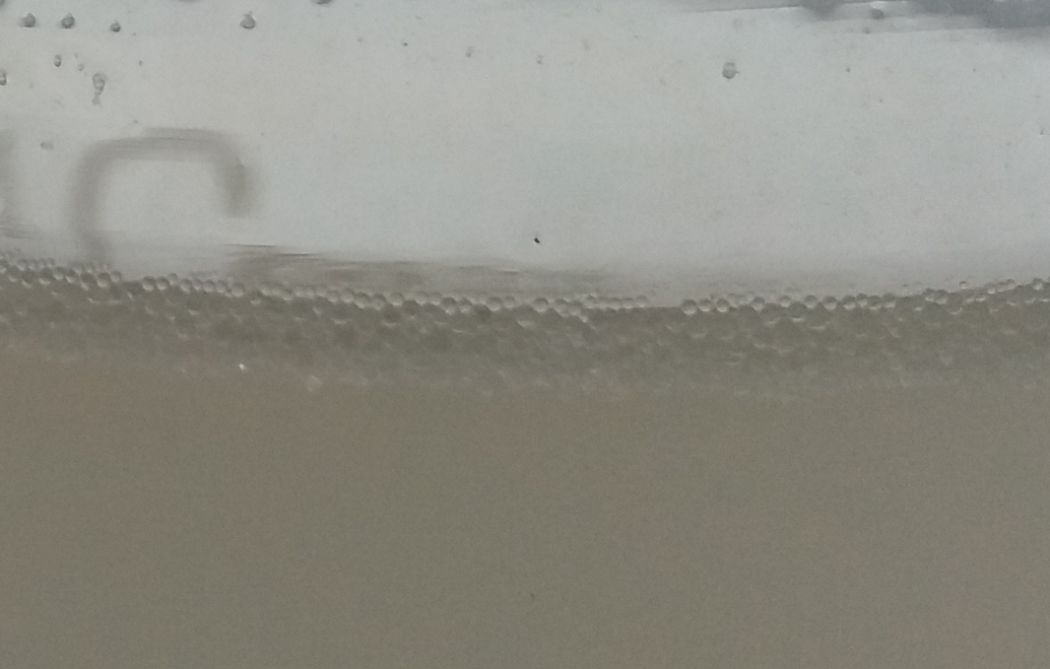
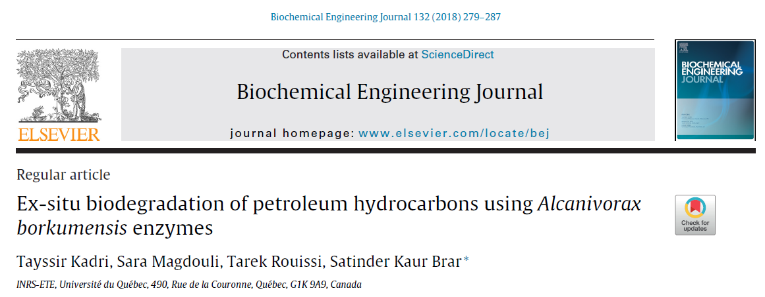
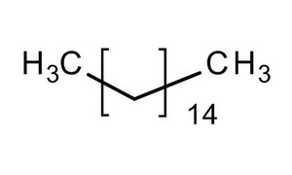
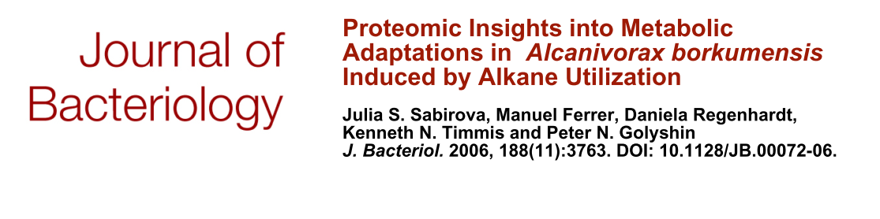
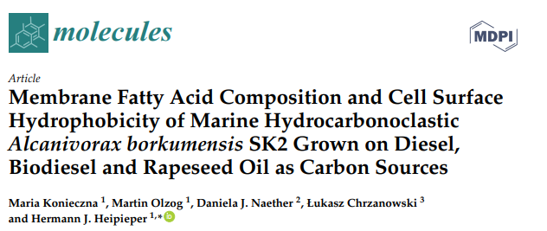
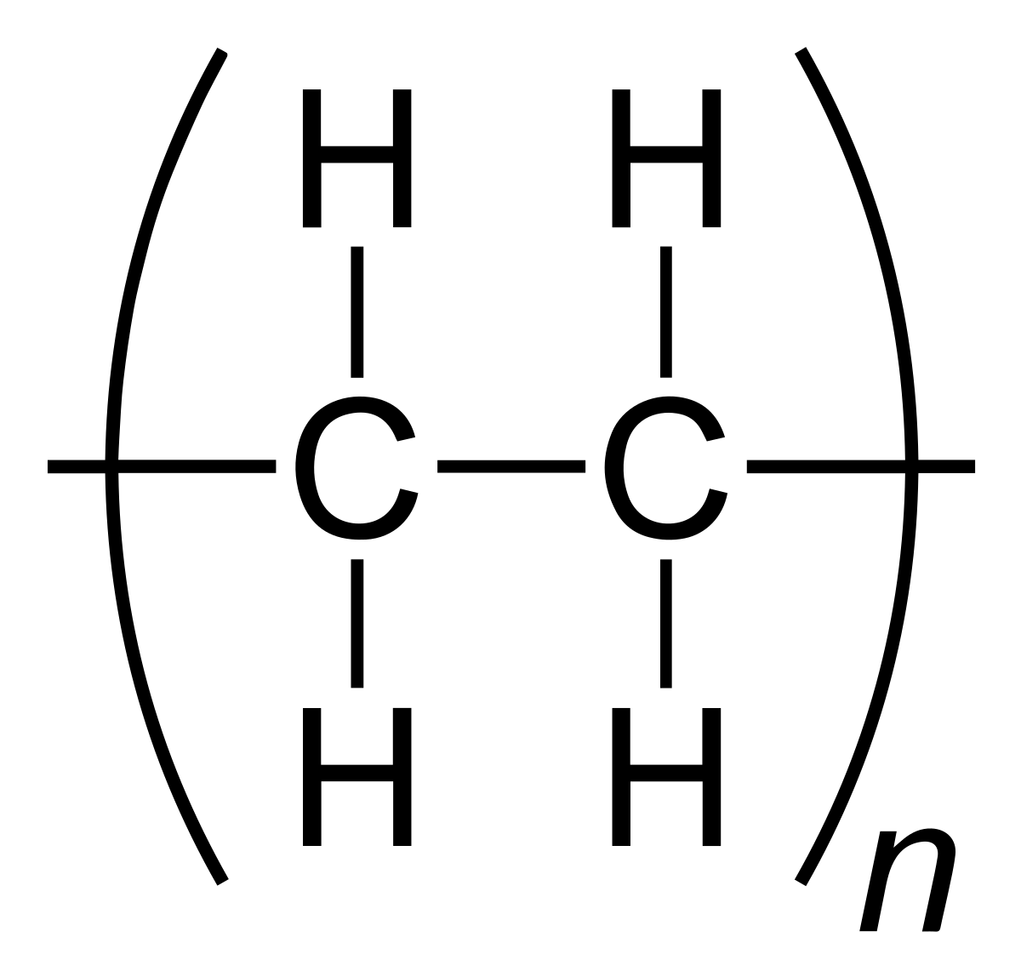
Isolation of Alcanivorax borkumensis
Hexadecane
LDPE

Slide 11
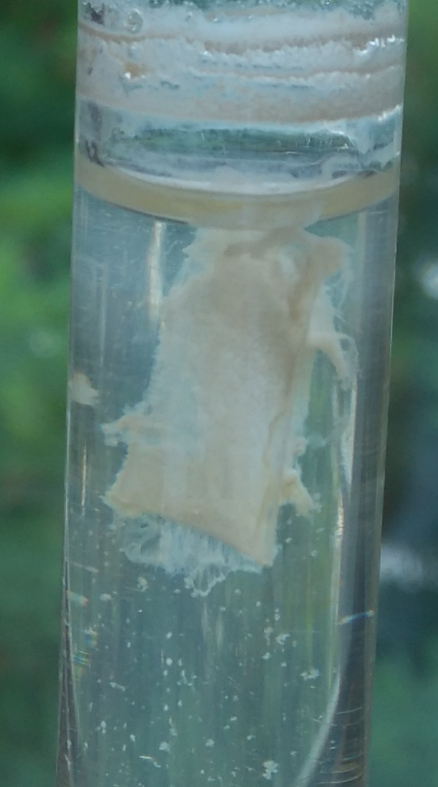
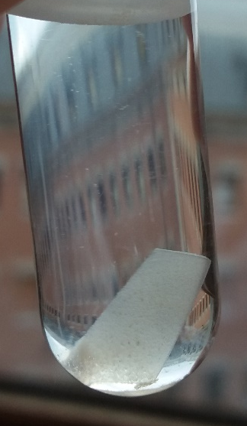
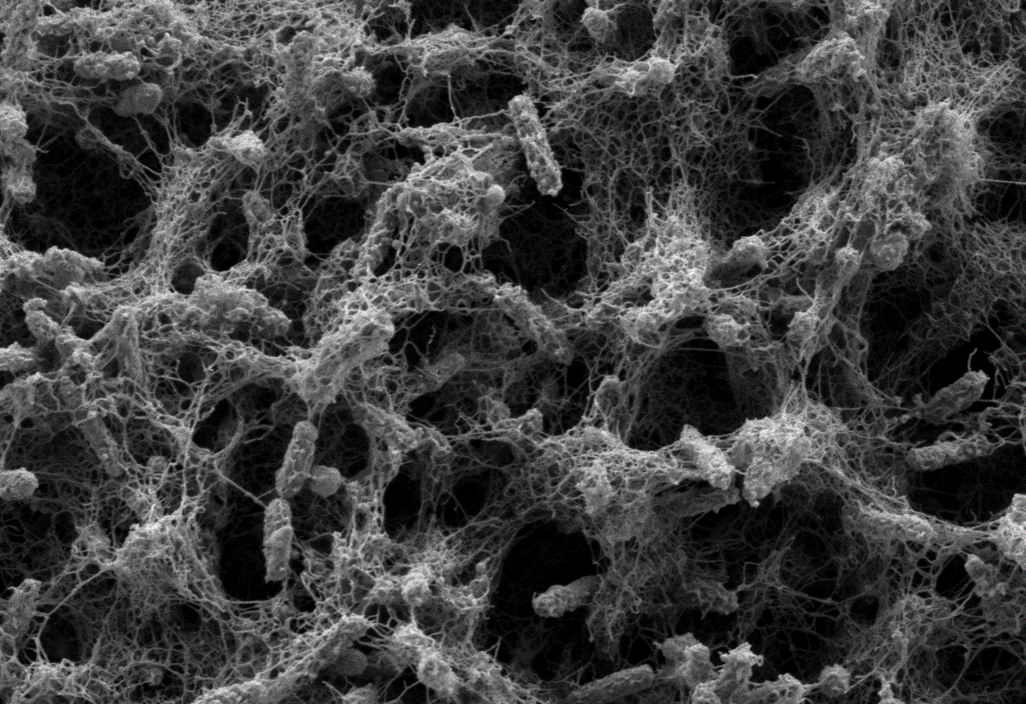
Biofilm formation by Alcanivorax borkumensis
Hexadecane
LDPE
PS
A. borkumensis clearly displayed a higher affinity for the LDPE (more than 70% of bacteria in biofilm) than the others
LDPE

Slide 12
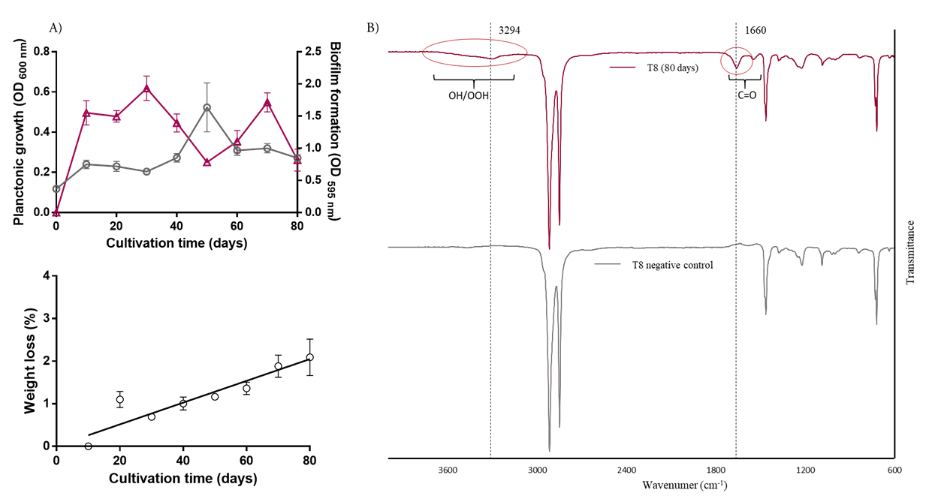
LDPE degradation by Alcanivorax borkumensis
ATR-FTIR spectra revealed the formation of C=O and OOH/OH functional groups resulting from the polymer degradation

Slide 13
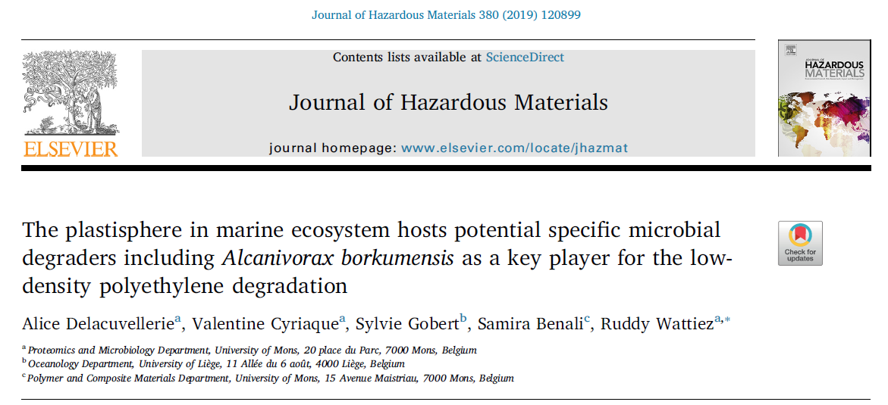

Conclusion
Selection of Alcanivorax borkumensis on LDPE
Signs of degradation
Finding optimal condition to improve the LDPE degradation
Study of the mechanism of A. borkumensis for the LDPE degradation

Slide 14
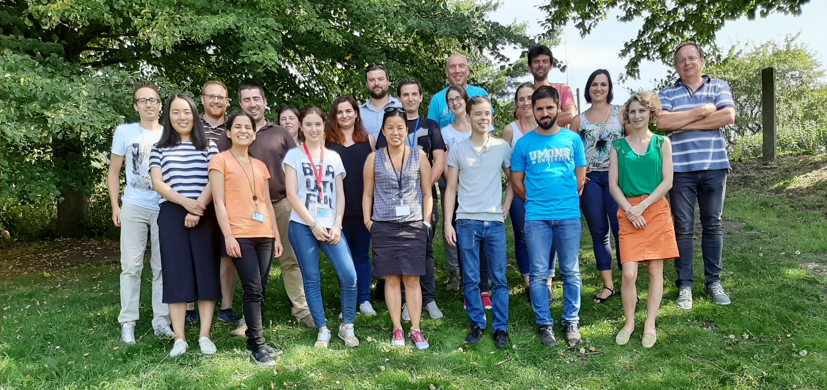



Acknowledgments
Supervisor: Prof. Ruddy Wattiez
Proteomics and Microbiology Laboratory:
Polymer and Composite Materials Laboratory: Samira Benali
Oceanology Department: Sylvie Gobert
National Scientific Research Fund (F.R.S-FNRS)

