Slide 1


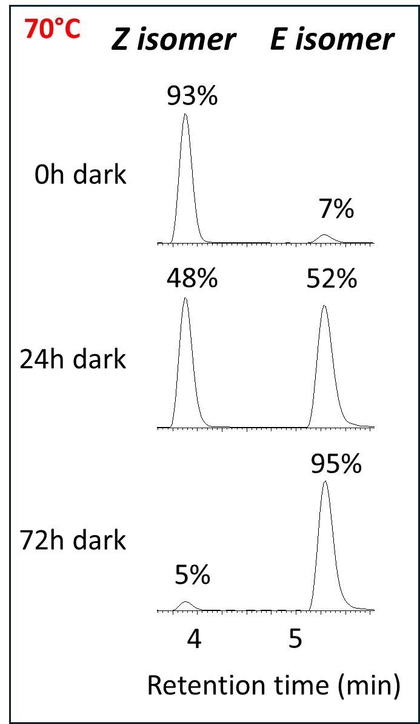
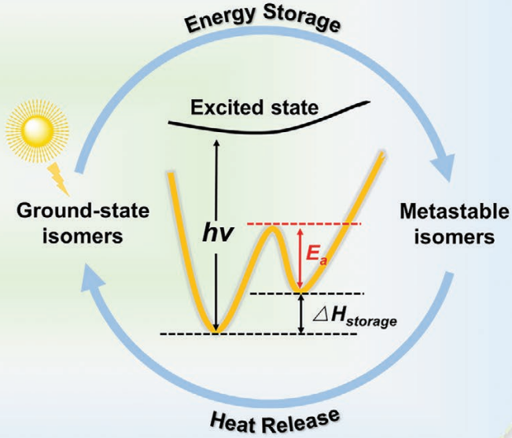
Self-Assembled Monolayers of Azobenzene Derivatives : on the use of Mass Spectrometry to Monitor Photo and Back Isomerization Reactions
Biotechnology
LC-MS
Catalysis
Data storage
0
hν₁
hν₂, ∆, cat
X. Xu and G. Wang, Small, vol. 18, no. 16, 2022
Glass
Glass
Emma Piplart
P01
Azobenzene synthesis/purification
Grafting
on different substrates
Property analysis before and after grafting
Emma Piplart, Gwendal Henrard, Ari Serez, Julien De Winter, Marc Frère, Jérôme Cornil, Pascal Gerbaux

