Slide 1
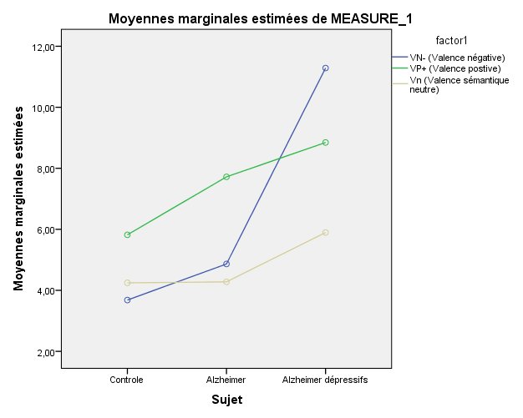
SIMOES LOUREIRO Isabelle, MICELI Aurélie, GERIN Kimberly, RENDON DE LA CRUZ Aurelia, KANDANA ARACHCHIGE Kendra, & LEFEBVRE Laurent
Depression in Alzheimer’s disease:
Impact of the emotional valence of concepts on semantic memory
Cognitive Psychology and Neuropsychology Department, UMONS
isabelle.simoesloureiro@umons.ac.be
Introduction
In Alzheimer’s disease (AD), memory breakdown is an early symptom characterized by episodic disorders, but also by semantic memory (SM) impairment. This SM alteration appears through modifications in the lexico-semantic network and can be observed with a semantic priming paradigm. Moreover, mood disorders may also be noted in AD. It is well known that depression can have a significant impact on memory performances. Nevertheless, there are few studies that clarify the deleterious impact of depression on SM in AD. Therefore, the aim of this study is to analyse this impact on priming effect in AD with an affective priming protocol.
AD participants
(N=16)
Control group
(N=20)
Depressed AD
(D-AD) (N=8)
Non-Depressed AD
(ND-AD) (N=8)
Population
(N=36)
Methodology
Semantic and emotional priming paradigm
(lexical decision)
4 experimental conditions (3 related and 1 unrelated control)
1. POPULATION
2. TASK
1) Positive affective valence (PV+)
2) Negative affective valence (NV-)
.
.
 | Age | MMSE | GDS | QAG | PPTT
Control (N=20) | 81.8 (6.8) | 28.4 (1.2) | 4,1 (1,6) | 34,7 (1,2) | 94,8 (3,2)
ND-AD (N=8) | 85.8 (4.4) | 24.1 (0,9) | 5,6 (4) | 33,6 (4,3) | 85,6 (4,1)
D-AD (N=8) | 82.7 (7.5) | 24 (1,6) | 16,1 (2,4) | 41,1 (6,6) | 89,2 (4,3)
500 ms
Joke
500 ms
Army
Soldier
200 ms
Laugh
200 ms
50 ms
1500 ms
50 ms
1500 ms
*
*
*
3) Neutral semantic condition (NSc)
4) Unrelated control condition
*
.
.
Soup
*
*
*
Class
Robot
Mean and standard deviation : MMSE = Mini-Mental State Examination ; GDS= Geriatric Depression Scale ; QAG = Questionnaire of general anxiety ; PPTT = Pyramid and Palm Trees Test
500 ms
200 ms
School
500 ms
200 ms
Tremon
*
Significant difference with p<.05 (comparison with the control group at the Student t test)
50 ms
1500 ms
50 ms
1500 ms
The target is either a word (soup) either a non-word (tremon)
Results
1. INTRAGROUP COMPARISONS
2. INTERGROUP COMPARISONS
Measure of priming effect (PE)
Student t test comparing related conditions (R) and unrelated condition (UR)
Comparison of PE
Repeated-measures ANOVA
Group (G) effect
(F=41.526 ; p=.001)
Condition (C) effect
(F=5.453, p=.008)
Interaction effect G*C
(F=3.082 ; p=.025)
Transformed PE by group and by conditions
*
*
NV – (Negative valence)
PV + (Positive valence)
NSc (neutral condition
 | Control group | ND-AD | D-AD
PE for NV- | 122.9 (117) * | 254.5 (267.27) * | 668.12 (544.78) *
 | t=-4.696 ; p=.001 | t=-2.688 ; p=.031 | t=-3.469 ; p=.010
PE for PV+ | 183.22 (209.44) * | 391.98 (331.78) * | 543.68 (456.65) *
 | t=-3.912 ; p= .001 | t=-3.342 ; p=.012 | t=-3.367 ; p=.012
PE for NSc | 118.98 (164.28) * | 236.92 (263.47) * | 380.7 (424.73) *
 | t=-3.239 ; p=.004 | t=-2.543 ; p=.038 | t=-2.535 ; p=.039
*
*
*
Estimated marginal means
*
*
*
*
*
*
Priming effect (PE) : reaction time (UR-R) by group and by condition
*
Control ND-AD D-AD
*
Significant difference with p<.05
*
Significant difference with p<.05 (comparison with the control group)
Significant difference with p<.05 (comparisons between conditions)
Discussion and conclusions
These results demonstrate, as expected, priming effects for semantic and emotional conditions in all our groups. However, we showed a specific hyperpriming effect for the negative valence condition in the AD group with depression comparatively to positive valence and neutral condition. On the contrary, control participants and non-depressed AD present more important priming effect for the positive condition compared to neutral and negative ones. We propose that a negative mood has an impact on the processing of negative information, shown by a specific hyperpriming effect in AD patients with depression, in line with an easier processing. This facilitation effect can be viewed as a difficulty to inhibit negative thoughts, probably linked to a disorganized semantic network, as demonstrated by the hyperpriming effect in subjects with depression

